Slide 1
PC Guy
IT Consulting – Service Sales
By: Santos Covarrubias & Trenton Lemon
ITC 250/CPET 499 Web Systems (12/13/16)

Slide 2
Report Summary
Built a website that advertises, markets and sell PC related goods and services.
The website is easy to navigate and understand.
Built a website that offers price list of available hardware and hardware related services.
Built a website that offers a price list of available software and software related services.
In the website, we included a homepage about us so our clients can get familiar with us.
Build a database that will take the information that is input into a table and save it in a selected database.

Slide 3
Project milestones/Timeline

Slide 4
System Requirements
System Must Promote IT firm Hardware
System Must Promote IT firm Software
System Must store quote requests via database
System Must Greet New Guests/potential clients
System Must track and record new visitors
System should be easy to navigate
System should be visually apealling

Slide 5
Software Programming Tools
Notepad++
XAMPP
Apache Webserver
MySQL
Adobe Dreamweaver CS6
Microsoft Project 2016
Microsoft Virtual Machine
Parralles (used for virtual machine)

Slide 6
Web System Design

Slide 7
Web System Design

Slide 8
Web System Design / Data Table
Index | Auto Number
Name | Short Text
Email | Short Text
Message | Long Text

Slide 9
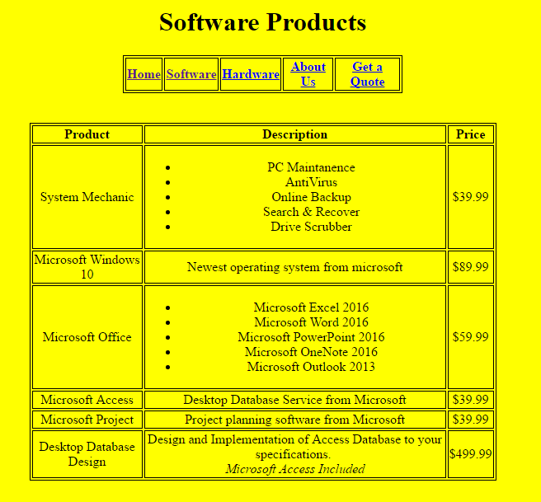
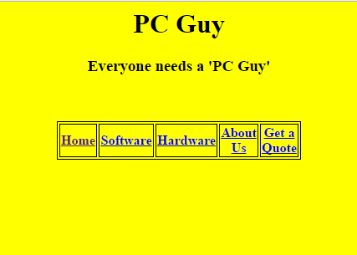
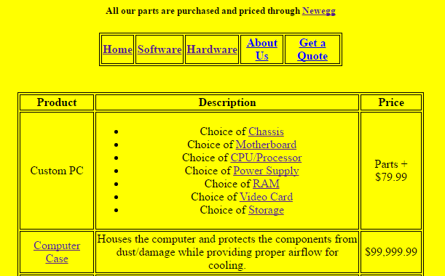
Implementation and Testing

Slide 10
Lessons Learned
Tasks take longer than expected
Do not under-estimate the complexity of a task.
There is never too much debugging.
More debugging time should have been added to our time line.
Extra reading on databases would have been helpful.
Learned how to work with someone else on a website and merge the progress made by two individuals to end up with one website that is up-to-date.

Slide 11
Conclusion
In conclusion, this project helped us build a multi-purpose IT consulting firm webpage. This website is going to help our company to market itself to their potential consumers as well as allow the guests to contact and request direct quotes from the firm. We learned many valuable lessons from this project, as time management and communication. This project will help my partner and I in our future careers.

Slide 12
References
Hosting, SiteGround Web. "How to Create Database with PhpMyAdmin Tutorial." How to Create Database with PhpMyAdmin Tutorial. SiteGround, 12 Mar. 2014. Web. 10 Dec. 2016. <https://www.siteground.com/tutorials/phpmyadmin/phpmyadmin_create_database.htm>.
HTML5 Tutorial. (n.d.). Retrieved December 13, 2016, from http://www.w3schools.com/html/default.asp

