Slide 1
Mobile Mann Tech
By Brendan Mann and Keegan Nodine
11/01/2016

Slide 2
Introduction
Mobile Mann Tech is a portal for those who want to view technological news.
Users can subscribe for notifications. They will provide an email for our site database.
The website’s ultimate purpose to keep people connected with the modern world.

Slide 3
Executive Summary
In this presentation we will provide information on how Mobile Mann Tech will become a profitable website and maintain a community of news viewers. The website will focus on marketing information online for free and users will have the option of subscribing for notifications. The website will solely profit from advertising revenue. Hosting details are included as well as a diagram of the website, a tentative schedule, and estimation for costs and revenue.

Slide 4
Project Scope
Our website will use a connected SQL database to keep a list of users by email.
Our website will offer links and notifications for news, but not provide news on site.
Different pages will categorize site content.
Website will be fully functional and aesthetically pleasing.

Slide 5
Scope Change
Initially Mobile Mann Tech was going to have an article writer produce the content for users to view. Users would require membership to view the exclusive news. Now the scope has changed to be more profitable. The site will provide links to news stories on other websites. Users will not require membership, but to maintain a community of viewers they will have the option to subscribe for notifications.

Slide 6
Milestones
At this time..

Slide 7
Deliverables
Functioning website 12/15
Project Presentation 12/15
Project Report 12/13

Slide 8
Functional Description
Users can navigate the portal using the links at the top of any page on the site. At the home page there will be a input form where users have the option to subscribe for notifications by email. There is a connected database that will hold a list of subscribed users.

Slide 9
Data Storage
The website will utilize a SQL Database to keep track of users subscribing for notifications. The string input is the email address which will update the database.

Slide 10
Hardware Requirements
You won’t need high end specs in your computer to access this site. We do have a couple of recommendations though to ensure a smooth browsing experience.
Have a Core 2 Duo or better
2gb or more of ram
80gb HDD or more
We recommend using Google Chrome, Mozilla Firefox, or Microsoft Edge browsers.

Slide 11
Major Components of proposed system
Database
Ehost domain
Links to news

Slide 12
Software Programming Tools
We used Microsoft Web Expression 4 to edit our pages in real time, which saved us time from not having to update the site every time we wanted to view the changes we made.

Slide 13
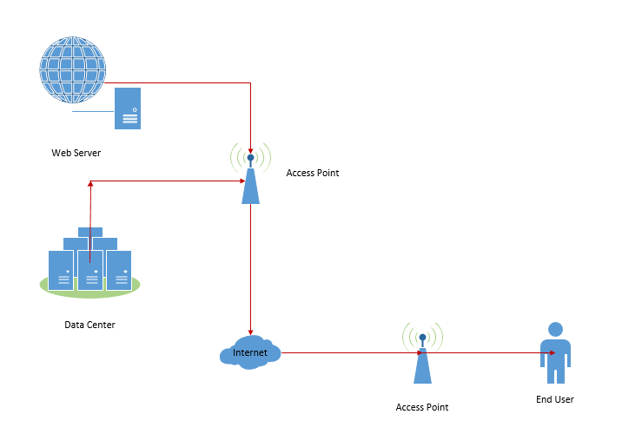
System
Infrastructure

Slide 14
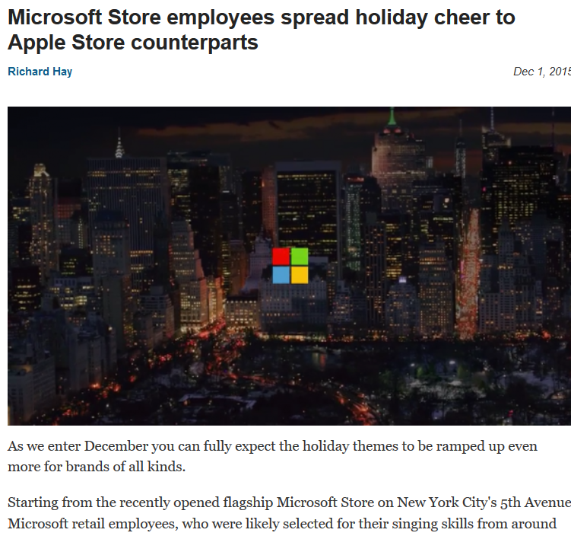
System interaction diagrams
A user finds a link on the page that interests them. The link takes them to the actual article.
Microsoft spreads holiday cheer!

Slide 15
Business Logic
This will be a profitable website because of the advertisement revenue. It only costs $1.99 a month to host our domain from Ehost. We are expecting to be payed about $83.33 a month for having advertisements displayed on the page.

Slide 16
Estimated
If we have a CTR of 1%, which is standard, and the price of each click is .50 we will get 500 a year.
 | January | February | March | April | May | June | July | August | September | October | November | December | Yearly Total
Ad payment | 83.33 | 83.33 | 83.33 | 83.33 | 83.33 | 83.33 | 83.33 | 83.33 | 83.33 | 83.33 | 83.33 | 83.33 | 1000
Host Fee | 1.99 | 1.99 | 1.99 | 1.99 | 1.99 | 1.99 | 1.99 | 1.99 | 1.99 | 1.99 | 1.99 | 1.99 | 23.88
Profit | 81.34 | 81.34 | 81.34 | 81.34 | 81.34 | 81.34 | 81.34 | 81.34 | 81.34 | 81.34 | 81.34 | 81.34 | 976.12

