Slide 1
Guides for a Smarter Home
ITC 499 Web Systems Cole Buzzard and Brett Carusillo 9 December 2016

Slide 2
Project Summary and Overview
Intent: instruct first time users to successfully convert their home to a “smart home”.
We broke the web page down into 4 pages;
Home
Initial Insteon setup
Amazon Echo integration
Hardware required
Users can subscribe for future guides
Information is stored in our database.

Slide 3
Project Scope
Create a webpage to show users how to easily turn their home into a “smart home”
Requirements
The webpage will include the use of the following programming language/tools; HTML (forms for user interactions), CSS, Client side script: JavaScript, Server-side script: PHP, MySQL database and data tables
Exclusions
Any type of external hardware
Out of pocket expenses

Slide 4
Milestones | Deliverables
Deliverable | Due by | Status
Basic website layout designed | 11/14/2016 | Complete
Creation of home page | 11/21/2016 | Complete
Creation of guide-page | 11/21/2016 | Complete
Creation of required hardware page | 11/21/2016 | Complete
CSS designed | 11/21/2016 | Complete
How-to guide example written | 11/23/2016 | Complete
Comments/Feedback section implemented | 11/24/2016 | Complete
SQL implemented | 12/5/2016 | Complete
Javascript implemented | 12/5/2016 | Complete
Webpage finalized | 12/12/2016 | Complete

Slide 5
Web System Design
System Requirements: Minimum hardware requirements for XAMPP: + 64 MB RAM (RECOMMENDED) + 350 MB free fixed disk + Windows 2003, XP (RECOMMENDED), VISTA, Windows 7
Software Programming tools:
Notepad++
XAMPP
Visio

Slide 6
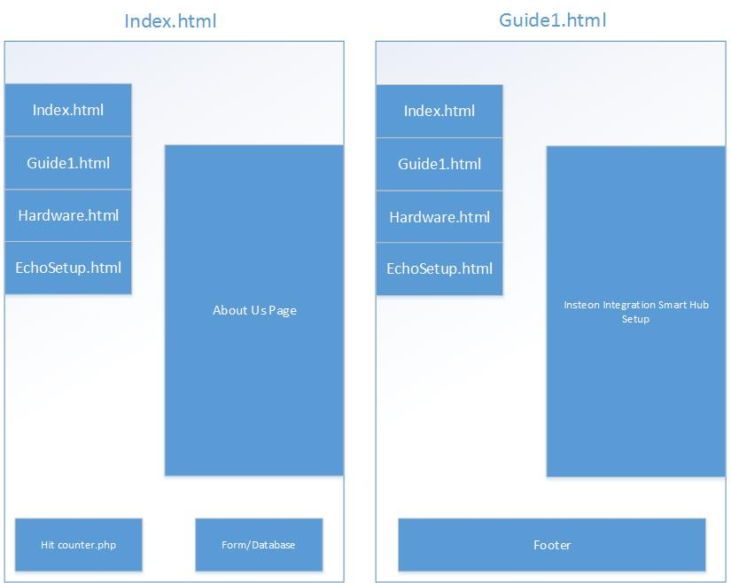
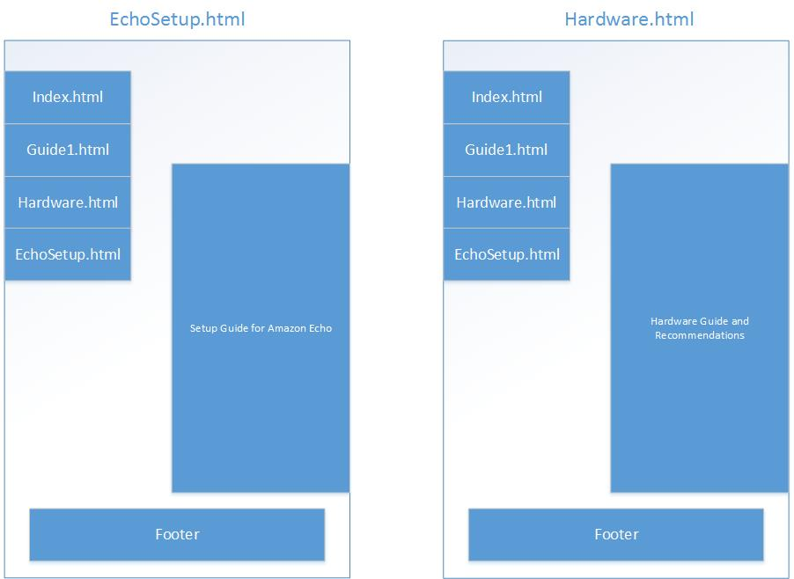
System Infrastructure Drawings:

Slide 7
Implementation and Testing
No severe issues were encountered
Minor issues with SQL implementation
Smooth process
Met all self-appointed deadlines

Slide 8
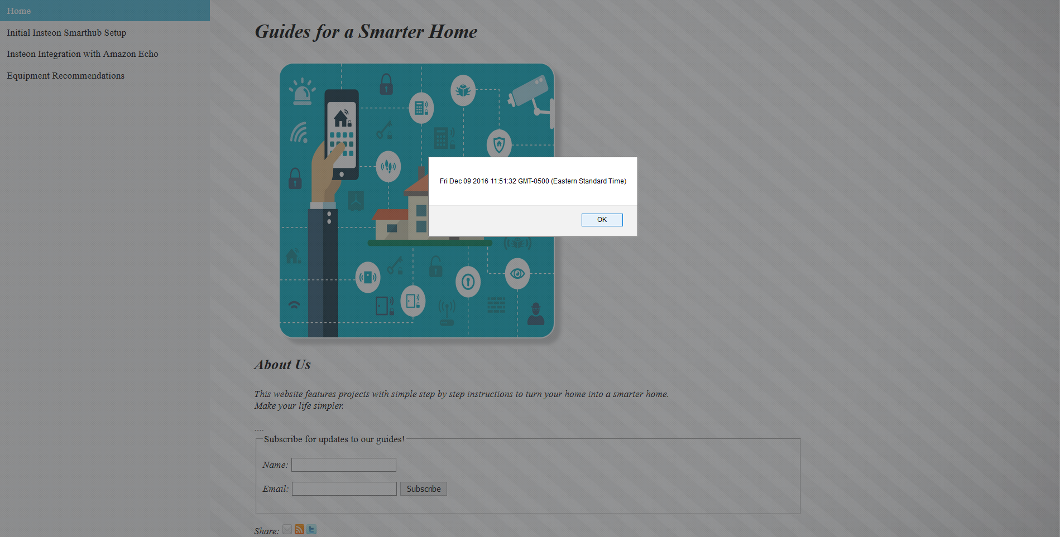
The Homepage
Notes:
Upon loading the homepage, an alert will pop up informing the user of the current time and date.
As you can see at the bottom of the screen is a user form. This form allows the user to subscribe for future guides.
The input information is stored in a database.

Slide 9
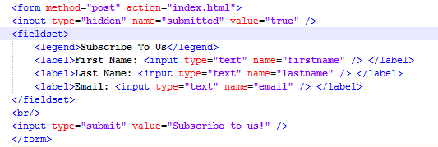
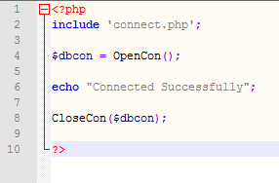
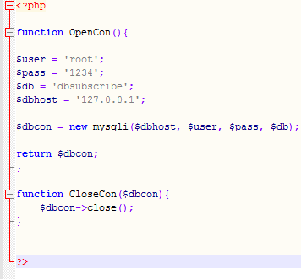
A closer look
The code for the alert:
The code for subscribing:

Slide 10
The CSS
Centered the page
Added a navigation pane
Added shadows and borders to pictures
Add a wallpaper

Slide 11
The PHP
Hit counter
Connection to database
Populate the database

Slide 12
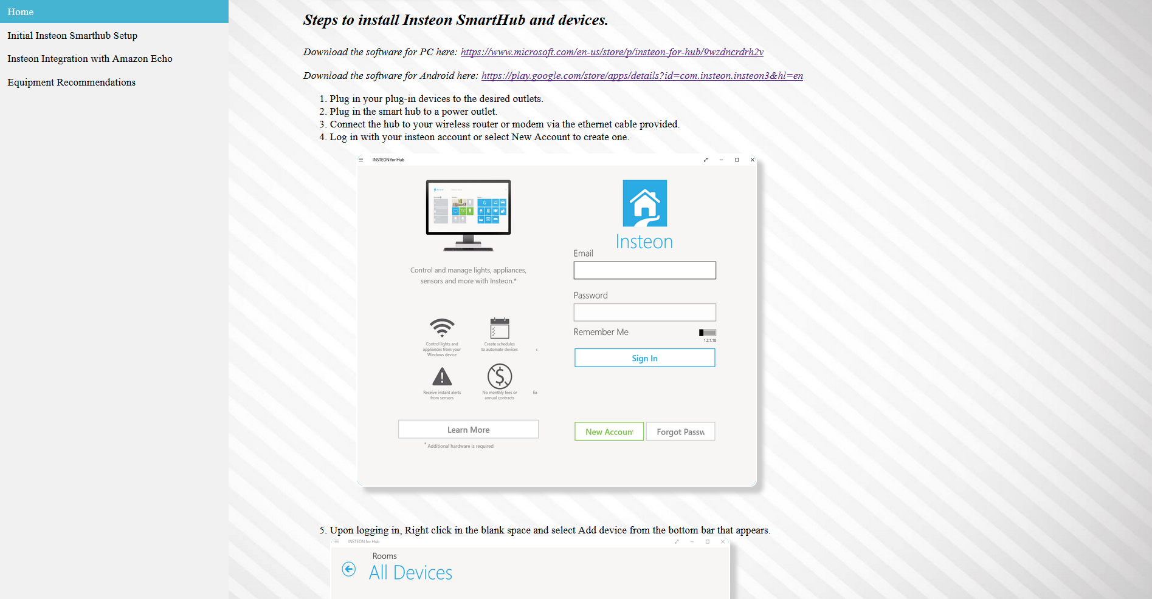
Guide for Initial Setup
Notes:
This page contains step by step instructions for installing the Insteon Smarthub and devices.

Slide 13
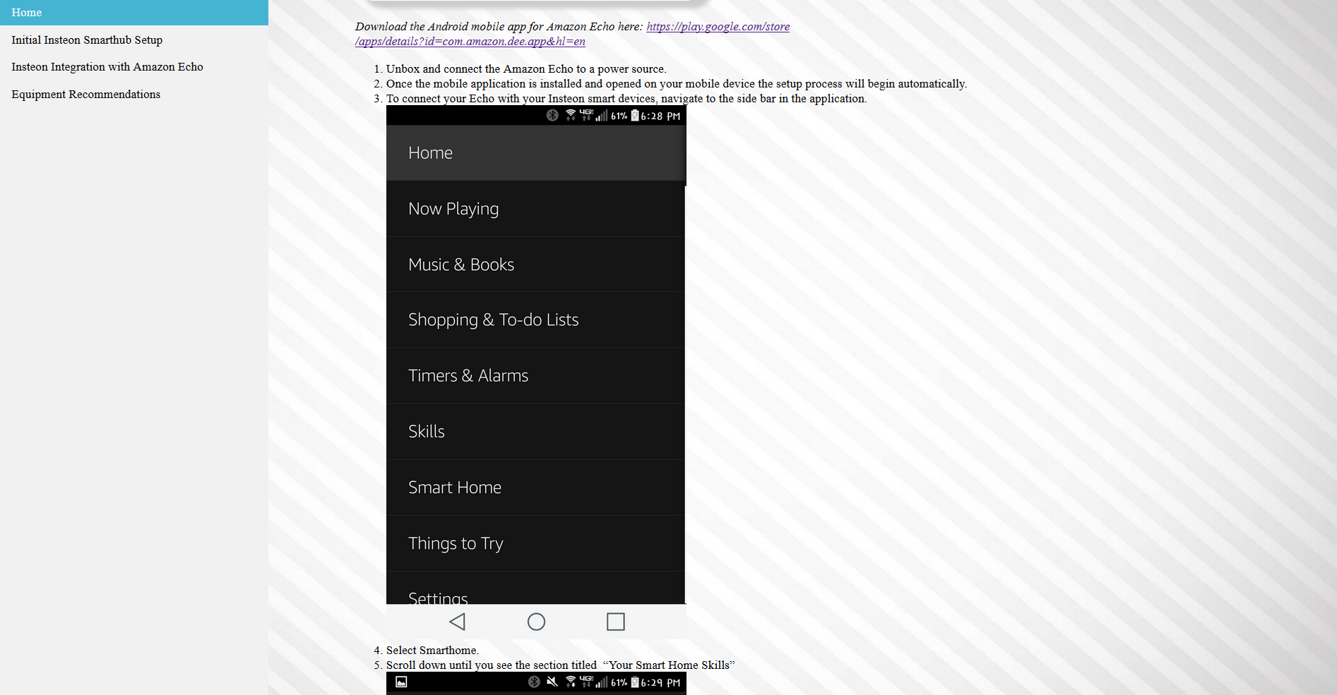
Integration with Amazon Echo
Notes:
This page is the guide for integrating the Insteon Smarthub and devices with Amazon Echo.
This allows for voice commands to control the smart devices.

Slide 14
Recommended Hardware

