Slide 1
Guides for a Smarter Home
Cole Buzzard and Brett Carusillo

Slide 2
Project Summary and Overview
Our websites intent is to guide first time users to successfully convert their home to a “smart home”. We broke the web page down into 4 pages; home, initial setup, Amazon Echo integration, and the hardware that it takes to do it. Confused users can ask questions in a form which is then stored in our database.

Slide 3
Still need to achieve...
JavaScript
MySQL
Improve/add more content to homepage
Add hit counter
Add a form linked to database for user questions

Slide 4
Project Scope
Deliverables
A web page to show users how to easily turn their home into a “smart home”
Presentation of web page
Milestone
Implement mySQL
Implement JavaScript
Implement PHP
Implement CSS
Finish HTML
Test the web pages
Requirements
The selected final project should include the use of the following programming language/tools; HTML (forms for user interactions), CSS, Client side script: JavaScript, Server-side script: PHP, MySQL database and data tables
Exclusions
Any type of external hardware
Out of pocket expenses

Slide 5
Problems thus far...
Our initial schedule was surprisingly accurate, and we have not really ran into any major problems. We still need to implement JavaScript and MySQL which we fear my cause a few speed bumps but we are moving smoothly. One place we did find a small problem in was our sites navigation. We found that it was gaudy and inefficient. To fix this we added a simple navigation bar with CSS to each page. The results were great.

Slide 6
Supporting Information
Web System Design - The website allows for easy navigation among the various pages which consist of the homepage, the available guides, and recommended hardware pages.
System Requirements -
Minimum requirements for XAMPP: + 64 MB RAM (RECOMMENDED) + 350 MB free fixed disk + Windows 2003, XP (RECOMMENDED), VISTA, Windows 7
Major Components - Software: XAMPP, Firefox, Chrome, Edge
Hardware: Windows PC
Software Programming Tools -
Notepad++
MySQL

Slide 7
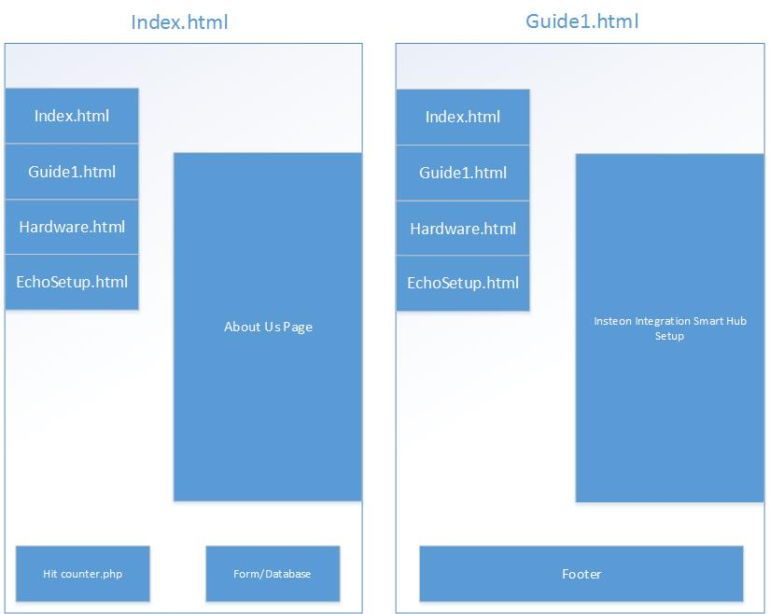
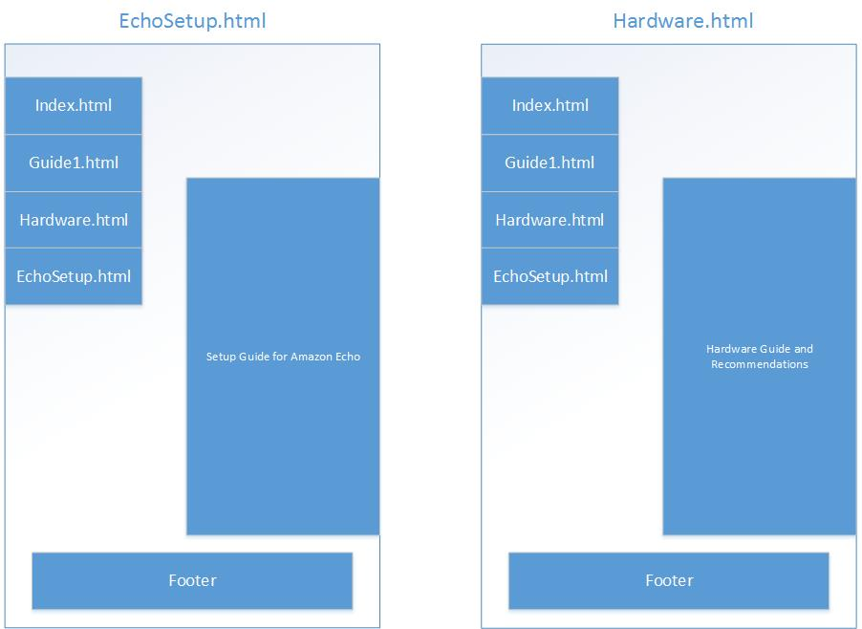
System Infrastructure Drawings

Slide 8
Project Schedule
Deliverable | Due by | Status
Basic website layout designed | 11/14/2016 | Complete
Creation of home page | 11/21/2016 | Complete
Creation of guide-page | 11/21/2016 | Complete
Creation of required hardware page | 11/21/2016 | Complete
CSS designed | 11/21/2016 | Complete
How-to guide example written | 11/23/2016 | Complete
Comments/Feedback section implemented | 11/24/2016 | WiP
SQL implemented | 12/5/2016 | WiP
Javascript implemented | 12/5/2016 | WiP
Webpage finalized | 12/16/2016 | WiP

