Slide 1
ITC 250
Final Project
Sirean Store Site
Allyson Barton

Slide 2
Topics of Discussion
Report Summary
Project Milestones and Deliverables
Web System Design
Implementation and Testing
Summary and Conclusion

Slide 3
A. Report Summary
Required: home, shirts, pants, cutomerLogin, customerInfo, newCustomer, & validation pages. MySql tables.
What could be done [wasn’t finished]: password & more security and credit card payment methods
Project Scope:
  Activities: create sites with forms, the database, connect the database and website. And a hit counter on home.php.
  Design: webpages, csc sheet, database with tables, & hit counter
  Building: designing and coding.
  Testing: Make sure sites come up & tables are correct and can be modified

Slide 4
B. Milestones and Deliverables (status report)
Prototype:
  Separate PHP pages, the final cascading style sheet, database and the tables in mySql, hitcounter html, and php codes finished. JavaScript on newCustomer page
Final Report: up to date
Final Project Presentation: up to date

Slide 5
C. Web System Design
System requirements:
  XAMPP with myPhpAdmin & Apache
  Internet

Slide 6
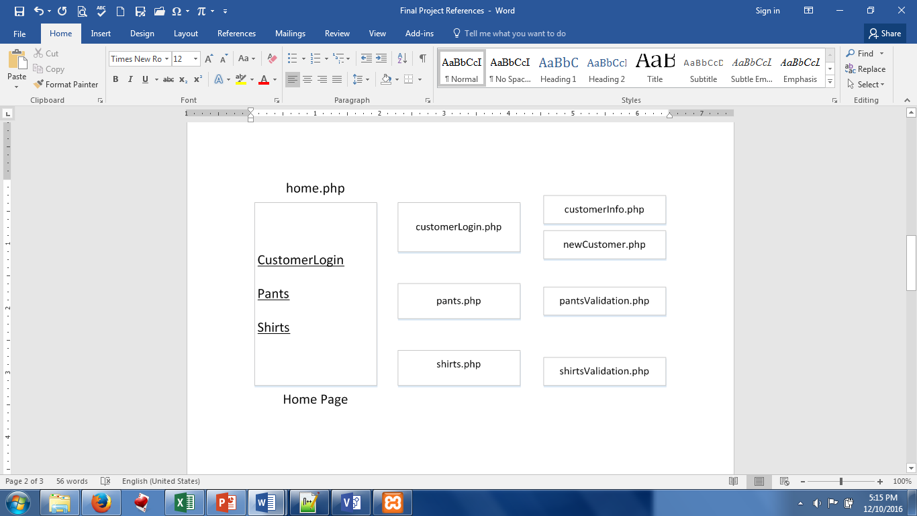
Website Design (visio)

Slide 7
C. Web System Design
Software Programming tools:
  Notepad++
  HTML
  PHP
  MySql
  CSS
  JavaScript

Slide 8
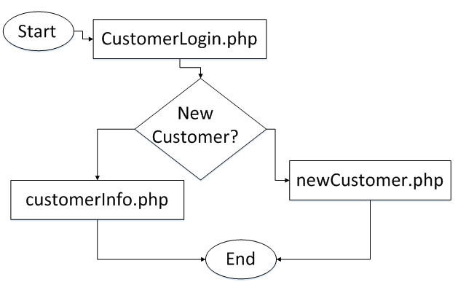
System Infrastructure—Customer Processes

Slide 9
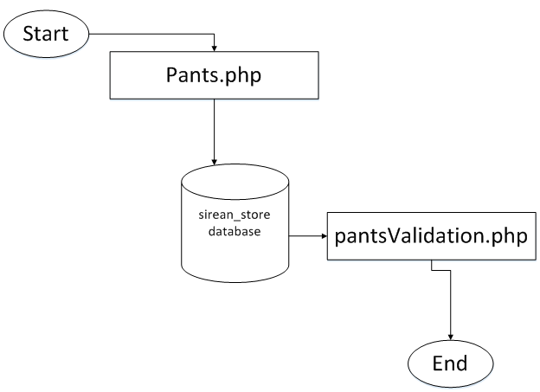
System Infrastructure—Ordering Processes

Slide 10
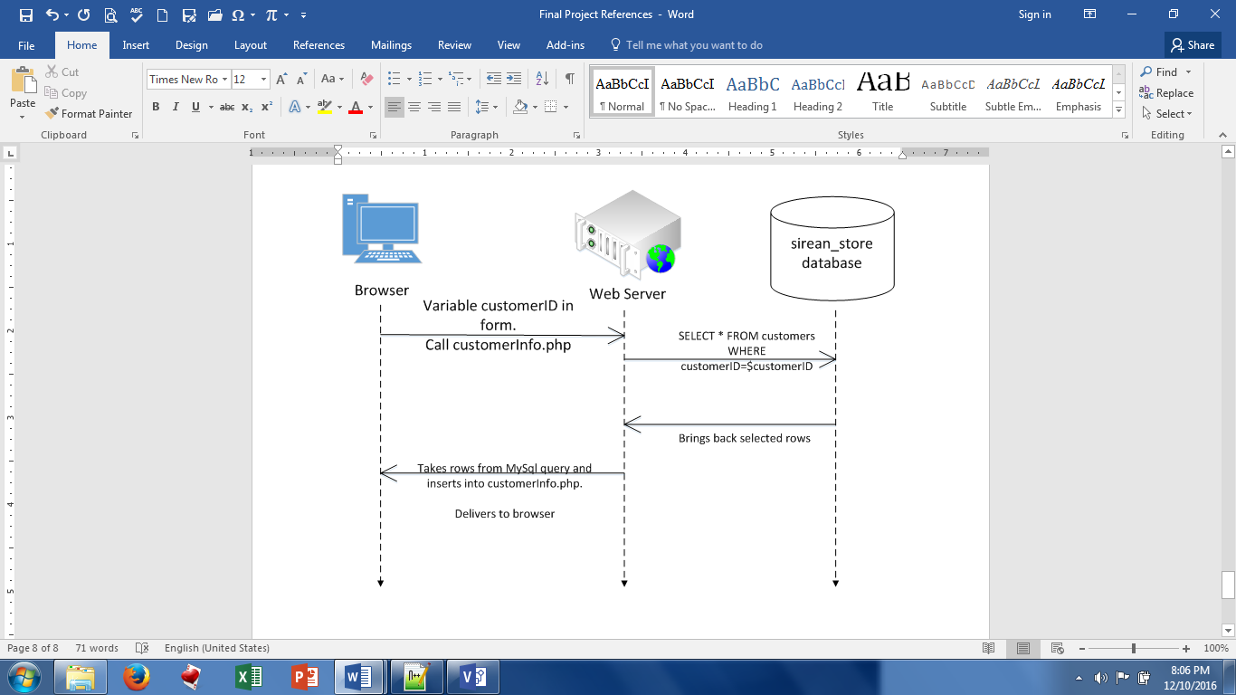
System Interaction—Select Customer Info

Slide 11
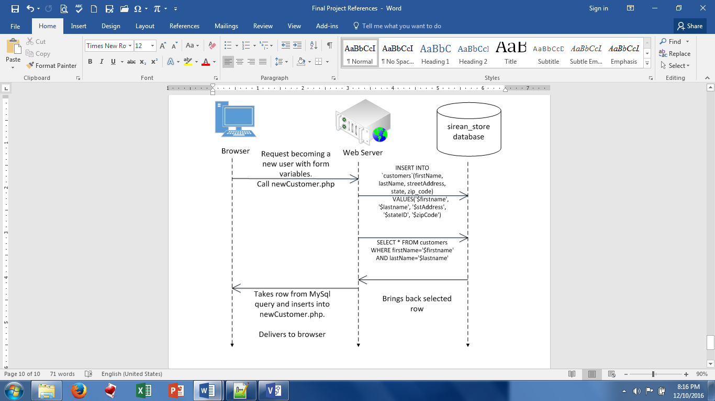
System Interaction—Create New Customer

Slide 12
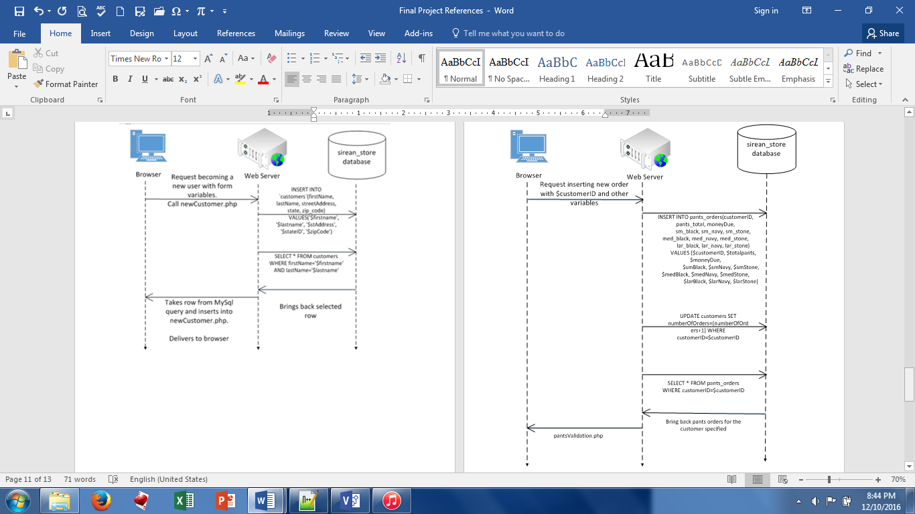
System Interaction—Ordering [same as shirts.php, different variables]

Slide 13
D. Implementation & Testing
Results:
  Can call customer information
  Can create a new customer by inserting into customers table
  Can create an order by inserting into corresponding pants/shirts table and updating customers table
Pages: home.php, customerLogin.php, customerInfo.php, newCustomer.php, pants.php, pantsValidation.php, shirts.php, & shirtsValidation.php
Database: sirean_store
  Data tables: customers, pants_orders, shirts_orders

Slide 14
Summary & Conclusion
The Sirean Store Company needs a way to reach out to their customers. A website for their store online will help them reach the customers who do not want to travel far to come to the physical store. This website helps the customers order pants and shirts effectively.

