Slide 1
Camera Webpage
Course : ITC 250
Team: Jacob Lee
Date: 12/2016

Slide 2
Report Summary
My project was to create a webpage that could be used to access a camera via a link. This webpage needed security so that the user would have to input a username and password in order to access the webpage.
The scope of my project is to include a login page that validates the information using a PHP page based on a MYSQL database.

Slide 3
Milestones
Login Page – This is a page that allows the user to enter in their user credentials and create new credentials.
PHP page – This page is used to validate the information input and allow access to the Camera Page.
MySQL database – This holds the user login information including the username and password
Camera Page – This page houses link(s) that can be used to access the cameras.

Slide 4
Deliverables
Power Point
Project Report
HTML Code
Database
PHP Code

Slide 5
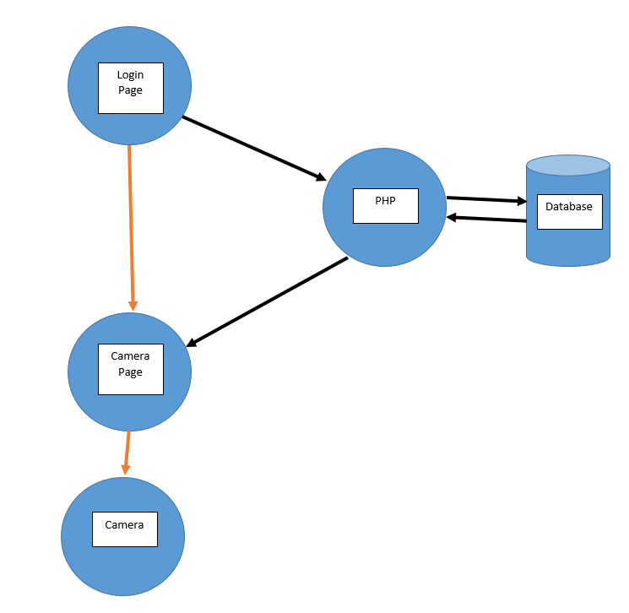
Web System Design

Slide 6
Software programming tools
XAMPP
MYSQL
Apache
Notepad++

Slide 7
Implementation & testing
Results

Slide 8
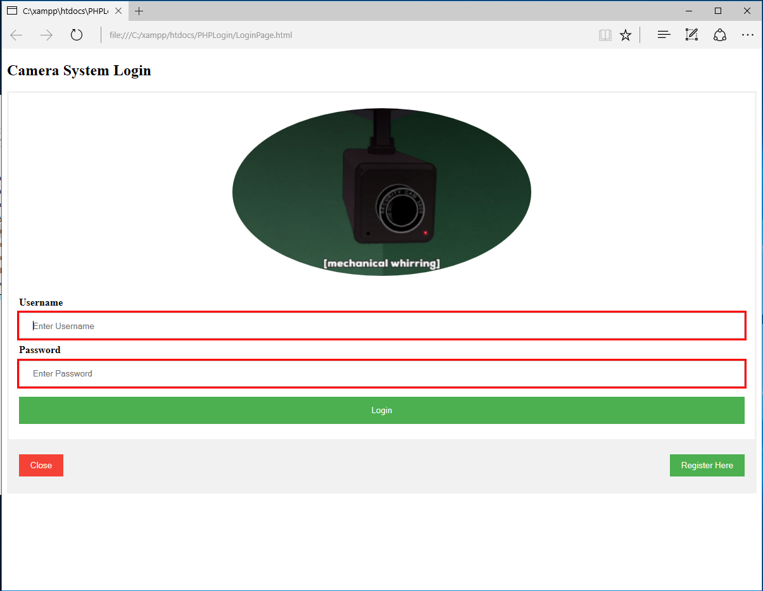

Slide 9
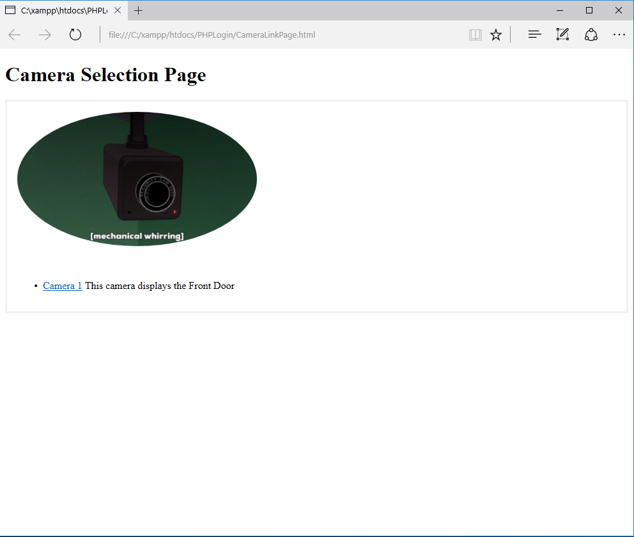

Slide 10
Conclusion
Difficulties
Existing Problems
Security Risk
Need session ID information
Database writing in new username password combos

