Slide 1
ITC 250/CPET 499 Web Systems Web Design Help Blog 12/15/2016
By: Andy Kaufman

Slide 2
Report Summary
Geared to help users with web design
Offers many links to other pages or websites
Users can email tutors for help
Provides detailed schedule of tutors available hours
Scope
Detailed schedule
Email Communication
Informational matter

Slide 3
Project Milestones
Prototype got lost
Final Report is finished
Final Project is finished

Slide 4
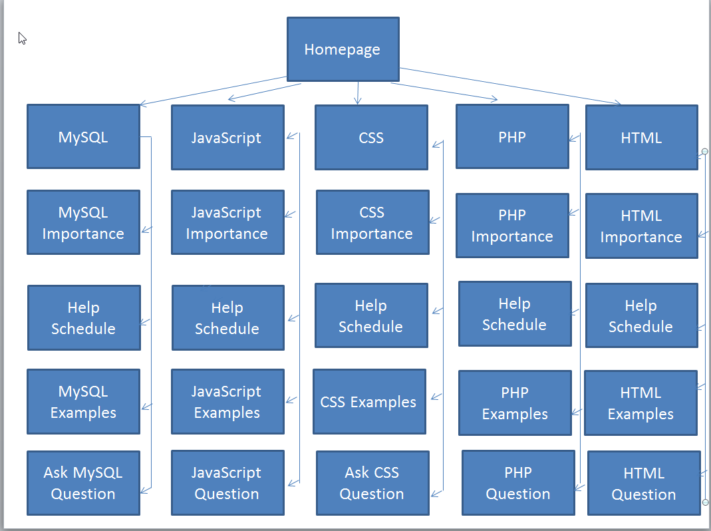
Web System Design
System Requirements
1 GHz or faster processor
2 GB RAM
16 GB disk space
DirectX 9 or later graphic card
800x600 display screen
Windows 7

Slide 6
Database Server
Web Server
Browser
Internet
Application Server
Data
CSS, Images, Pages

Slide 7
Software Programming Tools
Notepad++
XAMPP
SnagIt Capture

Slide 8
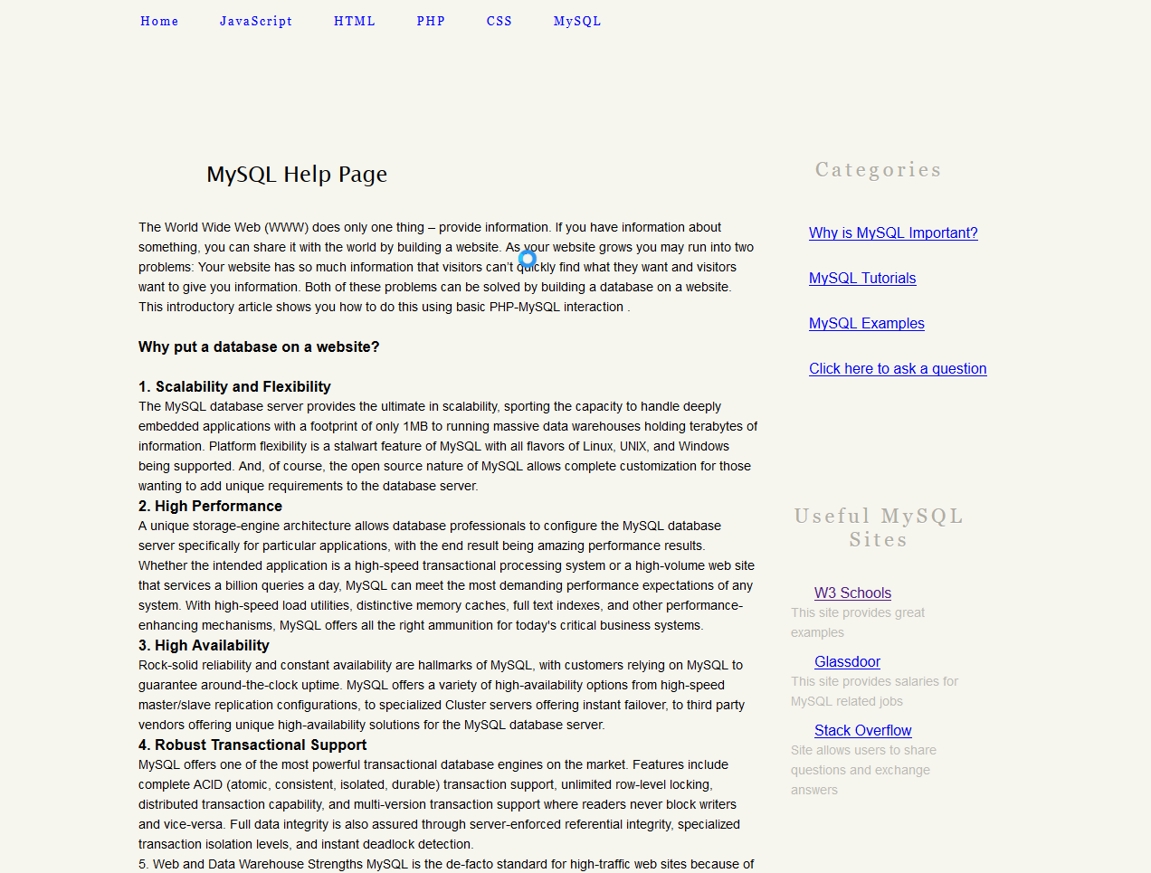

Slide 9
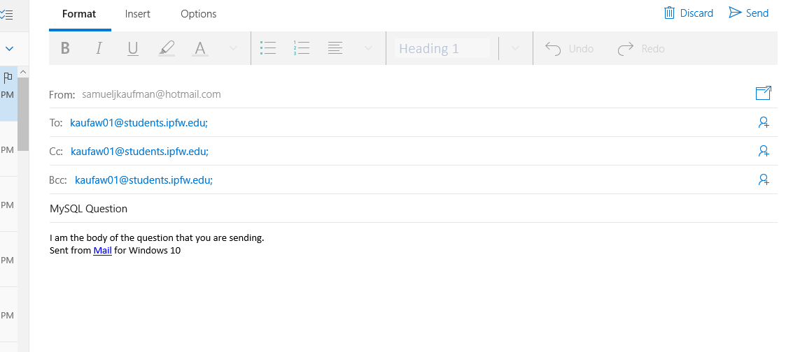

Slide 13
Summary & Conclusion
Learned a lot about JavaScript uses in web design
Gained experience on how to create a website

