Slide 1
Oh So Flye Games
Colby Flye
12/6/2016
Flyece01@students.ipfw.edu
Paul Lin

Slide 2
Overview
Report Summary
Project Milestones and Deliverables
Web System Design
Implementation and Testing
Summary and Conclusion

Slide 3
Report Summary-Overview
Oh So Flye games is a fictional hub of information regarding all the latest in technology, gaming, and promotes Oh So Flye games.
Microsoft Web Expression was used as the interface to create the website in the languages of html, javascript, php, AJAX, jquery, and css
The websites main goal is to provide a place for people of technology and games to have a place to gather and discuss.

Slide 4
Scope of Project
The website is small
There are fictional, fun articles made in the website that show just what the future might be like in technology
There is a small quiz game, powered using javascript, the game is full of riddles that are medium difficulty
There is a chat system for users in the website to talk to one another and hold conversations
Users can create an account and log in.

Slide 5
Milestones and Deliverables-Prototype
At first the website was going to use a discussion forum as a means to communicate with users
This was changed to a chat system as it was much easier
The change did hurt project progress and was a setback
At about the mid-point 28th, the project was majorly done, besides the chat system and javascript game

Slide 6
Final Report and Final Presentation
The Final Report was finished on December 11 and started on December 6th
This presentation was started December 6th and finished December 11th

Slide 7
Web System Design- System Requirements
A basic build of a computer with internet access through a provider is all that is required

Slide 8
Desired System
It is quite simple the navigation can be accessed from any page besides the chat pages
The chat page can be only accessed after a successful log on, if info matches the database
The quiz game checks for the correct radio button submitted and will display if it is right or wrong
The chat system actually writes to a log webpage, and the results are put back into the chat system, in a loop

Slide 9
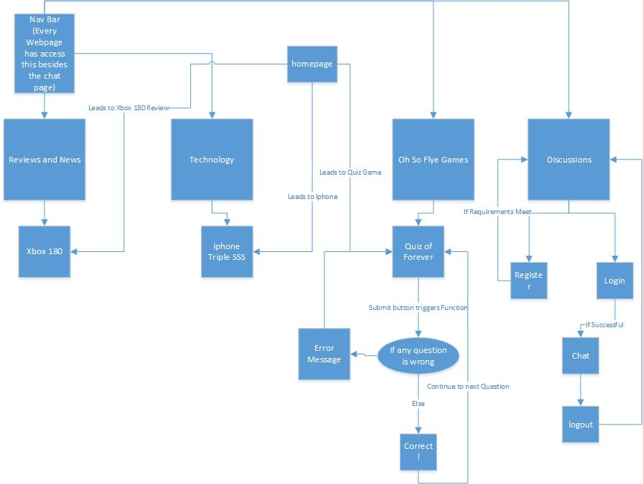
Desired System Diagram

Slide 10
Major Components of the Proposed System
The navigation bar is the key to navigating around pages
The quiz game is a simple and fun activity for users to use
The most complex is the log on system and chat system
To get to the chat system users must log on or register
The chat system writes to a log, which is then read back by the chat system, users can log out to return to the log on page

Slide 11
Software Programming Tools
Microsoft Web Expression is a full-featured professional tool for designing, developing, and publishing compelling, feature-rich websites that conform to web standards.
XAMPP is an easy to install Apache distribution containing MariaDB, PHP and Perl.
Several web browsers was used to test the web pages (Chrome, IE, Firefox)

Slide 12
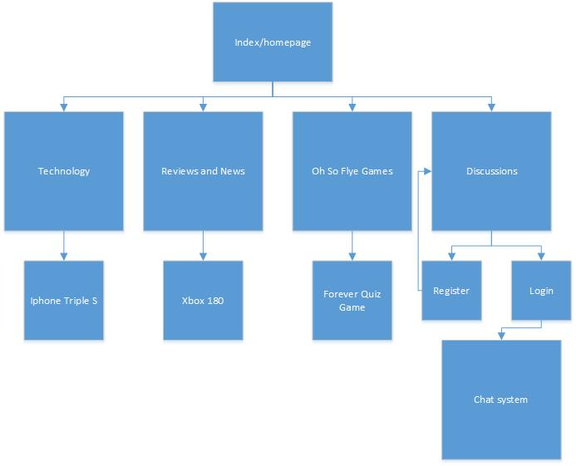
System Infrastructure

Slide 13
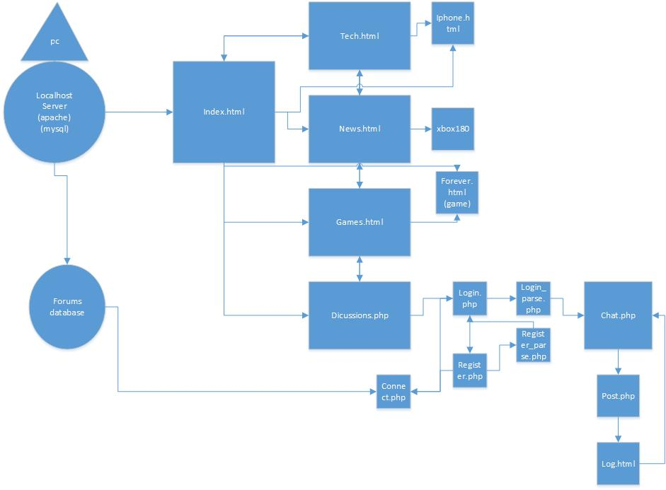
System Interaction Diagram

Slide 14
Implementation and Testing-Results
The site is fully-functional and running, response and criticism from friends was positive.
It works in all tested browsers (Chrome, IE, Firefox)

Slide 15
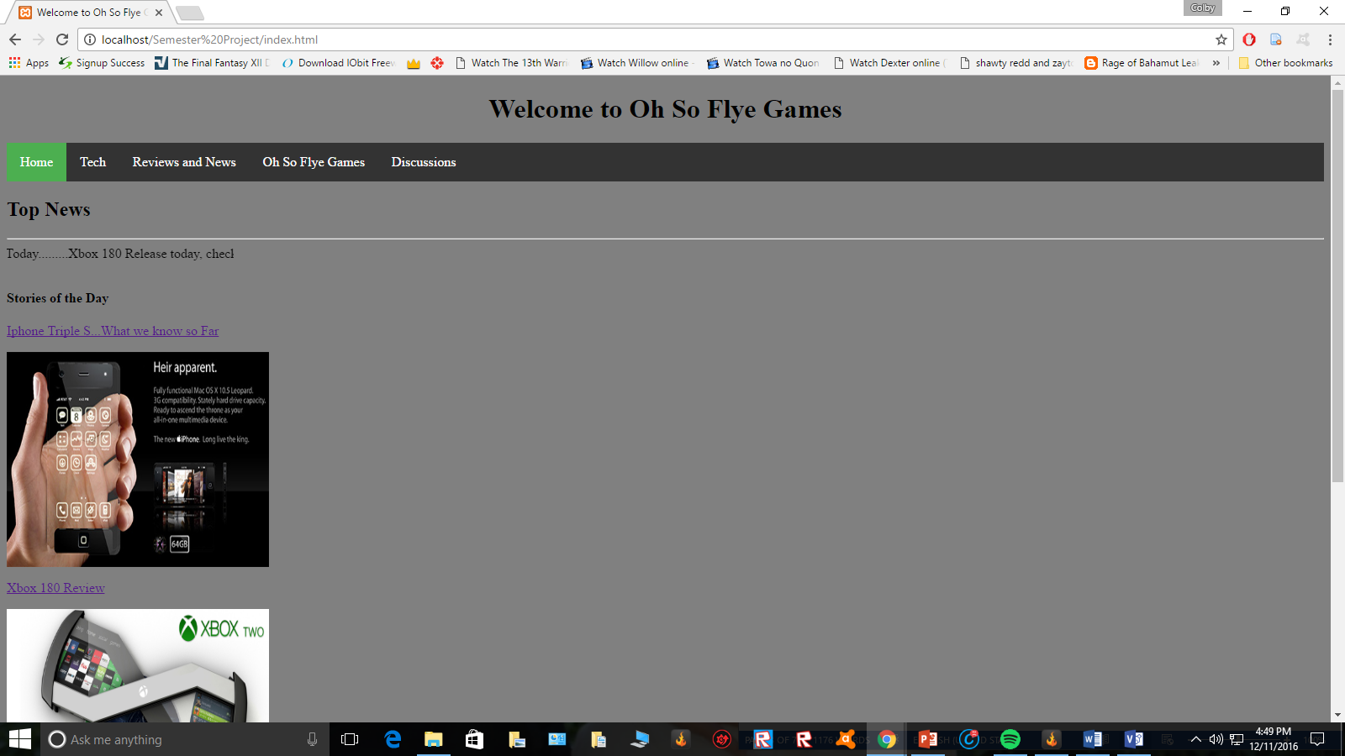
Screens

Slide 16
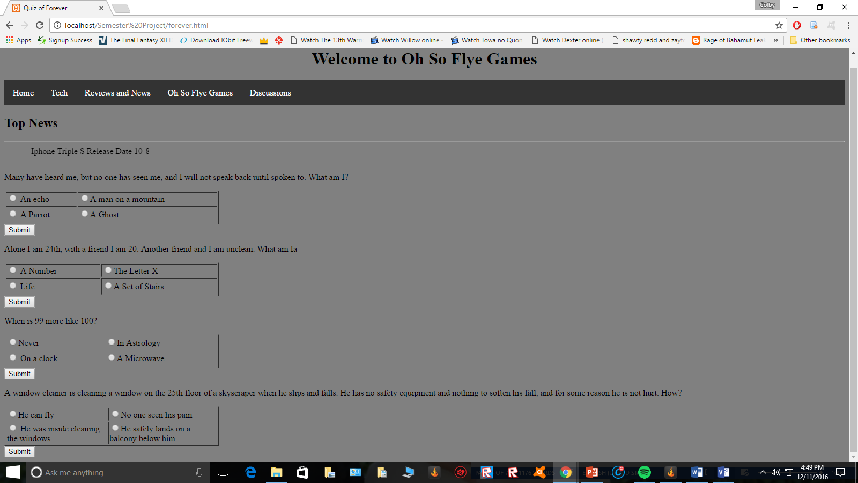
Screens

Slide 17
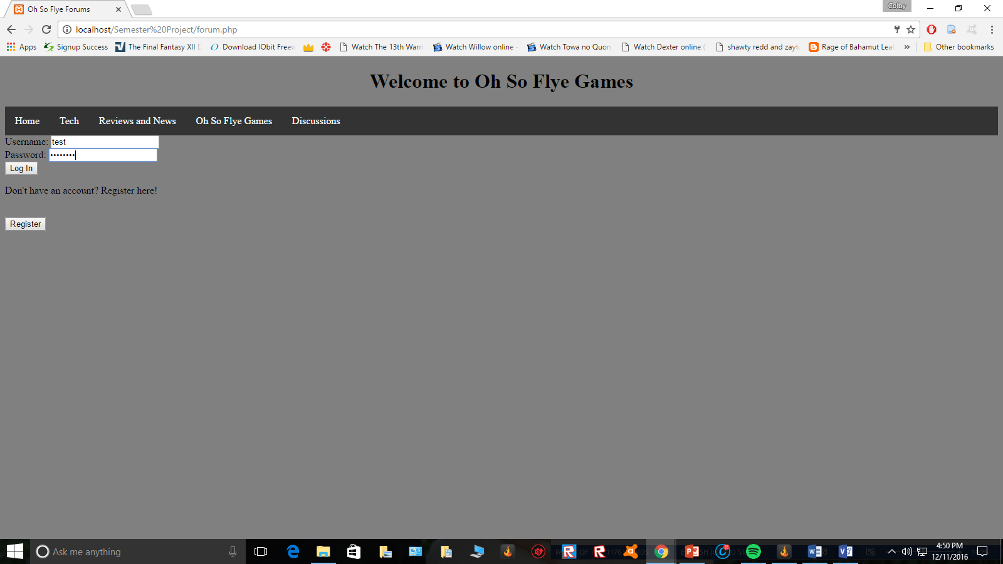
Screens

Slide 18
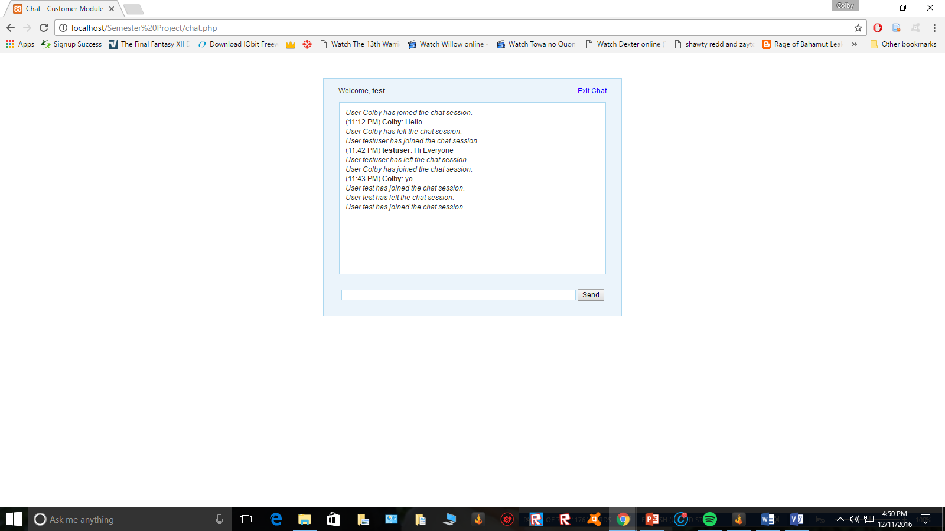
Screens

Slide 19
Summary and Conclusion
Site allows users to view articles, play a quiz game, log on/register, and talk to other users via a chat system
Assignment was a fun and great learning experience, I knew nothing of PHP and how vital it is to webpages
Knew nothing of XAMPP and similar tools
Was quite challenging to create chat system and log on system

