Slide 1
ITC 250/CPET 499 Web Systems Final Project Technology Job search website Presented by Taz Silvia Date: 12/13/2016

Slide 2
An overview

Slide 3
Project Scope
The main goal and one major activities of this project is to build a website in such a way that job seekers can easily look for jobs in different companies around USA.

Slide 4
System Activity

Slide 5
System Design

Slide 6
Project Milestone & Deliverables Prototype- , Final Report, Final Project Presentation status is complete.

Slide 7
Web System Design
System requirements
Hardware & software
Any laptop or PC . I used a Dell laptop where operating system is Windows 10 Home
64 bit operating system and processor: intel core i5-i7
XAMPP installation wizard, version 3.2.2
IDE-Eclipse or Notepad++
Microsoft Visio
Microsoft PowerPoint
Used User agent switcher application to test the website on different browser

Slide 8
Functional Description of the desired System with Diagrams

Slide 9
Major component of the proposed system
The three major components of the proposed system are:
The Web browser:
The XAMPP Web server
The database-

Slide 10
Software Programming Tools
To build my job search website, I used the following language
HTML,
CSS
Java Script,
PHP,
MY SQL database

Slide 11
System infrastructure drawings To make this system infrastructure drawings, I used Microsoft Visio software.

Slide 12
System Interaction diagram To make this system Interaction diagram, I used Microsoft Visio software

Slide 13
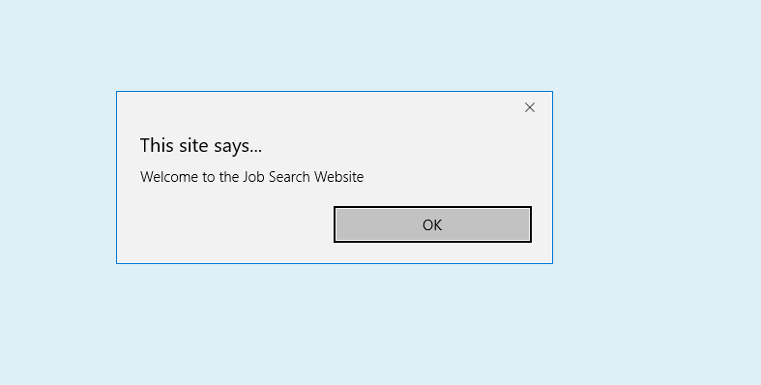
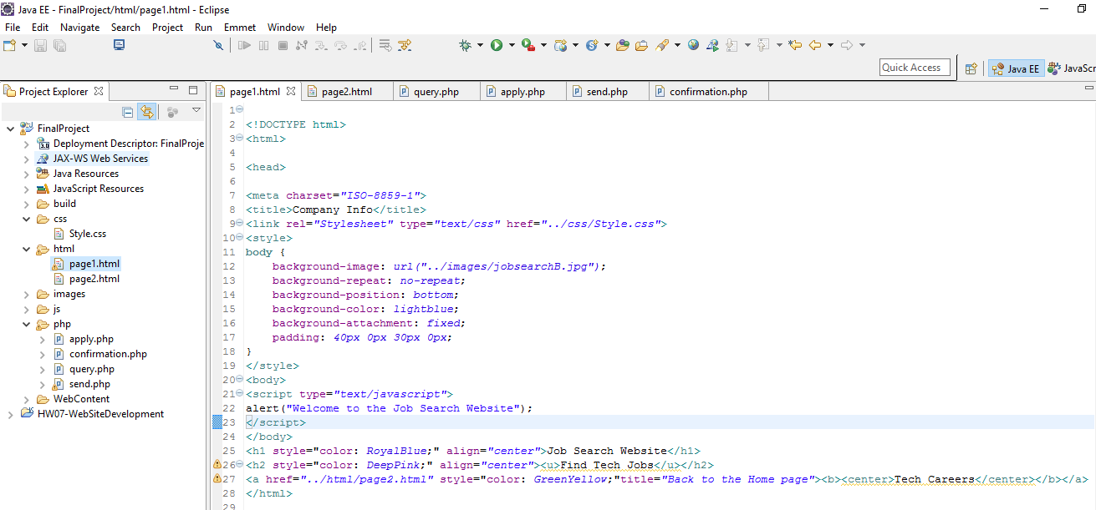
Implementation
First page of my website

Slide 14
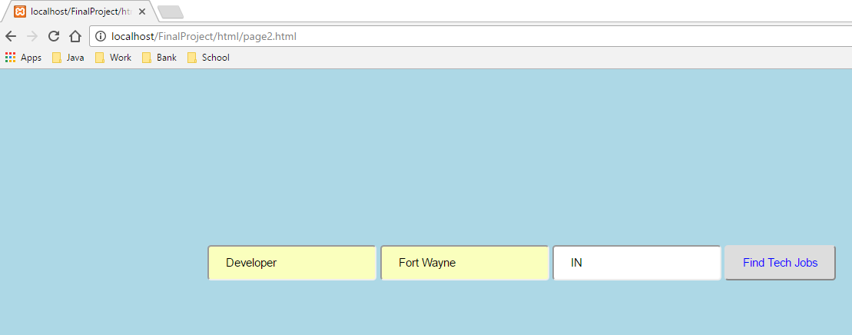
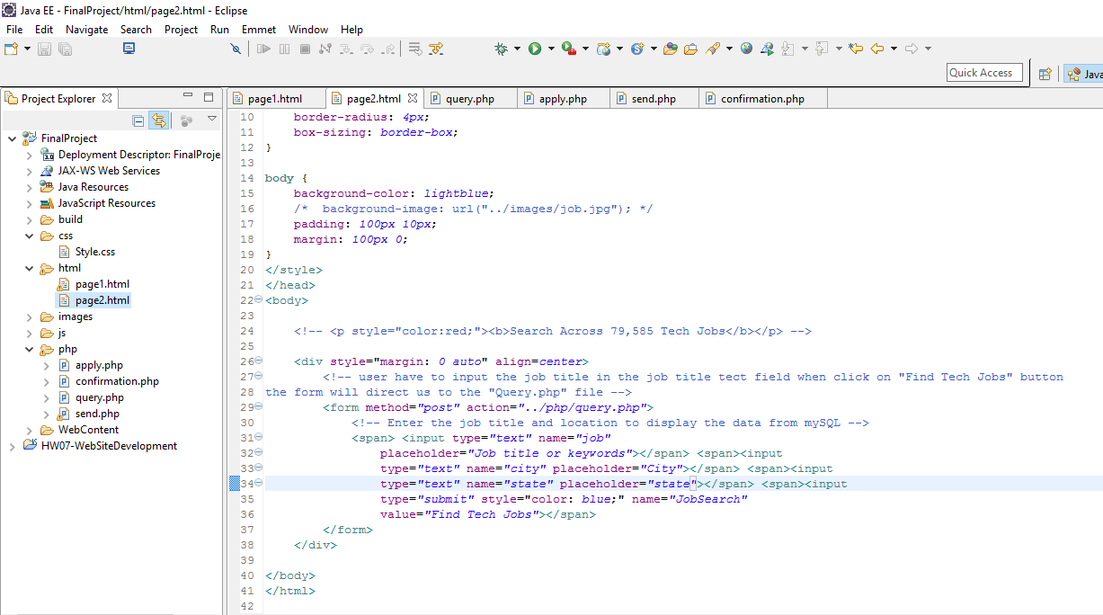
Implementation
Job Search Page

Slide 15
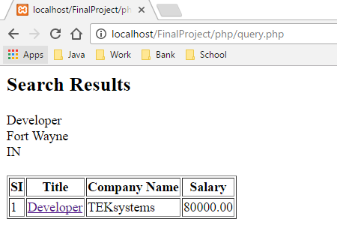
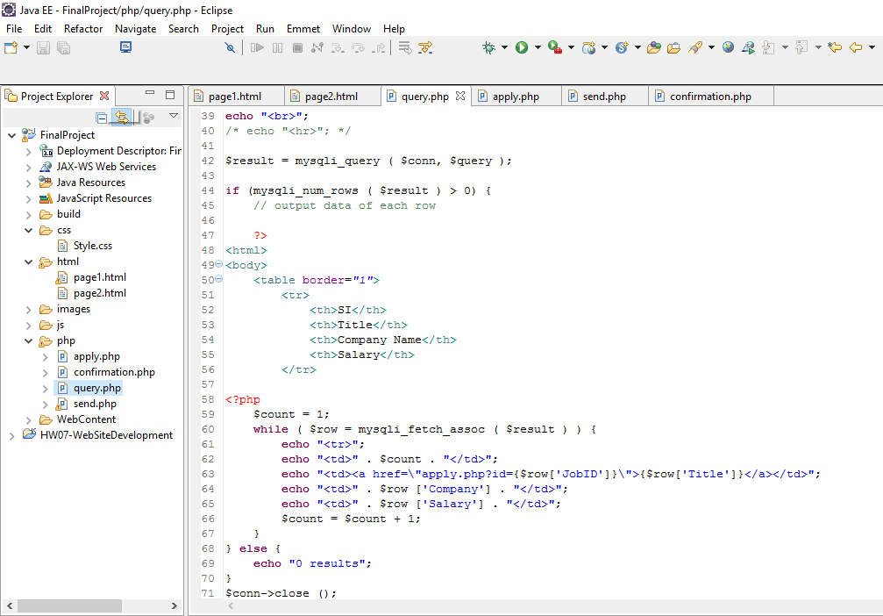
Implementation
Job Search results webpage

Slide 16
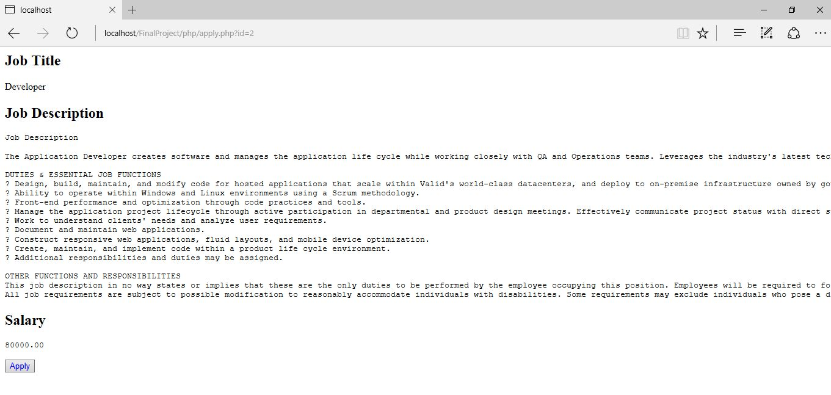
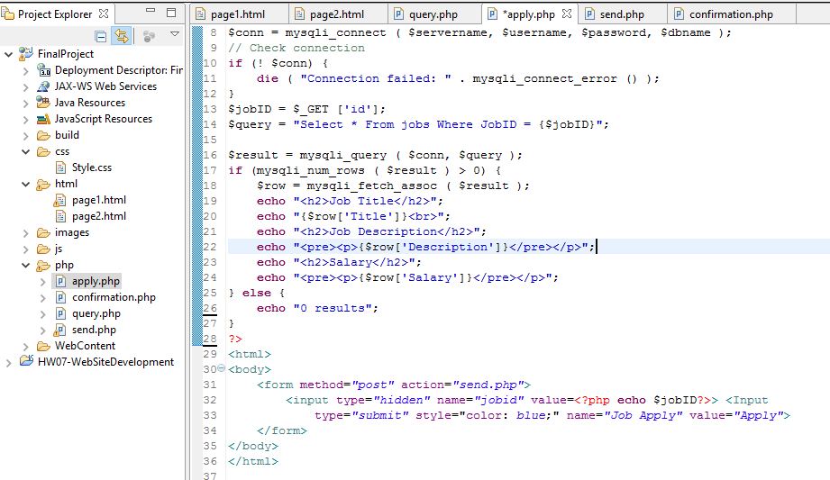
Implementation
Job Description Page

Slide 17
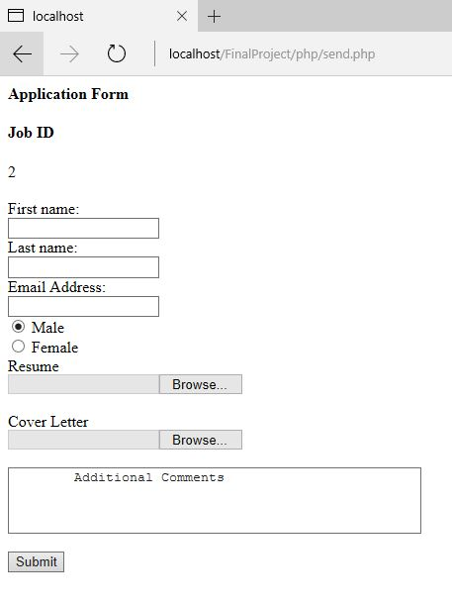
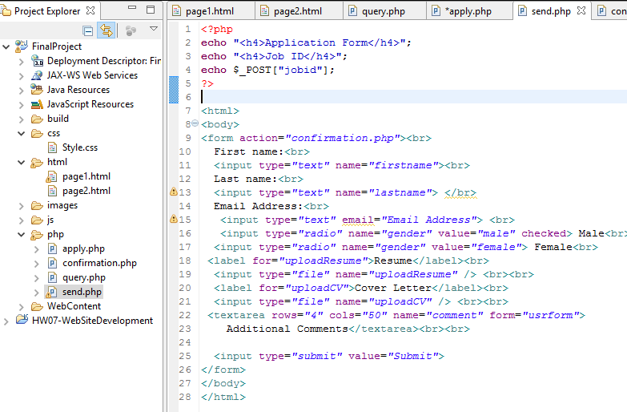
Implementation
Job Application Page

Slide 18
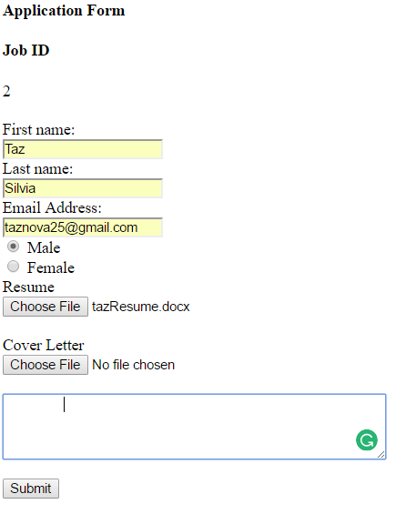
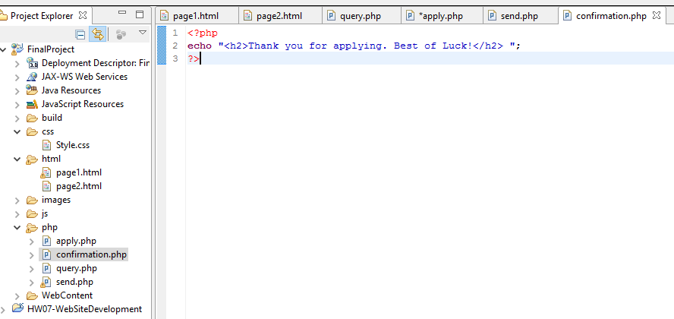
Implementation
Confirmation Page

Slide 19
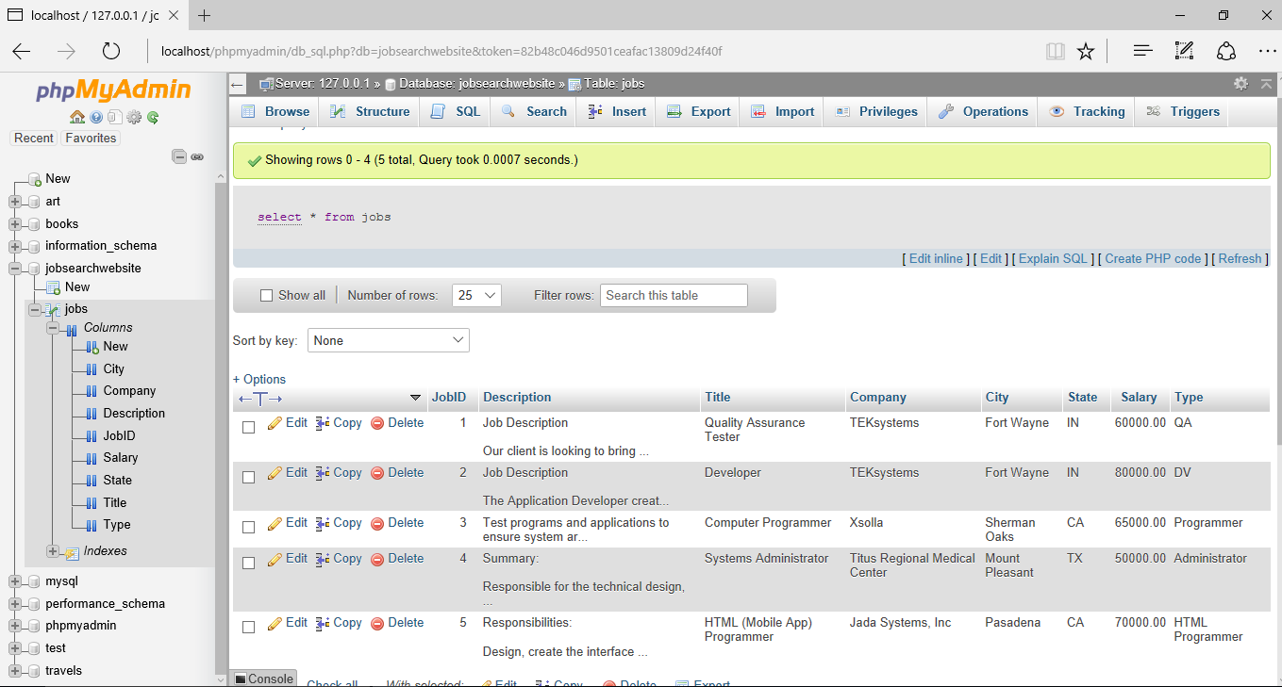
Implementation
Used MySQL to create a database for my website

Slide 20
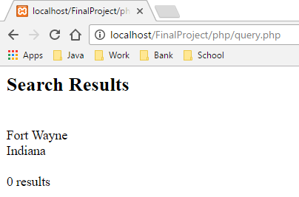
Testing
Data validation:
User will receive zero job search results, if they don’t enter any data inside the textbox “Job title or key words ” .

Slide 21
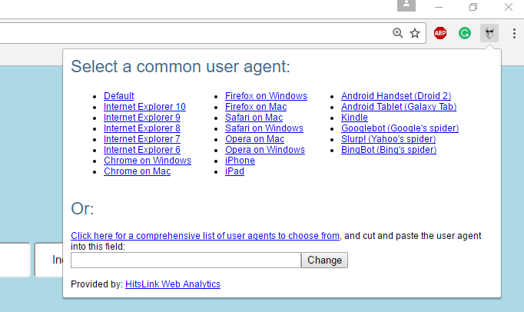
Testing
Tested the website in different browsers and I used an application name “agent string” to test the website.
I installed the application on my laptop. See the screenshot below:

Slide 22
Website Testing results on different browser
The following webpages was tested on Internet Explorer 10, Firefox, Safari on Mac and Android Tablet (Galaxy Tab).
Tested the website successfully. On different browsers.

Slide 23
Summary & Conclusion

