Slide 1
CPET 565/499 Mobile Computing Systems
Introduction to Ad Hoc and Sensor Networks
Lecture 14
Fall 2012
A Specialty Course for
Purdue University’s M.S. in Technology Graduate Program
By Hongli Luo and Paul I-Hai Lin
Dept. of Computer, Electrical and Information Technology
Purdue University Fort Wayne Campus

Slide 2
Introduction to Ad Hoc and Sensor Networks
Overview
Ad Hoc Network
Wireless Sensor Networks
Protocol Design Issues

Slide 3
Single-hop vs. multi-hop wireless networks
One common problem: limited range of wireless communication
  Essentially due to limited transmission power, path loss, obstacles
Option: multi-hop networks
  Send packets to an intermediate node
  Intermediate node forwards packet to its destination
  Store-and-forward multi-hop network
Basic technique applies to both WSN and MANET

Slide 4
Basic scenarios: Ad hoc networks
(Mobile) ad hoc scenarios
  Nodes talking to each other
  Nodes talking to “some” node in another network (Web server on the Internet, e.g.)
    Typically requires some connection to the fixed network
  Applications: Traditional data (http, ftp, collaborative apps, …) & multimedia (voice, video) ! humans in the loop
ad hoc
© J. Schiller

Slide 5
Basic scenarios: sensor networks
Sensor network scenarios
  Sources: Any entity that provides data/measurements
  Sinks: Nodes where information is required
    Belongs to the sensor network as such
    Is an external entity, e.g., a PDA, but directly connected to the WSN
      Main difference: comes and goes, often moves around, …
    Is part of an external network (e.g., Internet), somehow connected to the WSN
Source
Source
Source
Sink
Sink
Internet
Sink

Slide 6
Mobile Ad Hoc Networks
May need to traverse multiple links to reach a destination

Slide 7
Mobile Ad Hoc Networks
Mobility causes route changes

Slide 8
Mobile Ad Hoc Networks
Formed by wireless hosts which may be mobile
Don’t need a pre-existing infrastructure
  ie, don’t need a backbone network, routers, etc.
Routes between nodes potentially contain multiple hops
Why MANET?
  Ease, speed of deployment
  Decreased dependence on infrastructure
  Can use in many scenarios where deployment of a wired network is impractical or impossible
  Lots of military applications, but there are others

Slide 9
Overview: what is wireless sensor networks (WSNs)?
Networks of typically small, battery-powered, wireless devices.
  On-board processing,
  Communication, and
  Sensing capabilities.
Sensors
P
O
W
E
R
Storage
Processor
Radio
WSN device schematics

Slide 10
WSN node components
Low-power processor.
  Limited processing.
Memory.
  Limited storage.
Radio.
  Low-power.
  Low data rate.
  Limited range.
Sensors.
  Scalar sensors: temperature, light, etc.
  Cameras, microphones.
Power.
  Batteries or passive power source
Sensors
P
O
W
E
R
Storage
Processor
Radio
WSN device schematics

Slide 11
WSN
Use of networked sensors dates back to the 1970s.
  Primarily wired and
  “Centralized”.
Today, enabling technological advances in VLSI, MEMS, and wireless communications.
  Ubiquitous computing and
  Ubiquitous communications.

Slide 12
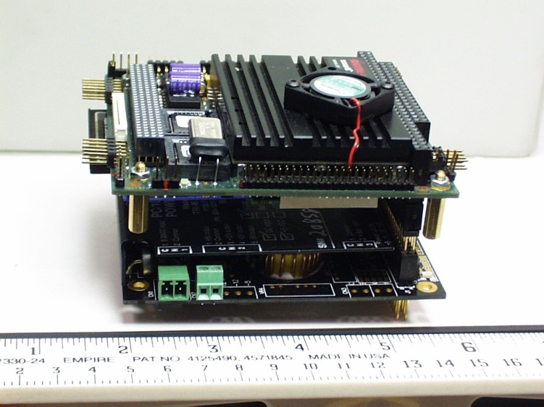
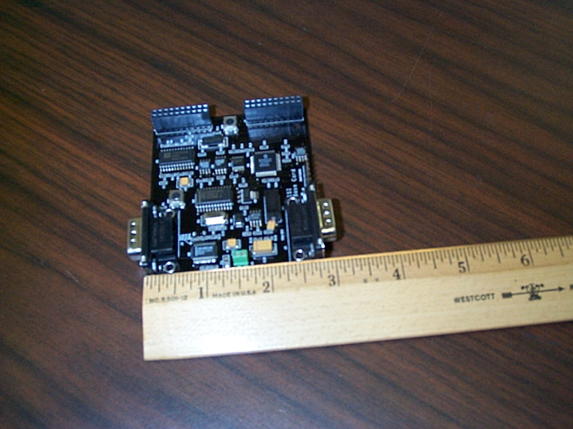
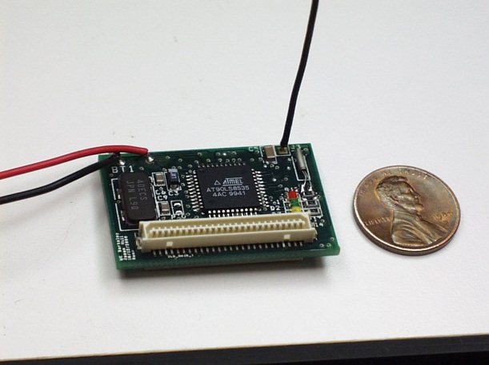
Examples of WSN Platforms
PC-104+
(off-the-shelf)
UCLA TAG
(Girod)
UCB Mote
(Pister/Culler)

Slide 13
Berkeley Mote
Commercially available.
TinyOS: embedded OS running on motes.

Slide 14
Many Applications
Military applications
  Tracking, detection of biological or chemical weapons, improved battlefield communications
Medical applications
Industrial applications
  Tracking, RFID tags
Environmental applications
  Environment monitoring, wildlife monitoring

Slide 15
Design Challenges
Why are WSNs challenging/unique from a research point of view?
Typically, severely energy constrained.
  Limited energy sources (e.g., batteries).
  Trade-off between performance and lifetime.
Self-organizing and self-healing.
  Remote deployments.
Scalable.
  Arbitrarily large number of nodes.

Slide 16
Design Challenges (Cont’d)
Heterogeneity.
  Devices with varied capabilities.
  Different sensor modalities.
  Hierarchical deployments.
Adaptability.
  Adjust to operating conditions and changes in application requirements.
Security and privacy.
  Potentially sensitive information.
  Hostile environments.

Slide 17
WSN tasks
Neighbor discovery
Self-organization or self-configuration
Sensing
Signal processing or sensor data processing
Data aggregation, storage, and caching
Target detection, target tracking, and target monitoring
Topology control for energy savings
Localization
Time synchronization
Routing
Medium access control

Slide 18
WSN protocol requirements
Depend on the characteristics of the sensor network
  Hardware limitations – limited computational capabilities, limited memory and storage, limited power
  mobility
Depend on the intended applications

Slide 19
Properties of Ad Hoc Network
No preexisting infrastructure
Limited access to a base station
Power-limited devices
No centralized mechanisms

Slide 20
Features of Sensor Networks
Direct interaction with the physical world
Usually special-purpose devices
Very limited resources
Operate without a human interface
Specialized routing patterns

Slide 21
Protocol design
Constrained resources
  No centralized authority
    Routing in the ad hoc network is decentralized
    No designated routers
    Routing protocols
      Dynamic Source Routing (DSR) – source routing protocol
      Destination-Sequenced Distance-Vector (DSDV) – distributed routing protocol
    Handling routing requests consumes energy
    Obtaining information is more computationally expensive

Slide 22
Protocol design
Constrained resources
  Limited power
    Battery –
      replace battery or deploy new sensors?
      Extending battery life through protocol design and energy-efficient hardware
    Passive power sources
      Solar or vibration energy
      Sometimes not available
      Typically provides a very modest amount of energy
    Combination of battery and passive power
    cross-layer protocol design
      optimized functionality across all layers of the protocol stack.

Slide 23
Protocol design
Constrained resources
  Wireless communication
    Lower bandwidth, requires more power from the node, less reliable
    Power is the most significant factor for sensor nodes
    tcp over wireless links is inefficient

Slide 24
Protocol design
Constrained resources
  Limited computation and storage
    Limited by power, cost, size of the device
    Less processing of the sensor readings
    Lower levels of security
    Data compression and FEC can not be computation expensive
    E.g., Mica 2 mote
      Runs at 4 MHz with 512 kB of programmable memory and 128 kB of SDRAM

Slide 25
Protocol design
Constrained resources
  Storage constraints
    TinyOs requires 3500 bytes
    Application is compiled with the OS into a single program
    Application must be optimized for space utilization
    Place significant bounds on the complexity of application
    Caching or buffering of data is limited

Slide 26
Protocol design
Constrained resources
  Limited input and output options
    General no input and output peripherals for the sensor nodes
    Input – on/off switch
    Output – LED light or speaker
    Difficult for configuring and trouble-shooting a sensor node
    Sensor nodes working in simulators, emulators, or testbed may work differently in a real application

Slide 27
Protocol design
Security
  Small keys reduce the security
  Limited computation
    Provide security that meets or exceeds the requirements of the application without consuming too much computing resources
  Changing network membership
    Affect security protocol that shares keys between neighboring nodes
    Routing may rely on authentication of nodes
  Arbitrary topology
    Number and identity of neighboring sensors are not known priori to network deployment

Slide 28
Protocol design
Mobility
  Mobility requirements
    Mobility needed in the applications
    Assist the application – buffer message before delivery
    Initial positioning and repositioning of sensor nodes
  Loss of connectivity
    End points moves beyond the range of connectivity
    Movement of the nodes along the path
    Reconnection of path introduces delay – packet loss or buffering
    Flooding consumes too much energy

Slide 29
Protocol design
Mobility
  Data loss
    Higher transmission errors in wireless communication
    Broken connection resulted from mobility
    Retransmission or dropped?
      Tradeoff between delay and overhead of reconstructing path
  Group communication
  Maintaining consistent views

Slide 30
Protocol design
Mobility
  Group communication
    Neighbors change
    Structure of the group change – multicast tree
  Maintaining consistent views
    Avoid loops in the routing tables
    Reduce the number of retransmitted packets

