Slide 1
CPET 565
Mobile Device & Communication Technologies Evaluation and Assessment
Homework 1
Andrew Repp, Kyle Blevins, and Richard Adeyemo

Slide 2
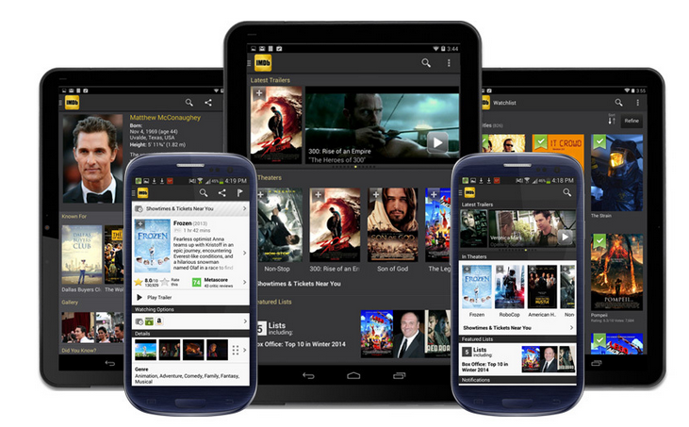
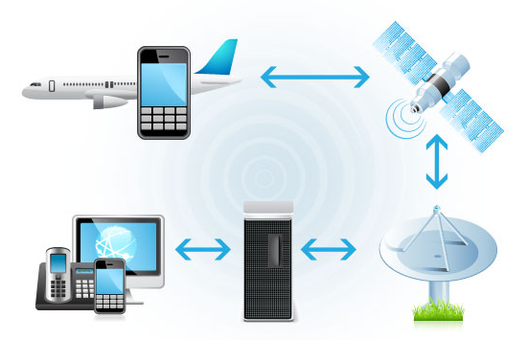
1. What effect will smart mobile devices have on mid-sized (service) enterprises in the next 5 years?
Networking
Wireless and other network infrastructure planning
Bandwidth Effects
BYOD Policies
Decrease purchases of traditional desktops
Mobile devices will outnumber desktop and laptop computers
Mobile Device Management (MDM)
Security
Increased security risks from mobile data across networks
Lost or stolen devices
Web-Enabled Applications
Mobile workspace expected with cloud services and web connected ERPs

Slide 3
Mobile Computing SWOT Analysis
STRENGTH Agile Workforce Productivity Enhancements Always Connected Optimized for specific tasks Lower costs than traditional computers | WEAKNESS Software application limits (i.e. Java applets) Data breaches more likely Storage capacity, computing power, battery power Network connection dependent
OPPORTUNITY BYOD policies to reduce capital Lower management and support costs Sensor integrations for process improvements | THREAT Target of theft (data and device) Security

Slide 4
Strategic Plan
Increase capabilities of the wireless infrastructure and server architecture (including mobile device management).
Develop the device policies and standards.
Train end users on devices and policies.
Increase the number of web-enabled applications.
Review security and policy and adjust as needed.

Slide 5
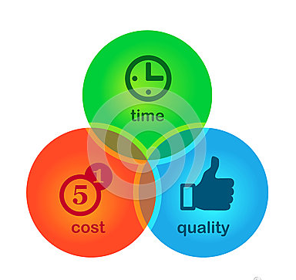
Decision cost effect

Slide 6
I.T infrastructure Cost
Decision cost effect
Client Mobile Device consideration cost (Sale Device automation)
Cost of Link speed upgrade cost
Network devices such as switches and routers upgrade cost
Server Machine upgrade cost
Server software cost
Manufacturing Cost
Client side software cost
Device communication cost

Slide 7
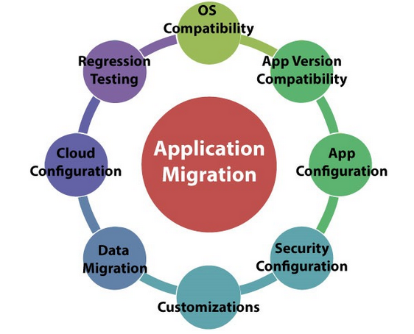
Migration Cost
Decision cost effect
Operational Cost
Logistic Cost
Implementation cost
Personnel Training cost
Operator salary
Maintenance/Repair cost
Emergency replacement cost
IT overhead cost

Slide 8
Technology, Services and Business

Slide 9
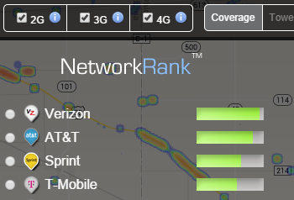
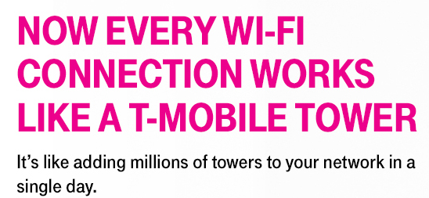
Comparison
Verizon Wireless: 123.5 million (2014 Q2)
AT&T Mobility: 116.6 million (2014 Q2)
Sprint Corporation: 54.3 million (2014 Q2)
T-Mobile US: 50.5 million (2014 Q2)

Slide 10
Overview
OPERATOR | Voice Technology | Data Technology | Subscriber | Coverage(Excluding Roaming) | Ownership
Verizon Wireless •Including hosted virtual operators | CDMA2000 | EVDO, LTE | 123.5 million (August 2014) | Contiguous US; AK, HI | Verizon
AT&T Mobility •Includes Cricket Wireless, GoPhonePrepaid and hosted virtual operators | GSM, UMTS | EDGE, HSPA+, LTE | 116.6 million (August 2014) | Contiguous US; AK, HI, PR, VI | AT&T
Sprint Corporation •Including hosted virtual operators | CDMA2000, IMS Wi-Fi calling | EVDO, WiMAX, LTE | 54.3million (August 2014) | Contiguous US; HI, PR, VI | SoftBank Corporation (80%)
T-Mobile US •Including hosted virtual operators and affiliates •Subscriber count includes MetroPCS | GSM, UMTS, HD Voice, IMS Wi-Fi calling | EDGE, HSPA+, LTE | 50.5 Million (August 2014) | Contiguous US; HI, PR | Deutsche Telekom (67%)

Slide 11
3. What technology should a company provide, with their headquarters in Chicago, in order to maximize their employees productivity and efficiency…

Slide 12
A. Employees who perform their office work at home most of the work week?
VMware
VSphere
InfoBlox
VPN
Active Directory
Laptop
SmartPhone
Personel Computer
Tablet
Virtual Machine

Slide 13
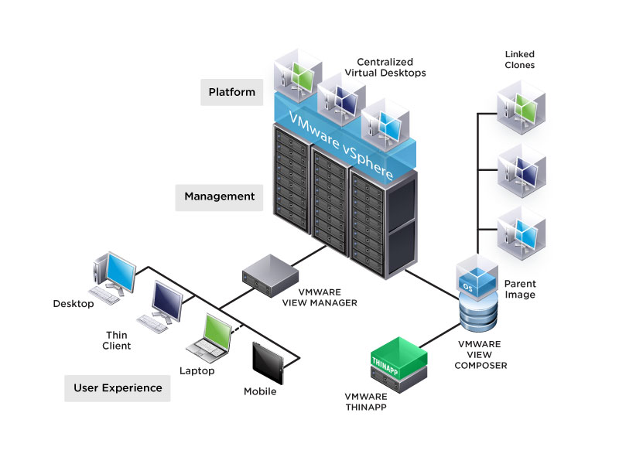

Slide 14
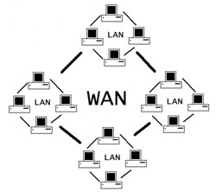
B. Technical staffs who spend most of their work time at a client site in New York city (commute weekly from Chicago to New York city)
Laptop, PC or Tablet
Routers
Switches
Fiber-Optics
ISP
Active Directory
WAN

Slide 15
References
“AT&T Digital Media Solutions and Content Delivery | AT&T.” [Online]. Available: http://about.att.com/mediakit/digitalmedia. [Accessed: 18-Sep-2014].
A. 8 and 2014, “Grading the top U.S. wireless carriers in the second quarter of 2014,” FierceWireless. [Online]. Available: http://www.fiercewireless.com/special-reports/grading-top-us-wireless-carriers-second-quarter-2014. [Accessed: 22-Sep-2014].
“United States Cell Coverage Map.” [Online]. Available: http://opensignal.com/coverage-maps/US/. [Accessed: 22-Sep-2014].

