Slide 1
IEEE Fort Wayne Section Technical Presentation
April 22, 2014
Indiana University-Purdue University Fort Wayne
Room ET 246
Wired and Wireless Sensor Networks for Bridge Health Monitoring
Paul I-Hai Lin, MengWei Li*, Robert Tilbury**, Max Yen, Dong Chen,
*Graduate of Purdue M.S. in Technology
** Graduate student of Purdue M.S. in Technology program
College of Engineering, Technology, and Computer Science
Indiana University-Purdue University Fort Wayne
http://www.etcs.ipfw.edu/~lin

Slide 2
Wired and Wireless Sensor Network for Bridge Health Monitoring
Topics of Discussion
Overview
The Army/IPFW Corrosion Monitoring System (CMS) Architecture and System Design
The Deployed Army/IPFW CMS System
The CMS System and Communication Subsystem Reliability Issues
Designed and Implemented Communication Infrastructure Improvement
SaaS Cloud Service, and Cloud Storage
Conclusion

Slide 3
Overview
The project: “Micro-Nano Technology Sol-Gel Corrosion Monitoring System,” 2011-2013
  Project sponsor: Army Construction Engineering Research Laboratory, IL: Richard Lampo and Michael McInerney
  Project Team
    Principal Investigator: Max S. Yen
    Co-Pis: Paul I-Hai Lin and Dong Chen
    Graduate Students: MengWei Li, Robert Tilbury, Muhammad Shoaib Mansur
    Undergraduate EE Student: Steve Groff

Slide 4
Overview (continue)
The Accomplishments
  “Examination of Corrosion on Steel Structures by Innovative Nano Sol-Gel Sensors,” by Max Yen, Dong Chen, Paul Lin, Bakul Dave, Steve Groff, Emily Hauter, Richard Lampo, and Michael McInerney, NCAE 2012 Corrosion Conference, to be held on March 11-15, 2012, Salt Lake City, Utah
  “Corrosion Sensor for Monitoring Early-Stage Environmental Corrosion of Steel Structure,” Dong Chen, Max yen, and Paul Lin, U.S. Provisional Patten Application #61763523, Feb. 2013
  “Micro-Nano Technology Sol-Gen Corrosion Monitoring System,” New Tech Showcase Demo & Presentation, Indiana University-Purdue University Fort Wayne, April 24, 2013.
  “A Corrosion Monitoring System for Early-Stage Warming of Environmental Corrosion of Structures and Infrastructures,” Technology Showcase, at 2013 Taipei International Invention Show & Technomart, Sept. 26-29, 2013.

Slide 5
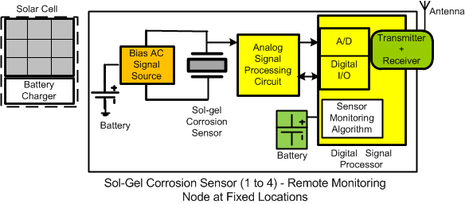
System Architectures of Corrosion Monitoring System: Initial Design (Nov. 2011)
Wireless Sensor Nodes powered by solar panels, with Internet Gateway for Remote Access

Slide 6
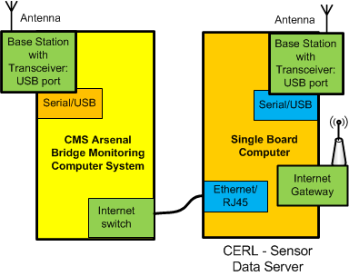
IPFW/Army CMS System Architecture Version 1: Wireless Sensor Nodes, with Internet Gateway (Nov. 2011)
Not implemented due to the concerns of wireless signal interference from other deployed sensor monitoring system

Slide 7
The IPFW/Army Corrosion Monitoring System Deployed at RIA Bridge, Rock Land, IL
Designed CMS monitoring system architecture
Designed and built Sol-gel, Cylindrical, uncoated and coated with tar-coal epoxy.
Designed and built the analog signal processing circuits for Sol-Gel based sensors and cylindrical sensors
Designed and built the RS-485-based DAQ sensors boxes and cabling system
Completed the testing and installation of CMS at IPFW
Installed the CMS system at Army Rock Island Arsenal Bridge, Rock Island, IL, May 2013
Encountered problems in the areas of Internet Networking and Communication, and followed up with solutions that we will be discussed …

Slide 8
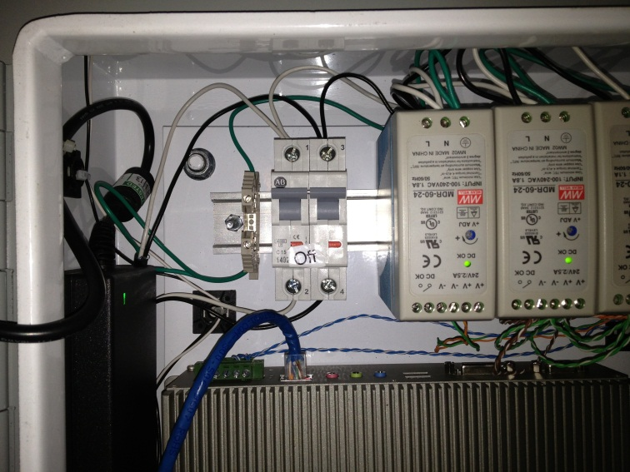
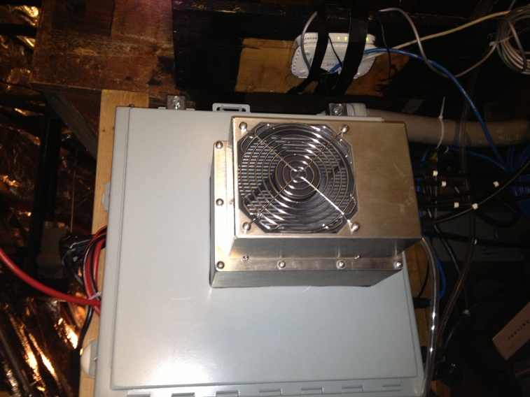
The IPFW/Army Corrosion Monitoring System
A Windows XP embedded computer: RS-485, Ethernet ports
  DC 12-24V powered, diskless, central controller and data server
  Thermaelectric cooler
  Running the program with “Centralized Data Polling Algorithm” to collect data from six sensor nodes at 30 minutes fixed interval, with time stamp data

Slide 9
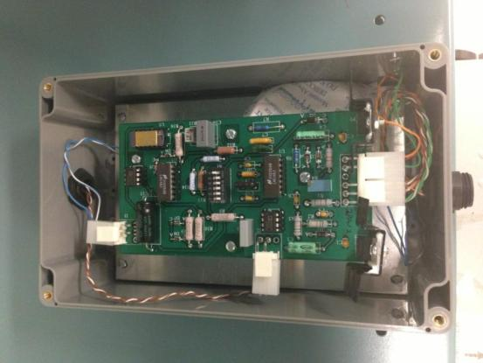
The IPFW/Army Corrosion Monitoring System
Six RS-485-based Sensor Nodes
  DC 24V, ±12V, Power Source
  Microcontroller-based with built-in commands, 12-bit ADC
  Analog signal processing circuits, calibrated for four types of corrosion sensors
Power and Communication Socket
Sensor wiring socket

Slide 10
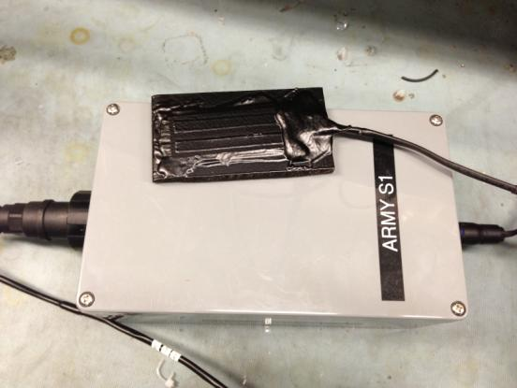
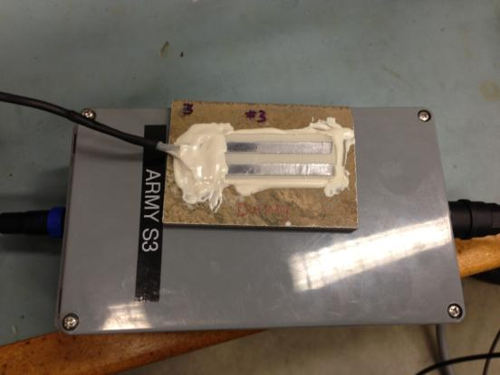
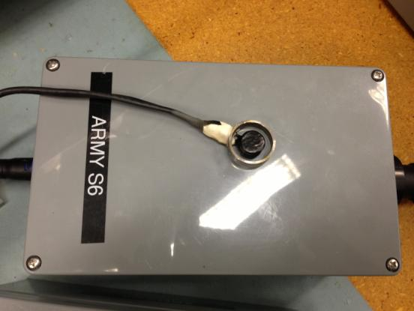
The IPFW/Army Corrosion Monitoring System
Six RS-485-based Sensor Nodes
  S1, S2: Coal-tar Epoxy Coated Sol-Gel Sensor
  S3, S4: Sol-Gel Sensor
  S5: Stainless Steel Cylindrical Sensor (coal-tar epoxy coated)
  S6: A36 Cylindrical Sensor (coal-tar epoxy coated)

Slide 11
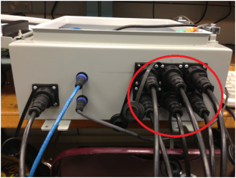
The IPFW/Army Corrosion Monitoring System
The Assembled Corrosion Monitoring System in an weather proofed enclosure and 100 ft to 150 ft cables and connectors
Army Sensors
S1 S2 S3
Internet
Power Cable
Army Sensors
S4 S5 S6

Slide 12
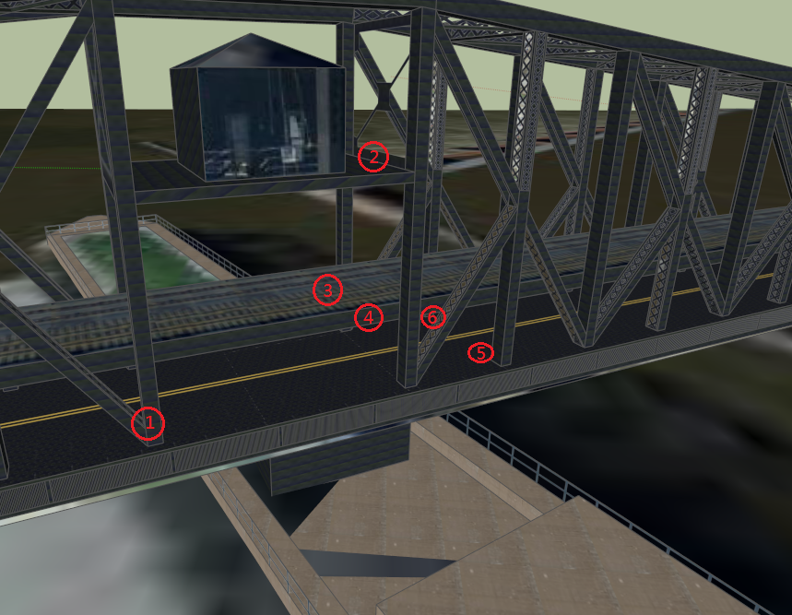
The IPFW/Army Corrosion Monitoring System: Sensor Locations

Slide 13
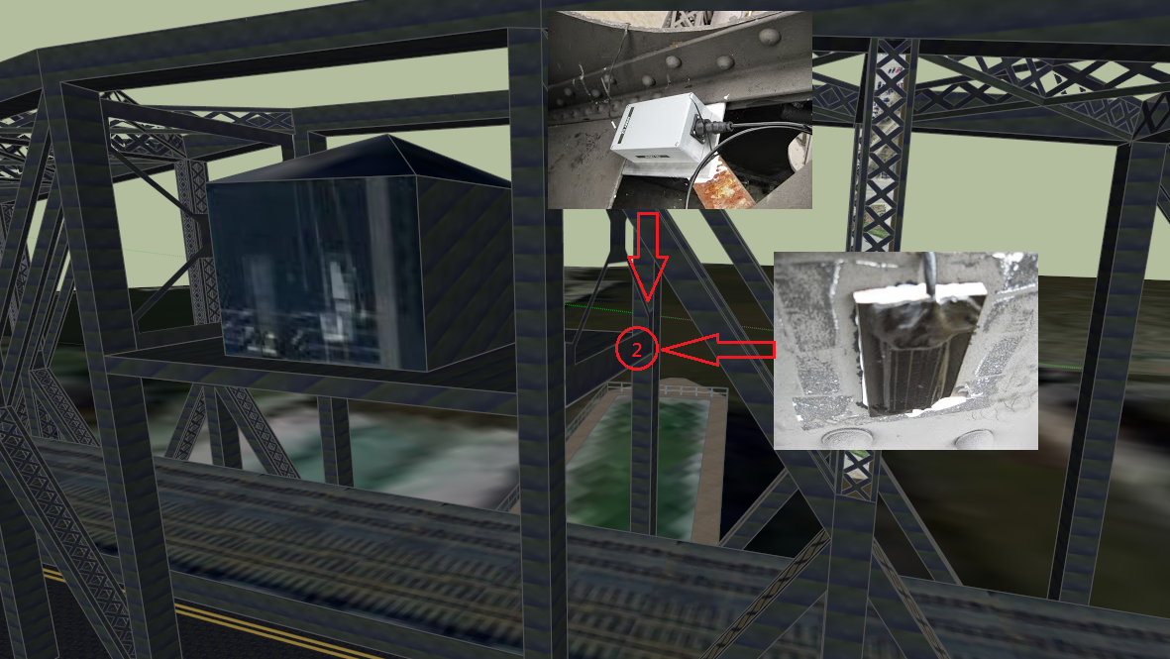
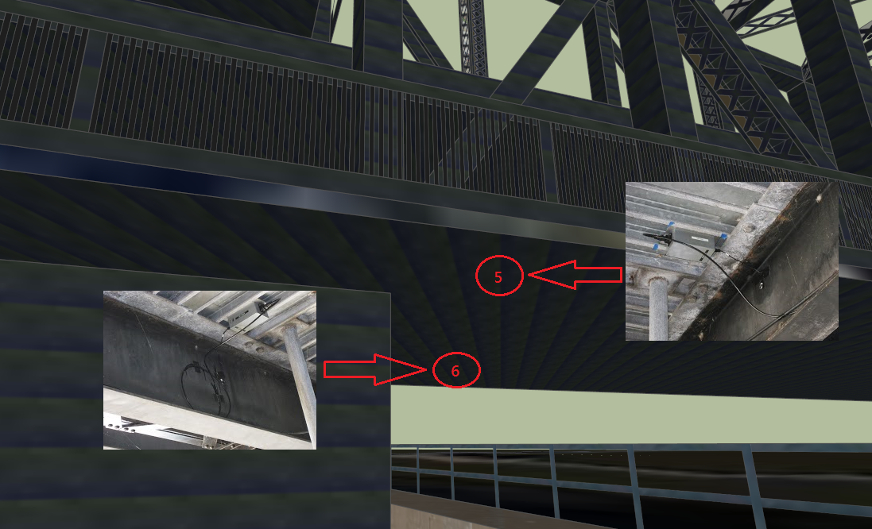
The IPFW/Army Corrosion Monitoring System: Sensor Locations

Slide 14
Installed Cloud Services
The following cloud services were installed on IPFW/Army CMS system, at RIA bridge, Rock Island, IL on May 2013:
  The LogMeIn Hamachi: SaaS (Software as a Service), On Demand Network Virtualization
  LogMeIn Pro: SaaS, remote access to computers for files, applications, and backup service
  DropBox – Cloud Storage Service
    Stored data & files are encrypted, and
    Kept securely on storage service via Amazon’s S3 storage (Simple Storage Service)

Slide 15
Features of LogMeIn SaaS Cloud Service
LogMeIn Pro, SaaS Cloud Service, Supporting Features
  Remote Access
  Web-based User Interface
  User management
  Computer search
  Online/Offline status
  Reporting
  256-bit SSL encryption
  Audit logging
  Computer grouping
  Host configuration
  Advanced reporting and analysis
  etc

Slide 16
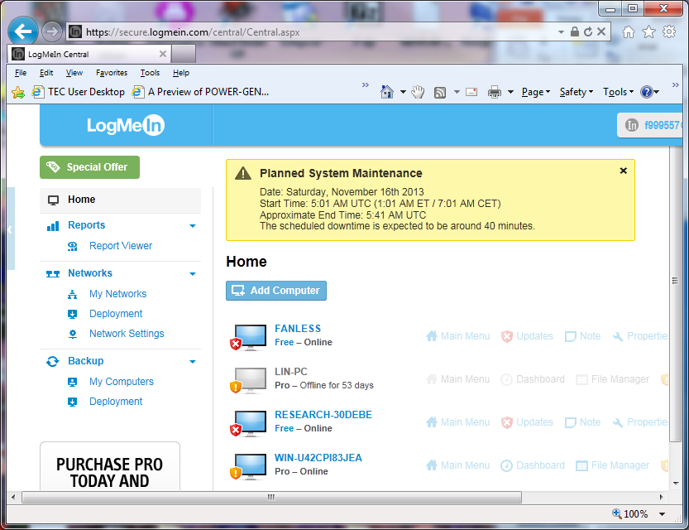
The LogMeIn – SaaS Cloud Service

Slide 17
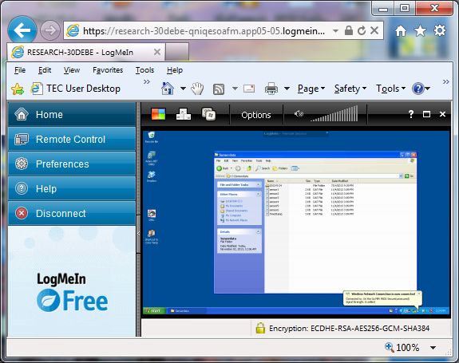
The Windows XP Embedded Data Server: Remotely Accessed through LogMeIn – SaaS Cloud Service

Slide 18
Dropbox - Cloud Storage Service
All sensor data collected in a 30 minutes interval at Rock Island Arsenal bridge.
Automatically saved into Dropbox storage setup at Embedded computer/data server.
These data saved in Dropbox storage is also synchronized and available to the real-time sensor data processing and web display system setup at IPFW.

Slide 19
The IPFW/Army CMS
Issues and Solutions: First Problem
The installed corrosion monitoring system was successfully collecting data from May 24-26, 2013; then it was offline from May 26 for 1 day, and then was offline since May 29.
  Need to install an UPS for the corrosion monitoring system to ensure the system’s reliability. (added)
  Suspected that high inrush current trip the circuit breaker (replaced with one with high current rating)

Slide 20
The IPFW/Army CMS
Issues and Solutions: First Problem
The installed corrosion monitoring system was successfully collecting data from May 24-26, 2013; then it was offline from May 26 for 1 day, and then was offline since May 29.
  Need to install a remote computer starter to ensure that the corrosion system can be restarted remotely.
    Readjust BIOS Power Management Setting of the Windows XP embedded data server: “Power Lost Resume Control – Turn on”
    iBoot remote starter was tested at IPFW, but not able to function properly due to the fact that a static IP is not available from its current ISP

Slide 21
The IPFW/Army CMS’s Networking Subsystem Improvement: Successfully Tested at IPFW

Slide 22
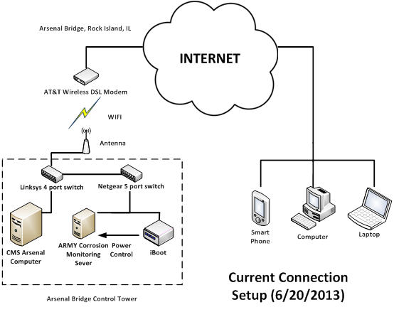
The IPFW/Army CMS’s Networking Subsystem: Failed iBoot Configuration at RIA Bridge
iBoot's IP address is assigned by the AT&T modem (router) with a dynamic IP address.
To ensure iBoot functional properly, a static IP address and a router with port forwarding function, but current AT&T modem (router) does not met either one of those requirement

Slide 23
The IPFW/Army CMS’s Networking Subsystem: Failed iBoot with LogMeIn Hamachi Configuration at RIA Bridge
iBoot with LogMeIn Hamachi VPN – SaaS Cloud service
Assigned a virtual IP address to the CMS which is different than the physical IP address assigned by the router.
Failed

Slide 24
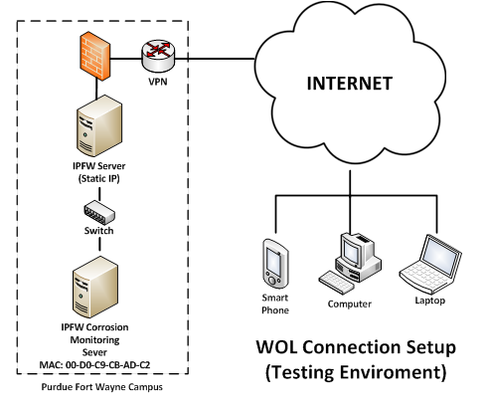
The IPFW/Army CMS’s Networking Subsystem: Tested OK with Wake-On-LAN (WOL) Technology using Magic Packet Configuration at IPFW
But Failed at RIA site
A static IP is required

Slide 25
The IPFW/Army CMS’s Networking Subsystem:
Problems and Tested Solution
Solution Item | Status | Result
Hamachi Virtual VPN software | Tried | Failed due to not able to assign IP to iBoot
iBoot Utility Manager | installed | Successfully installed utility manager, but failed due to no static IP

Slide 26
The IPFW/Army CMS: Second Problem - Unreliable DSL Service
It was found that CMS Data Server was running normally since our previous maintenance work. The logged data with time stamps shows that the Windows XP Embedded was function properly.
Further investigation showed that was the communication failure instead of the system failure. The connection between the AT&T DSL modem and the Linksys 4 port switch was lost therefore all the communication from outside to the CMS had been lost.
2nd maintenance and patched work at the RIA bridge on July 11-12, 2013

Slide 27
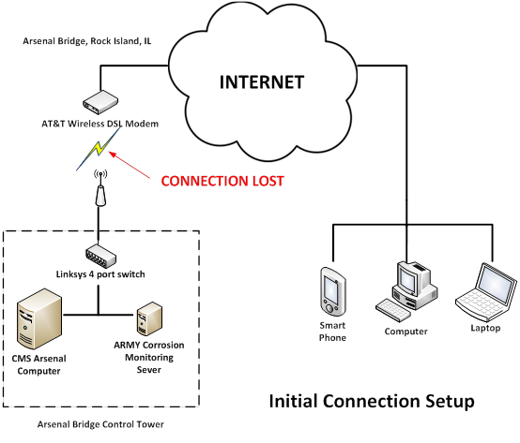
The IPFW/Army CMS: Second Problem - Unreliable DSL Service

Slide 28
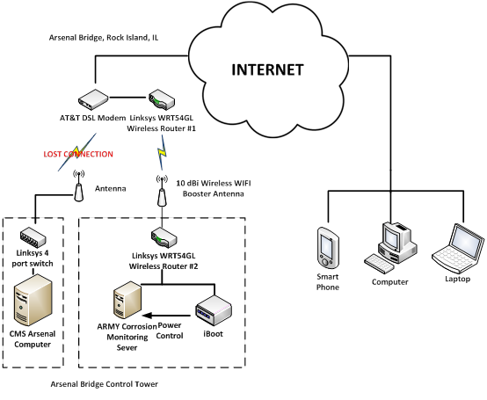
The IPFW/Army CMS: Solution 1 for Unreliable DSL Service
Reroute Internet connection through a 10 dBi wireless WiFi booster antenna and two routers
One works as transmitter, another serves as receiver
Tried but not implemented due to the access control rights to the AT&T DSL router

Slide 29
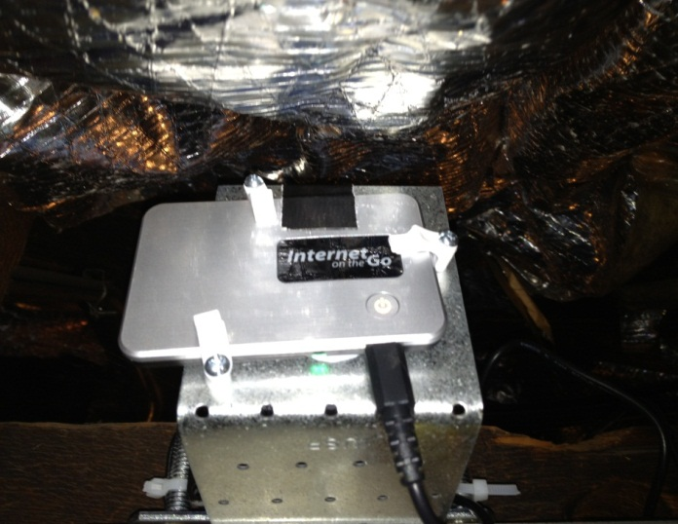
The IPFW/Army CMS: Solution 2 for Unreliable DSL Service
Added a WiFi Hotspot, with AC cooling fan with a thermostat, connected through 3G cellular network

Slide 30
The IPFW/Army CMS Communication Subsystem: Problem 3 – Unstable WiFi Hotspot
Implemented and running OK for almost a month; communication was lost again on Aug. 16, 2013

Slide 31
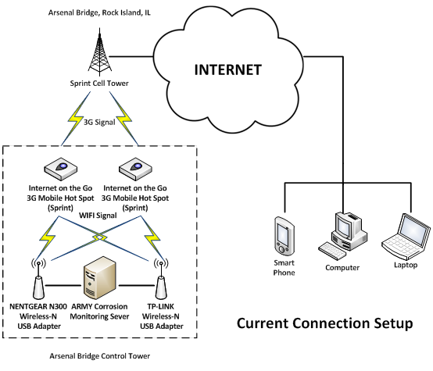
The IPFW/Army CMS Communication Subsystem: Solution to Unstable WiFi Hotspot
Two WiFi hotspots and two USB WiFi adapters were installed and configured.
The system has been running continuously for over two months.

Slide 32
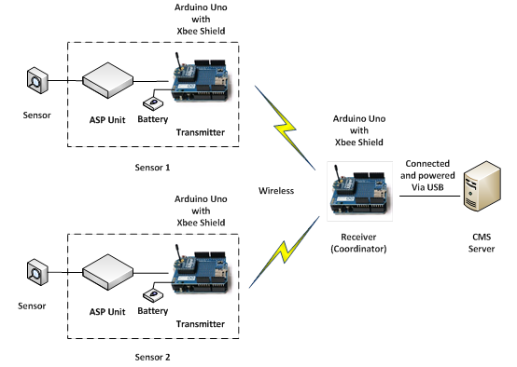
IPFW/Army CMS Communication Subsystem: Additional Improvement in Progress
Improved RS-485 communication between local sensor data nodes to data server through a Zigbee-based Mash Network (Xbee and Arduino microcontroller board

Slide 33
Conclusion
Unreliable networking and communication issues with dynamic IP
Real world solutions implemented
  Support or enable remote Internet-based on/off control of the Windows XP-based embedded data server computer
  Two WiFi Hotspots to support Internet networking and communication without static IP address
Future improvement
  Add a ZigBee-based Mash network and extra DAQs to Improved RS-485 communication reliability and sensor node redundancy

