Slide 1
Micro/Nano Technology Sol-Gel Corrosion Sensor System Project
End of the Project Report
Max Yen, Dong Chen, and Paul Lin
College of Engineering, Technology, and Computer Science
Indiana University-Purdue University Fort Wayne
April 14, 2014

Slide 2
Micro-Nano Technology So-Gel Corrosion Sensor System – End of Project Report
Sol-gel and Cylindrical Sensors
  Sol-gel Sensors: tar-coal epoxy coated and uncoated
  Cylindrical sensor: tar-coal epoxy coated and uncoated
  Sensor Testing and Calibration
Analog Signal Processing Circuits and Printed Circuit Board (PCB)
Corrosion Sensor Modules (Boxes)
Corrosion Monitoring Sensor System (CMS)
Deployment of Sensors and CMS at RIA, IL
Networking and Communication Subsystem
Remote Data Collection using Cloud-based Services
Sensor Data Analysis and Interpretation
Summary and Future Work

Slide 3
1. Sol-Gel and Cylindrical Sensors
Cylindrical Corrosion Sensor

Slide 4
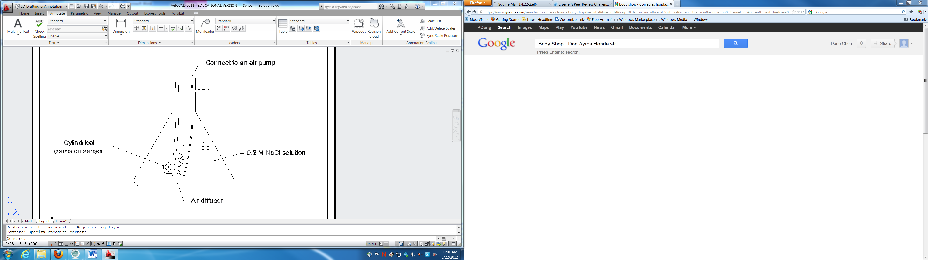
Lab Test of the Corrosion Sensor

Slide 5
Iron Loss of the Cylindrical Sensor due to Corrosion
The iron loss rate and the accumulated iron loss in the solution during the test of the prototype corrosion sensor containing A36 steel in an aerated 0.2 M NaCl solution.

Slide 6
XRD of Iron Rust
XRD patterns of the corroded A36 steel samples. The identified crystals are 1: iron, 2: lepidocrocite, 3: magnetite.

Slide 7
Table. Property of Iron Rust at Ambient Temperature
Materials | α-Fe₂O₃ | γ-FeOOH | Fe₃O₄ | α-FeOOH | amorphous Fe₂O₃ | iron | air
Electrical resistivity ρ (Ω·m) | (1.58-5.62) ×10⁴ [29] | (0.20-0.80) ×10⁵ [30] | 1.58×10⁻⁴ -0.1 [31] | (1.30-2.33) ×10⁵ [30] | 2.12×10³ [32] | 1.0×10⁻⁷ | 4×10¹³
Dielectric constant ε | 12 | 2.6 [33] | 20 | 11 [34] | 4.5 | - | 1
Note: Data are from reference [35] unless otherwise noted.

Slide 8

The Capacitance of the Sensor
$C=\frac{2πε_{0}h∗ε}{\ln\left(\frac{b}{a}\right)}$
where:
C = capacitance (F)
$ε_{0}$ = free space permittivity, 8.85 pF/m
h = height of the cylinder sensor (m)
$ε$ = dielectric constant of the material(s) between the A36 steel rod and the 316 stainless steel ring
b = inner radius of the 316 stainless steel ring (m)
a = radius of the A36 steel rod (m)

Slide 9
Increased Capacitance of the Sensor due to Corrosion
Normalized capacitance in parallel (C/C₀) of the sensors vs. the accumulated time in an aerated 0.2 M NaCl solution.

Slide 10
Decreased Resistance of the Sensor due to Corrosion
Normalized electrical resistance in parallel (R/R₀) of the sensors vs. the accumulated time in an aerated 0.2 M NaCl solution.

Slide 11
Coal Tar Epoxy Coated vs. Not Coated A36 Cylindrical Sensor

Slide 12
Coal Tar Epoxy Coated vs. Not Coated A36 Cylindrical Sensor

Slide 13
Coal Tar Epoxy Coated vs. Not Coated Stainless Steel Cylindrical Sensor

Slide 14
Coal Tar Epoxy Coated vs. Not Coated Stainless Steel Cylindrical Sensor

Slide 15
Salt Fog Test of the A36 Cylindrical Sensor

Slide 16
Salt Fog Test of the Stainless Steel Cylindrical Sensor

Slide 17
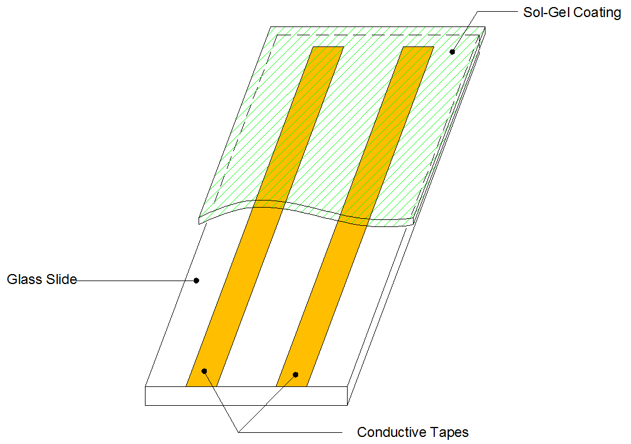
The Diagram of a Sol-Gel Corrosion Sensor

Slide 18
Coal Tar Epoxy Coated vs. Not Coated Sol-Gel Sensor

Slide 19
Coal Tar Epoxy Coated vs. Not Coated Sol-Gel Sensor

Slide 20
Coal Tar Epoxy Coated vs. Not Coated Sol-Gel Sensor

Slide 21
Salt Fog Test of Coal Tar Epoxy Coated Sol-Gel Sensor

Slide 22
2. Analog Signal Processing Circuit and Fabrication of Printed Circuit Boards
Analog Signal Processing Circuits and Printed Circuit Board (PCB):
  Voltage regulator (± 22V DC input; ±15 V DC output)
  1 kHz sine wave generator
  Capacitance-to-voltage conversion
  Precision full-wave rectifier
  Signal amplifier
  Root-mean-square and final signal buffering
  Printed Circuit Board Design and Fabrication

Slide 23
2. Analog Signal Processing Circuit and Fabrication of Printed Circuit Boards
Analog Signal Processing

Slide 24
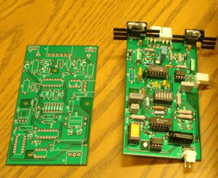
2. Analog Signal Processing Circuit and Fabrication of Printed Circuit Boards
Fabricated PCB Boards and ADMA 4016 ADC

Slide 25
3. Corrosion Sensor Modules (Boxes)
Corrosion Sensor Modules (Boxes):
  Power supply
  RS-485 communication
  Microcomputer with 16-bit ADC (analog-to-digital conversion)
  Sensor Box Packaging with Sensor’s analog signal processing PCB
  Cabling
  Deployment of Six Sensor Boxes

Slide 26
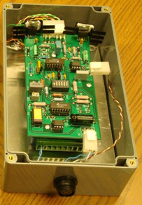
3. Corrosion Sensor Modules (Boxes)
Corrosion Sensor Modules (Boxes):

Slide 27
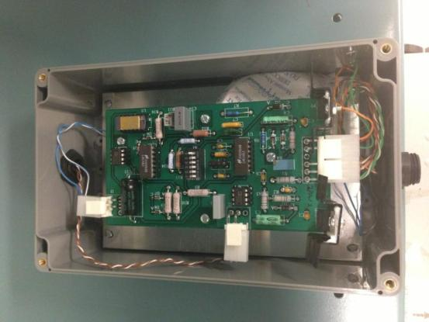
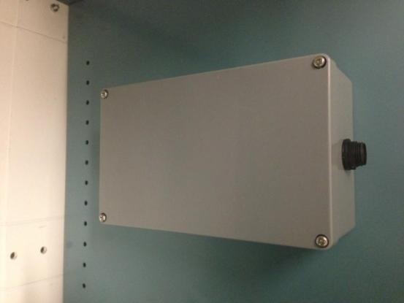
3. Corrosion Monitoring Sensor System
  Six RS485-based Sensor Nodes with 16-bit ADC: Sensor plus Sensor DAC box
Inside view of sensor DAC box
Mounted sensor box with Army S1 to S6 labels on all sides

Slide 28
4. Corrosion Monitoring Sensor System
Corrosion Monitoring Sensor System (CMS)
  Power supply system
  The Central Monitoring Computer (CMC)
    Fanless Embedded Computer, Windows XP OS setup and networking option configuration
    RS485 serial communication: CMS to Sensor Nodes
    Ethernet Ports for Internet communication
  Thermal Electric Cooler: mounted on the front-side of the CMC
  Six RS485-based Sensor Nodes with 16-bit ADC
  Packaging and Cabling
  Software for Polling Sensor Data Processing and Storage

Slide 29
4. Corrosion Monitoring Sensor System

Slide 30
4. Corrosion Monitoring Sensor System
  The Central Monitoring Computer (CMC)
    UNO-2173 AF: Fanless Embedded Computer (Intel Atom N270 1.6 GHz processor), Windows XP OS
    4 x USB 2.0 ports
    RS485 serial communication: CMS to Sensor Nodes
    Ethernet Ports for Internet communication
    Operating temperature range: -20 °C to 70 °C

Slide 31
CMS Wiring Diagram

Slide 32
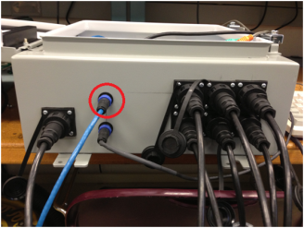
4. Corrosion Monitoring Sensor System
  Packaging and Cabling
Corrosion Sensor
S1 S2 S3
RJ 45
Internet
Power Cable
Corrosion Sensor
S4 S5 S6

Slide 33
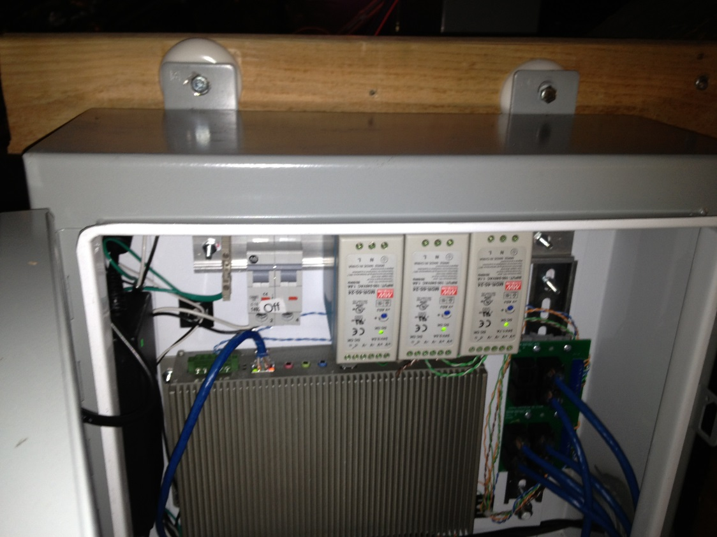
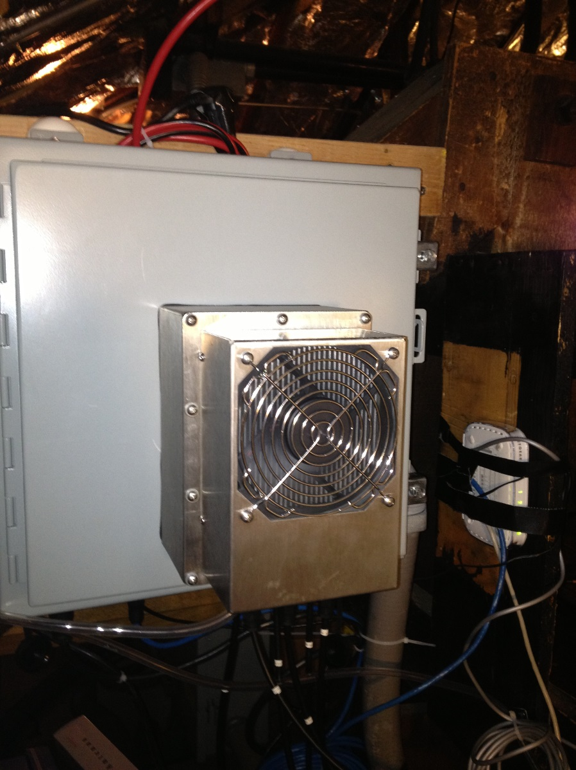
4. Corrosion Monitoring Sensor System – Installation (May 2013)
Power Supplies
Thermal Electric Cooler
(200 BTU)
Central Monitoring Computer (Windows XP, embedded)
Six Sensor Connection Suckets and Cabling

Slide 34
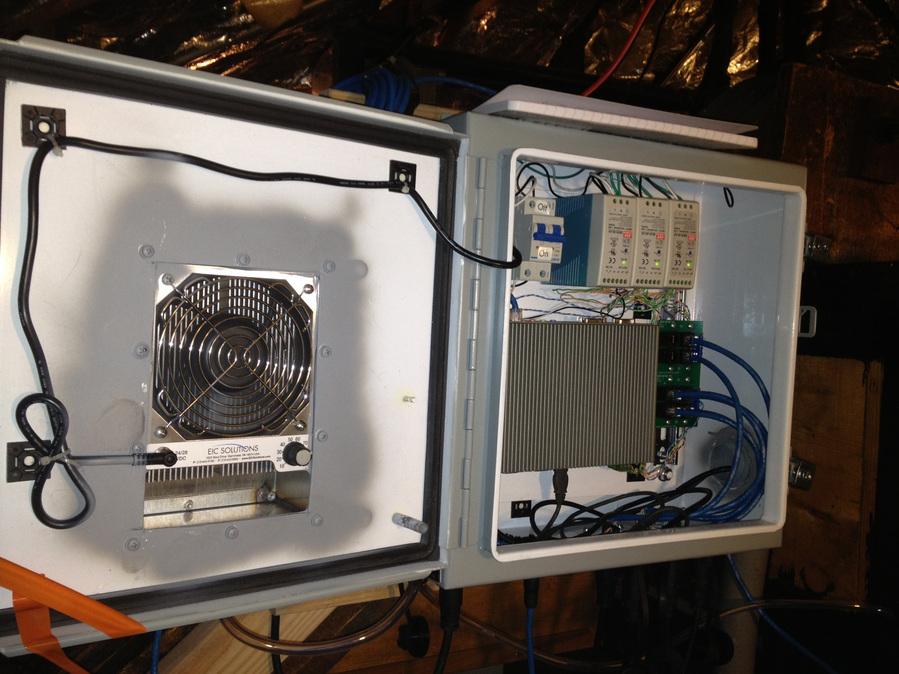
4. Corrosion Monitoring Sensor System Installation – May 2013
Power Supplies
Thermal Electric Cooler
Six Sensor Connection Sockets and Cabling
Central Monitoring Computer (Windows XP, embedded)

Slide 35
4. Corrosion Monitoring Sensor System
Server Scripts/Programs
CMS sensor data polling program
  Every 30 minute, read sensors capacitance value: S1,… S6
  Add time stamps
  Store sensor data S1, … S6
Sensor node control, data access
Remote access to the CMS through a secured web client

Slide 36
5. Deployment and Testing of Sensors at RIA Bridge, IL
Sensor #1 (coal tar epoxy coated sol-gel sensor)
Sensor # 2 (coal tar epoxy coated sol-gel sensor)
Sensor #3 (sol-gel sensor)
Sensor #4 (sol-gel sensor)
Sensor #5 (stainless steel cylindrical sensor, coal-tar epoxy coated) Sensor #6 (A36 cylindrical sensor, coal-tar epoxy coated)

Slide 37
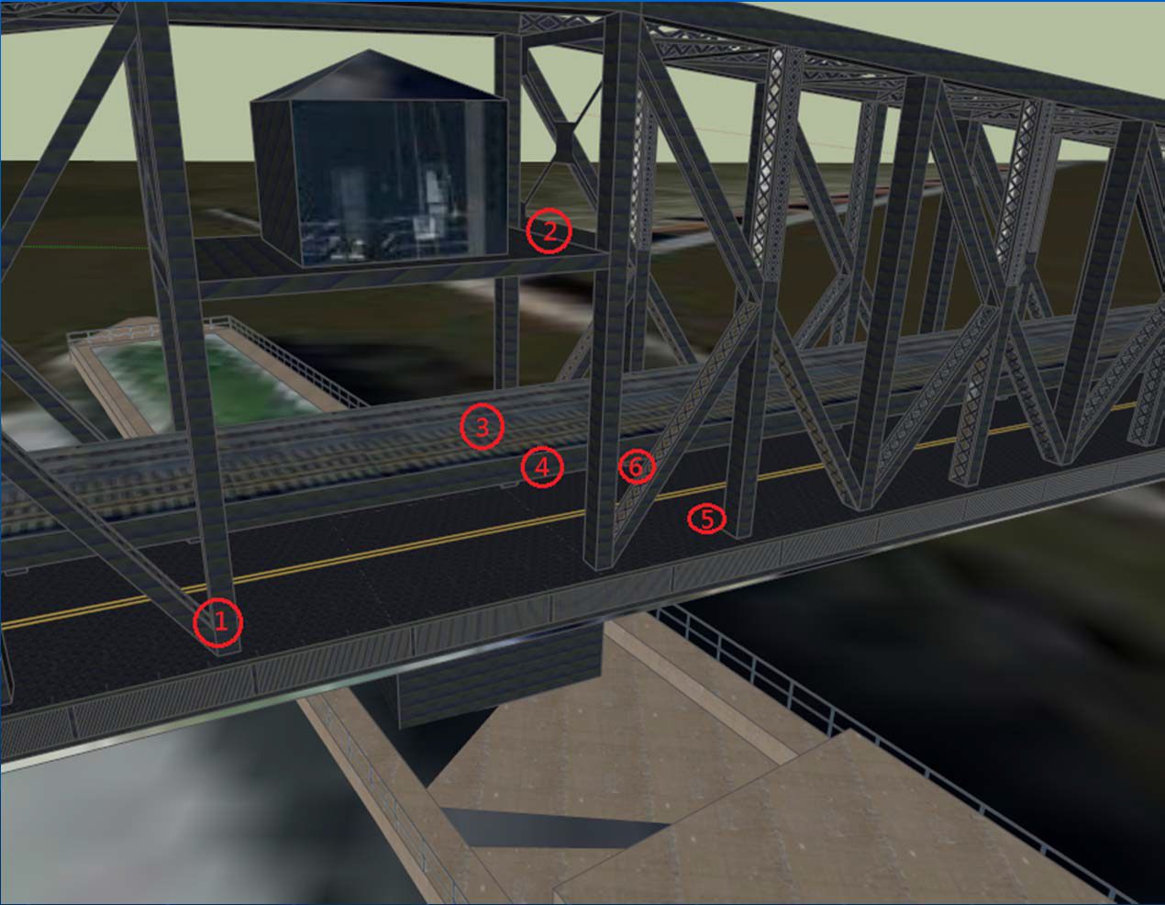
Sensor Locations on the Government Bridge

Slide 38
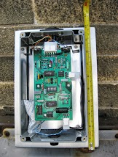
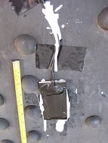
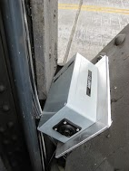
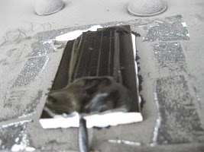
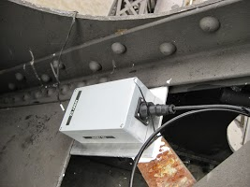
5. Deployment and Testing of Sensors at RIA Bridge, IL
Sensor #1 (coal tar epoxy coated sol-gel sensor) at the lower car deck (31 inches above the deck, 2 ft above the car deck level, on the west side of the bridge)
  Sensor #1 Sensor DAQ Box #1 Box#1 (before installation)
Sensor # 2 (coal tar epoxy coated sol-gel sensor) at the top of bridge control room (mounted on the vertically – south side)
Sensor #2 Sensor DAQ Box#2

Slide 39
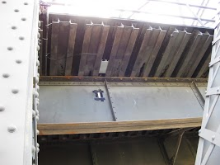
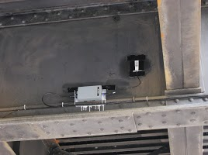
5. Deployment and Testing of Sensors at RIA Bridge, IL
Sensor #3 (sol-gel sensor) on the ceiling of the car deck, or below train deck (west side)
  Sensor #3 and Sensor DAQ Box#3
Sensor #4 (sol-gel sensor) on the ceiling of the car deck, or below train deck (east side)
  Sensor #4 and
  Sensor DAQ Box#4

Slide 40
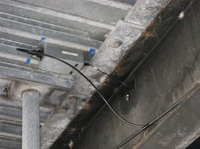
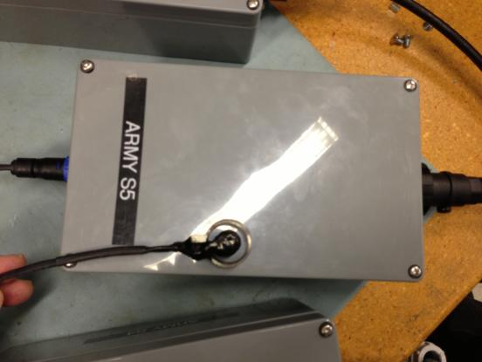
5. Deployment and Testing of Sensors at RIA Bridge, IL
Sensor #5 Cylindrical Sensor (316 stainless steel cylindrical rod and ring, coal-tar epoxy coated) under the car deck (west side)
  Sensor #5 and Sensor DAQ Box#5

Slide 41
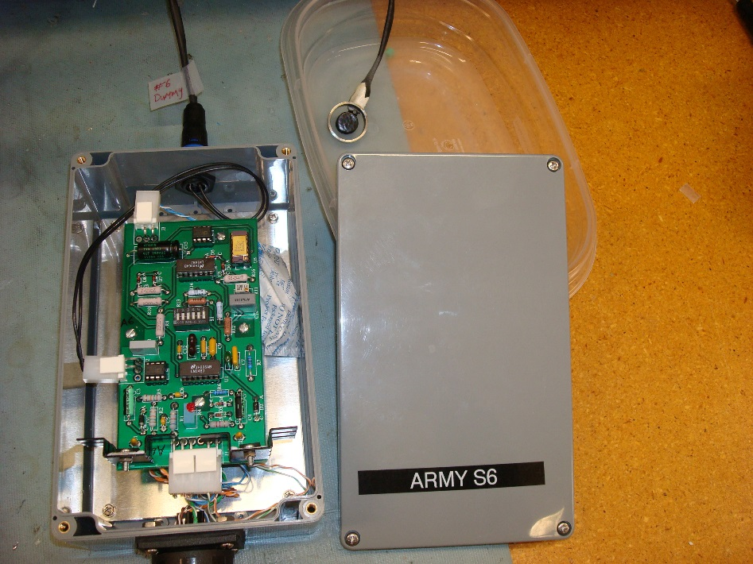
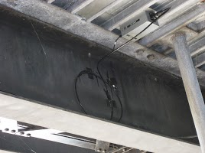
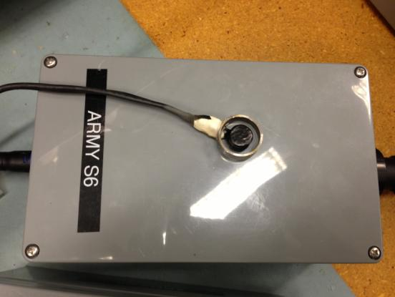
5. Deployment and Testing of Sensors at RIA Bridge, IL
Sensor #6 Cylindrical Sensor (A36 cylindrical rod sensor, stainless steel outer ring, coal-tar epoxy coated) under the car deck (east side).

Slide 42
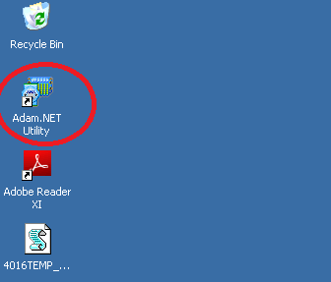
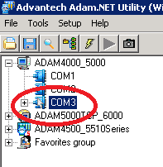
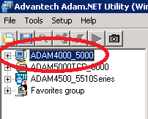
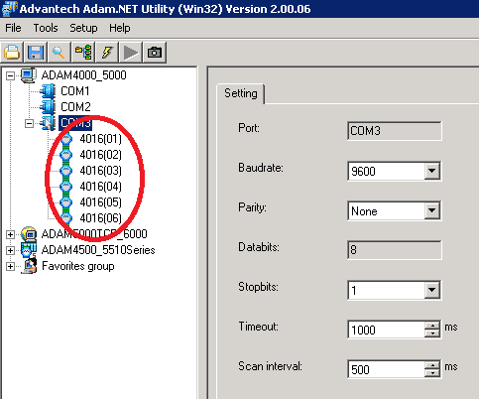
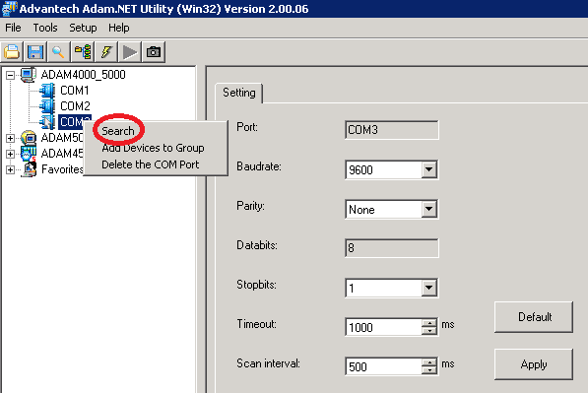
5. Deployment and Testing of Sensors at RIA Bridge, IL
Testing RS 485 Communication Link from CMS to ADAM 4016 DAC Module

Slide 43
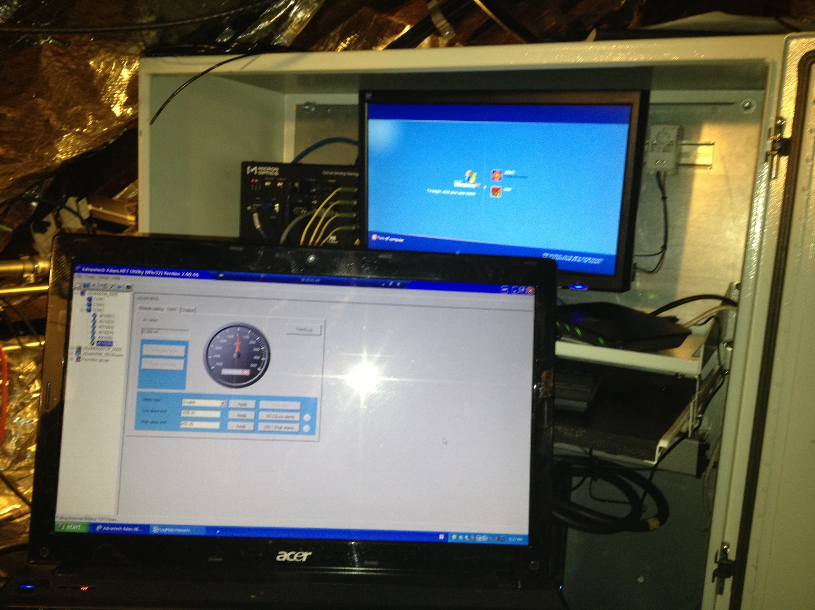
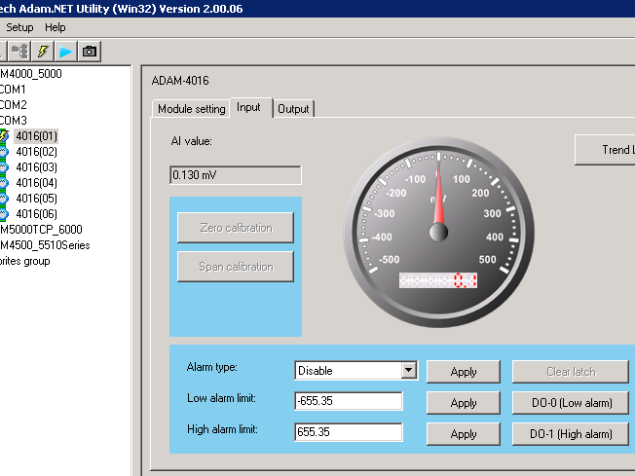
5. Deployment and Testing of Sensors at RIA Bridge, IL
Initial Testing of Deployed Sensors using ADAM Utility & Spraying Water on Sensors

Slide 44
6. Networking and Communication Subsystem (for Transporting Sensor Data)
Networking and Communication Subsystem
  Fanless PC ⬄ Two Ethernet
  Two RJ 45 Ethernet Ports ⬄ Two Wireless N USB Adapters
  Two Wireless N USB Adapters (no Fixed IPs) ⬄ Two WiFi Hotspots (3G)
  3G Cellular Carrier Tower ⬄ Internet

Slide 45
6. Networking and Communication Subsystem
Internet Remote Access using LogMeIn, through Hamachi Virtual VPN managed by Chandler. (tried but failed)

Slide 46
6. Networking and Communication Subsystem
Wi-Fi Hotspot for Internet Remote Accessing to the CMS (not reliable, failed a couple times)

Slide 47
6. Networking and Communication Subsystem
Redundant WiFi Hotspots and LAN Adapters

Slide 48
6. Networking and Communication Subsystem
Redundant WiFi Hotspots and LAN Adapters

Slide 49
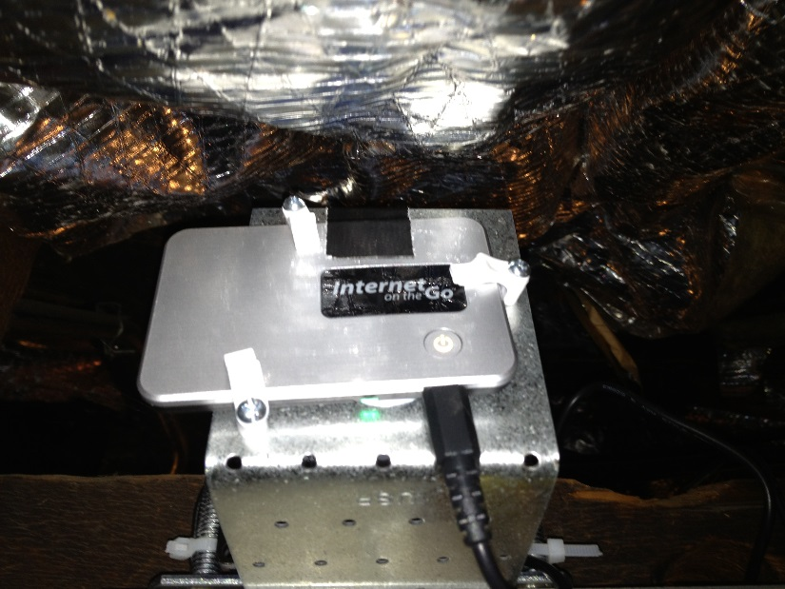
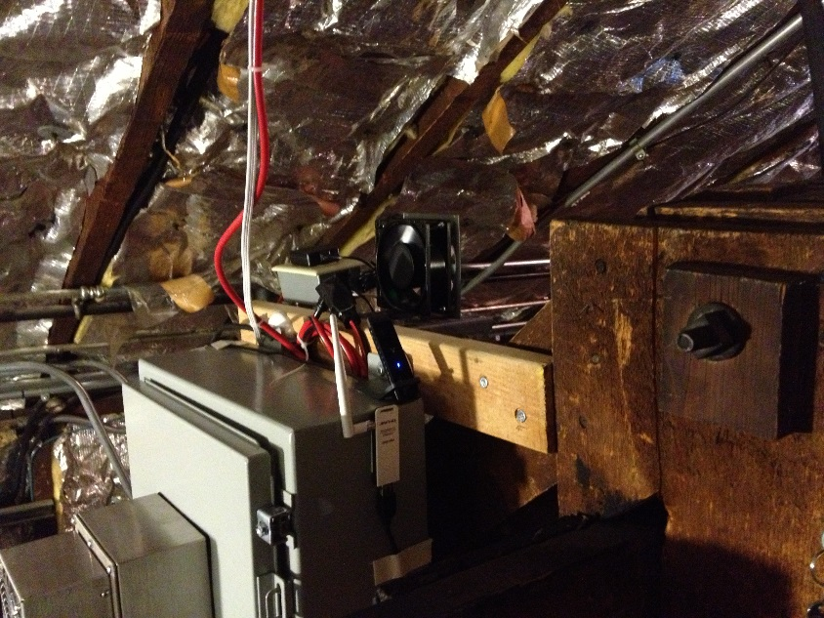
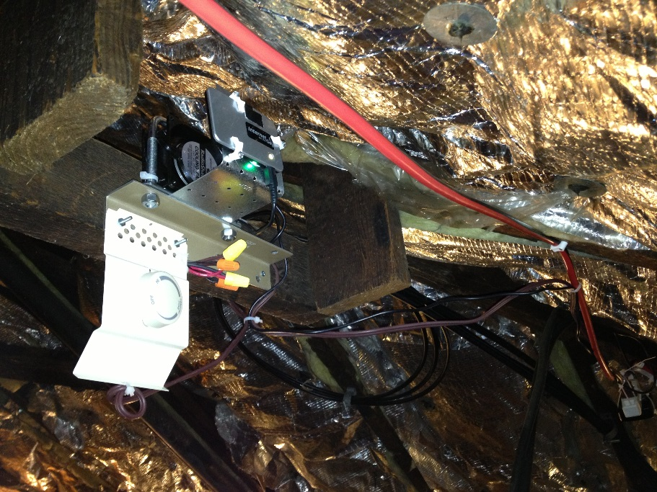
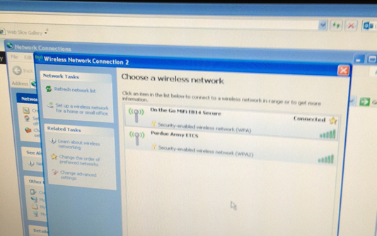
Redundant WiFi Hotspots and USB LAN Adapter
1st WiFi HotSpot
2nd WiFi HotSpot
Cooling Fan & Thermal Stat
2 WiFi HotSpot ⬄ Computer Side Wireless LAN Adapter

Slide 50
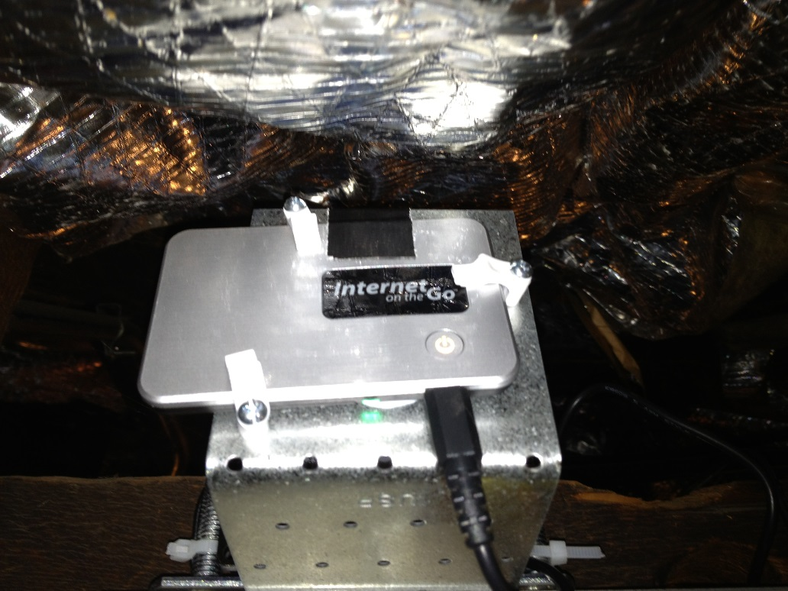

6. Networking and Communication Subsystem

Slide 51
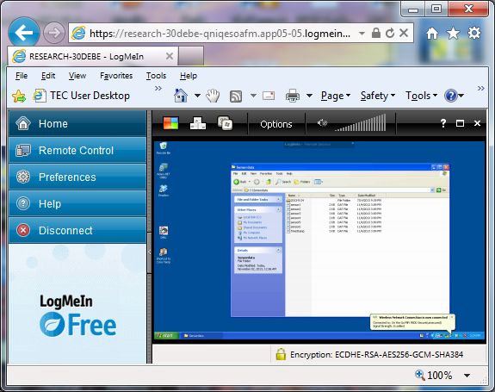
7. Sensor Data and Remote Data Collection
Data Collection and Storage
  Data saved (every 30 minutes) at the CMS system located at RIA bridge
Cloud-based Remote Access: LogMeIn
Move data to Cloud-based Data Store: Drop Box

Slide 52
7. Sensor Data and Remote Data Collection
b) Cloud-based Remote Access: LogMeIn

Slide 53
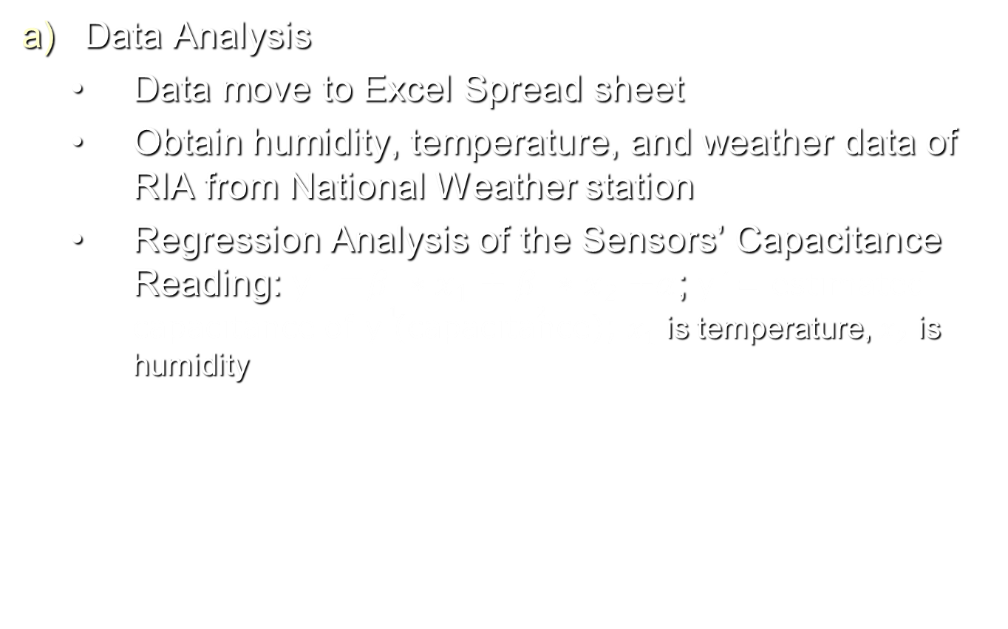
8. Sensor Data Analysis and Interpretation
Data Analysis
  Data move to Excel Spread sheet
  Obtain humidity, temperature, and weather data of RIA from National Weather station
  Regression Analysis of the Sensors’ Capacitance Reading: y´=$β_{1}∗x_{1}+β_{2}{∗x}_{2}+α$; y´= estimated capacitance of y (capacitance); $x_{1}$ is temperature, $x_{2}$ is humidity

Slide 54
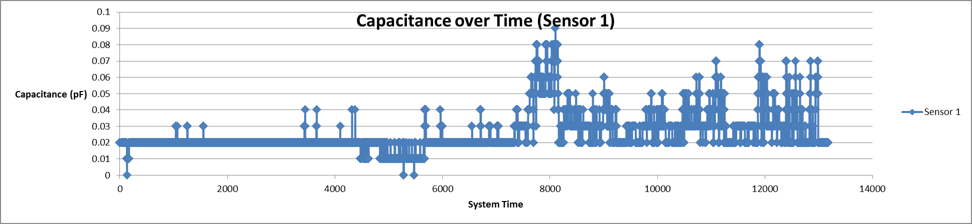
Capacitance of Sensor #1 (Coated Sol-Gel at the Car Deck Level)

Slide 55
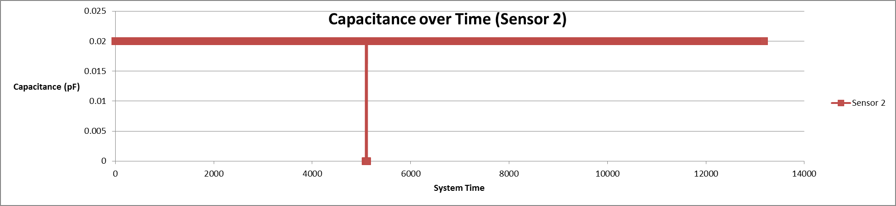
Capacitance of Sensor #2 (Coated Sol-Gel outside the Control Room)

Slide 56
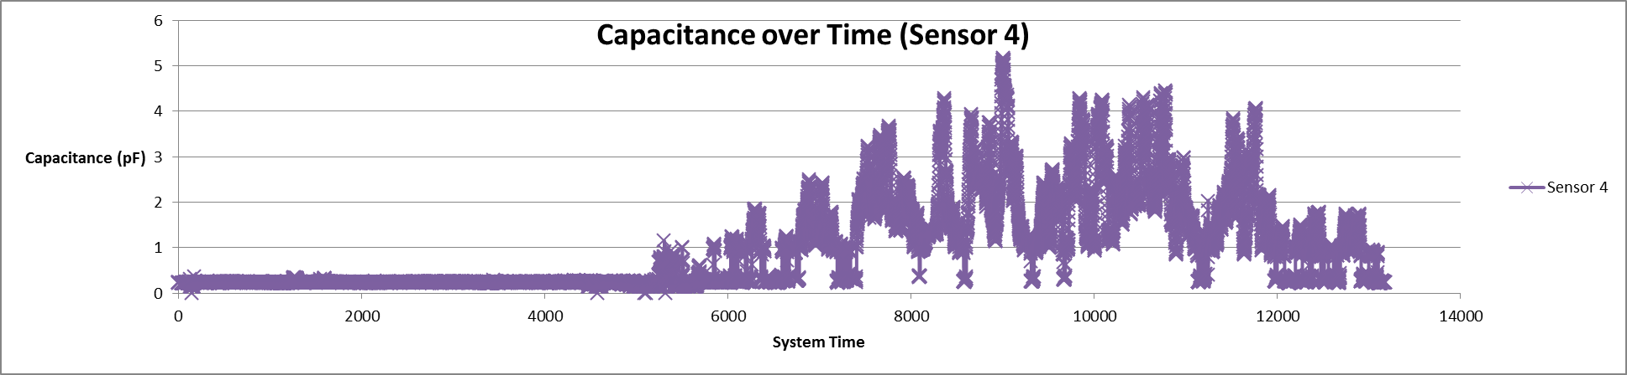
Capacitance of Sensor #4 (Uncoated Sol-Gel on the Ceiling of the Car Deck)

Slide 57
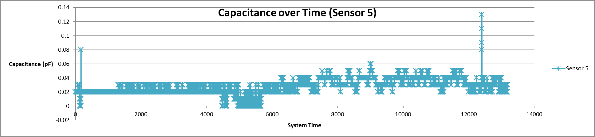
Capacitance of Sensor #5 (Coated Stainless Steel Cylindrical Sensor Under the Car Deck)

Slide 58
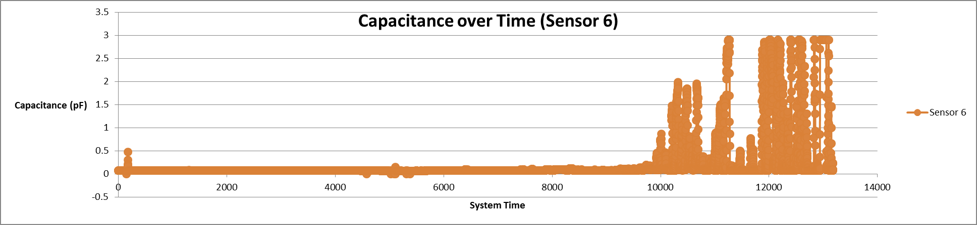
Capacitance of Sensor #6 (Coated A36 Cylindrical Sensor Under the Car Deck)

Slide 59
Data Interpretation
The proposed formula is:
Capacitance = β₁*Temp + β₂*Moisture + β₃*Corrosion index + constant,
where β₁, β₂ and β₃ are coefficients.
Temp and moisture data are collected along with the capacitance readings.
Dummy or reference sensors help to draw the baseline, including temp, moisture and surface fouling.
Corrosion index is evaluated in lab tests, such as soaking in aerated NaCl solution and salt fog chamber.
Multi-regression analysis is being conducted.

Slide 60
Primary Conclusions
Corrosion triggered higher capacitance reading of the sensors, including both cylindrical and sol-gel sensors.
Coating of coal tar epoxy decreased the capacitance of the sensors. This suggests that deterioration of the coating would increase capacitance, which is in consistence with the corrosion effect on capacitance.
Moisture had much bigger impact on capacitance than temperature. Greater capacitance occurred at higher moist level.

Slide 61
9. Summary and Future Work
1) Improved Internet and remote CMS system accessibility with at least one dedicated static IP address to provide better remote system access and maintenance support.
2) Improved Wireless Sensor Nodes and Networks to enhance the system reliability
3) Additional local temperature and humidity data collection

Slide 62
9. Summary and Future Work
Improved Wireless Sensor Nodes and Networks to enhance the system reliability
Wired star network: RS-485, Wireless Mesh Network

Slide 63
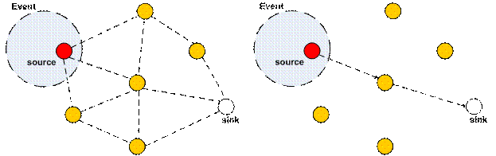
9. Summary and Future Work
Improved Wireless Sensor Nodes and Networks to enhance the system reliability
  Redundant measurement using an extra wireless sensor node running ZigBee sensor network protocol
  Mesh sensor network to provide maximum recheability and data routing for each sensor

Slide 64
9. Summary and Future Work
Wireless Sensor Nodes and Networks to enhance the system reliability

Slide 65
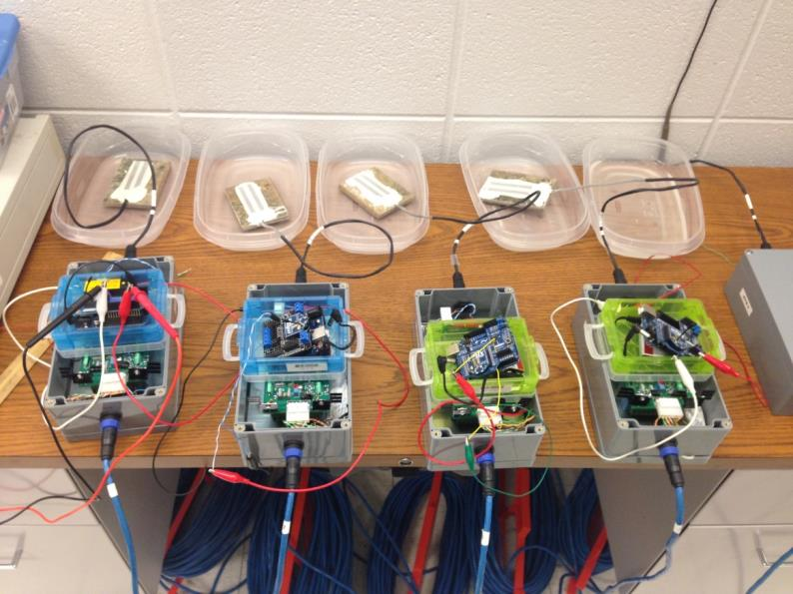
9. Summary and Future Work
Experimental Testing of Wireless Sensor Nodes and Networks to enhance the system reliability

Slide 66
9. Summary and Future Work
Experimental Testing of Wireless Sensor Nodes and Networks to enhance the system reliability

Slide 67
9. Summary and Future Work
Experimental Testing of Wireless Sensor Nodes and Networks to enhance the system reliability

Slide 68
9. Summary and Future Work
Experimental Testing of Wireless Sensor Nodes and Networks to enhance the system reliability

