Slide 1
Wired and Wireless Sensor Networks for Bridge Health Monitoring
Paul I. Lin, MengWei Li, Bob Tilbury, Max Yen, and Dong Chen
College of Engineering, Technology, and Computer Science
Indiana University-Purdue University Fort Wayne
Room ET 346
April 22, 2014

Slide 2
Wired and Wireless Sensor Networks for Bridge Health Monitoring
Introduction to Army CERL Sponsored “Micro/Nano Technology Sol-Gel Corrosion Sensor System – Corrosion Monitoring”
Sol-gel and Cylindrical Corrosion Sensors
Sensor Networks Technology: Wired and Wireless
The Corrosion Monitoring System with Wired Sensor Nodes
Experimental Testing of Second Generation CMS with Wired and Wireless Sensor Nodes
Summary and Future Work

Slide 3
Introduction
The project: “Micro-Nano Technology Sol-Gel Corrosion Monitoring System,” 2011-2013
  Project sponsor: Army Construction Engineering Research Laboratory, IL: Richard Lampo and Michael McInerney
  Project Team
    Principal Investigator: Max S. Yen
    Co-Pis: Paul I-Hai Lin and Dong Chen
    Graduate Students: MengWei Li, Robert Tilbury, Muhammad Shoaib Mansur
    Undergraduate EE Student: Steve Groff

Slide 4
Introduction (continue)
The Accomplishments
  “Examination of Corrosion on Steel Structures by Innovative Nano Sol-Gel Sensors,” by Max Yen, Dong Chen, Paul Lin, Bakul Dave, Steve Groff, Emily Hauter, Richard Lampo, and Michael McInerney, NCAE 2012 Corrosion Conference, to be held on March 11-15, 2012, Salt Lake City, Utah
  “Corrosion Sensor for Monitoring Early-Stage Environmental Corrosion of Steel Structure,” Dong Chen, Max yen, and Paul Lin, U.S. Provisional Patten Application #61763523, Feb. 2013
  “Micro-Nano Technology Sol-Gen Corrosion Monitoring System,” New Tech Showcase Demo & Presentation, Indiana University-Purdue University Fort Wayne, April 24, 2013.
  “A Corrosion Monitoring System for Early-Stage Warming of Environmental Corrosion of Structures and Infrastructures,” Technology Showcase, at 2013 Taipei International Invention Show & Technomart, Sept. 26-29, 2013.

Slide 5
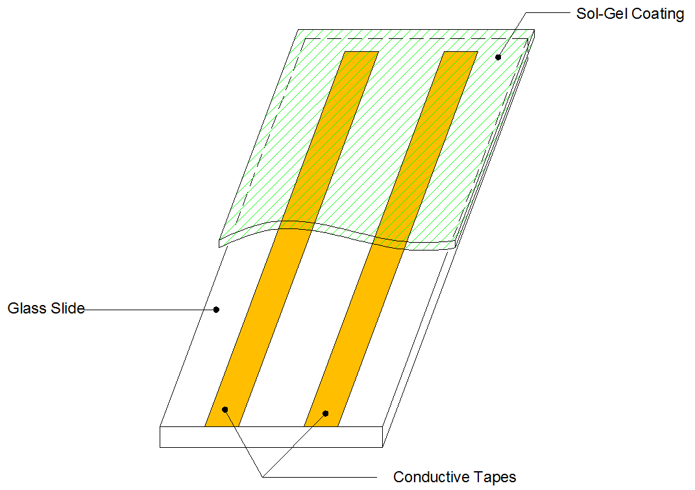
2. Sol-Gel and Cylindrical Corrosion Sensors
Cylindrical Corrosion Sensor:
A Sol-Gel Corrosion Sensor (Capacitive Type)

Slide 6
2. Sol-Gel and Cylindrical Corrosion Sensors: Cylindrical Corrosion Sensor (Capacitive Type)

Slide 7
3. Sensor Network Technology: Wired and Wireless
Definition of Sensor Network
  An infrastructure includes sensing, computing, and communication elements to provide the ability to instrument, observe and react to events and phenomena in a specific environment [1].
  Communication Element: Wired/Wireless
Physical Signal Sources
  Electromagnetic radiation signals: radio and light
  Optical, acoustic , seismic, acceleration, strain, vibration signals
  Chemical and biochemical signals
  Environmental signals: light, temperature, humidity, barometric

Slide 8
3. Sensor Network: Wired and Wireless
Wireless Sensor Network (WSN) Applications
  Industrial Monitoring, Control, Automation;
  Building Automation
  Home Automation and Consumer Electronics
  Security and Military Sensing
  Asset Tracking and Supply Chain Management
  Intelligent Agriculture and Environmental Sensing
  Health and Medical Monitoring
  Critical Infrastructure Monitoring, Protection and Security

Slide 9
3. Sensor Network: Wired and Wireless
Wireless Sensor Network (WSN) Architecture
  Application Dependent: network sensor nodes, gateway node, data sources and sinks
  Network Topologies and Routing Algorithms
    Single-hop vs. multi-hop networks
    Mobility consideration
    Network lifetime
    Scalability
    Protocols
  Energy Efficiency and Management
  Network Management
  Data Management
  Security and Data Integrity

Slide 10
3. Sensor Network: Wired and Wireless
Wireless Sensor Network (WSN) Architecture
  Network Topologies and Routing
    Star Network: One master node, multiple slave nodes
      One master node- synchronization and channel access
      Multiple slave sensor nodes
      Examples: Bluetooth, 802.11b “WiFi”
    Ring and Tree Network
      Cellular and paging system
      Base stations are connected using wired network
    Ad Hoc Networks
      Multiple-hops path relaying data from user-to-user to reach data receiver
      May form clustered and overlay network
    Mesh Network: Multi-hop, multi-path

Slide 11
3. Sensor Network: Wired and Wireless
Sensor Node Platform Selection Criteria
  Hardware:
  Software:
  Programming Language Tools
  Industrial Standard
  Protocols
  Other Features

Slide 12
3. Sensor Network: Wired and Wireless
Sensor Node Platforms
  Microcontroller: TI MSP430-based, Atmel ATmega, IntelPXA255, etc
  Memory: Program and Data
  Interface (USB/Serial/WiFi/Ethernet)
  ADC and Digital I/O
  Transceiver (802.15.4-compliant, others)
    XBee
    TI CC2420
  Wireless Communication
    License-free frequencies
    433, 868-915 MHz, and2.4 GHz

Slide 13
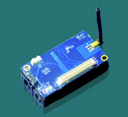
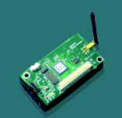
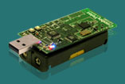
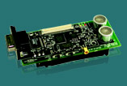
3. Sensor Network: Wired and Wireless
Commercially Available SNA Nodes (www.memsic.com)
IRIS node
MICAz/MICA2
TelosB
Cricket

Slide 14
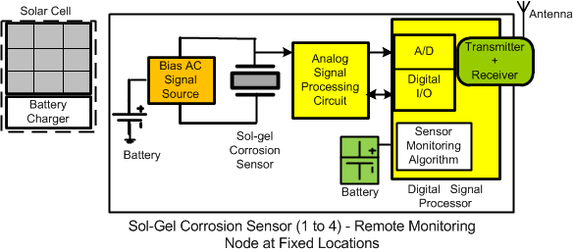
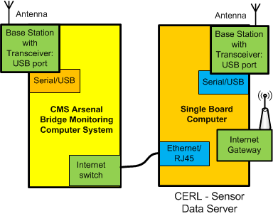
4. Corrosion Monitoring Sensor System: System Architecture I with Wireless Sensor Node

Slide 15
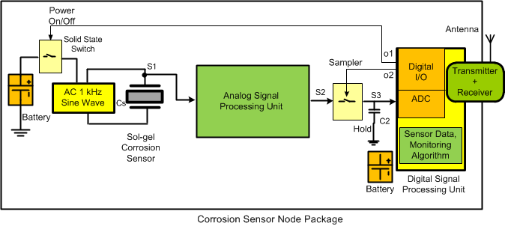
4.1 Remote Corrosion Sensor Node Design

Slide 16
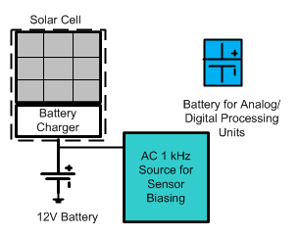
4.2 Remote Corrosion Sensor Node
(Power Source Subsystem)
Solar power panel and control (20 W)
DC battery power source (12 V 37 AH)
Power Source Requirement (~ 5 W)
  Sol-Gel sensor bias AC signal source (sine wave)
  RF power source requirement estimation (1 W)
  Sol-gel sensor power requirement (1 W)
  Analog signal processing unit power requirement (0.5 W)
  Digital signal processor (0.5 W)

Slide 17
4.3 Corrosion Monitoring Sensor System: System Architecture II with Wired Star Topology using RS 485 Serial Communication

Slide 18
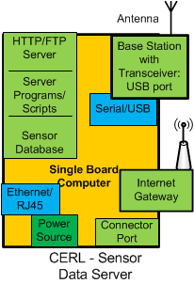
4.5 Corrosion Monitoring System – Base Station
Faneless Industrial Computer
  HTTP Web server
  FTP file server
  Sensor data storage
  Server scripts/programs
  Data manipulation programs
Internet Gateway
  Remote system
  Web client
USB – WiFi wireless adapter
RS 485, 232 Serial interface

Slide 19
4.5 Corrosion Monitoring Sensor System
(continue)
Corrosion Monitoring Sensor System (CMS)
  Power supply system
  The Central Monitoring Computer (CMC)
    Fanless Embedded Computer, Windows XP OS setup and networking option configuration
    RS485 serial communication: CMS to Sensor Nodes
    Ethernet Ports for Internet communication
  Thermal Electric Cooler: mounted on the front-side of the CMC
  Six RS485-based Sensor Nodes with 16-bit ADC
  Packaging and Cabling
  Software for Polling Sensor Data Processing and Storage

Slide 20
4.4 Analog Signal Processing Circuit and Fabrication of Printed Circuit Boards
Analog Signal Processing (ASP)

Slide 21
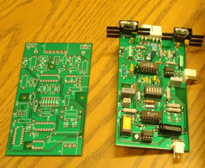
4.6. Analog Signal Processing Circuit and Fabrication of Printed Circuit Boards
Fabricated PCB Boards and ADMA 4016 ADC

Slide 22
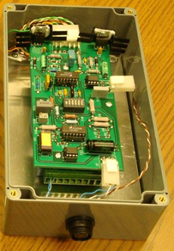
4.7 Corrosion Sensor Modules (Boxes)
Corrosion Sensor Modules (Boxes):
  Power supply
  RS-485 communication
  Microcomputer with 16-bit ADC (analog-to-digital conversion)
  Sensor Box Packaging with Sensor’s analog signal processing PCB
  Cabling

Slide 23
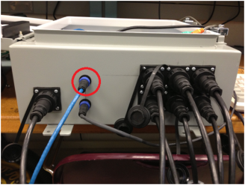
4.8 Corrosion Monitoring Sensor System
  Packaging and Cabling
Corrosion Sensor
S1 S2 S3
RJ 45
Internet
Power Cable
Corrosion Sensor
S4 S5 S6

Slide 24
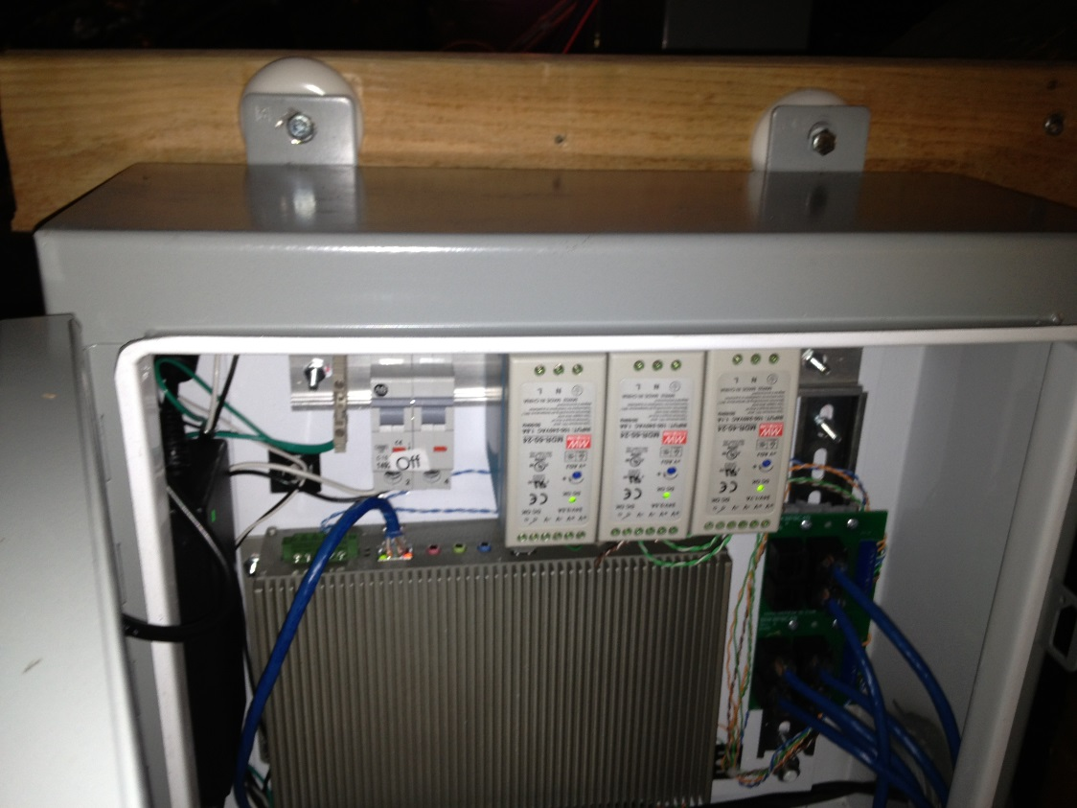
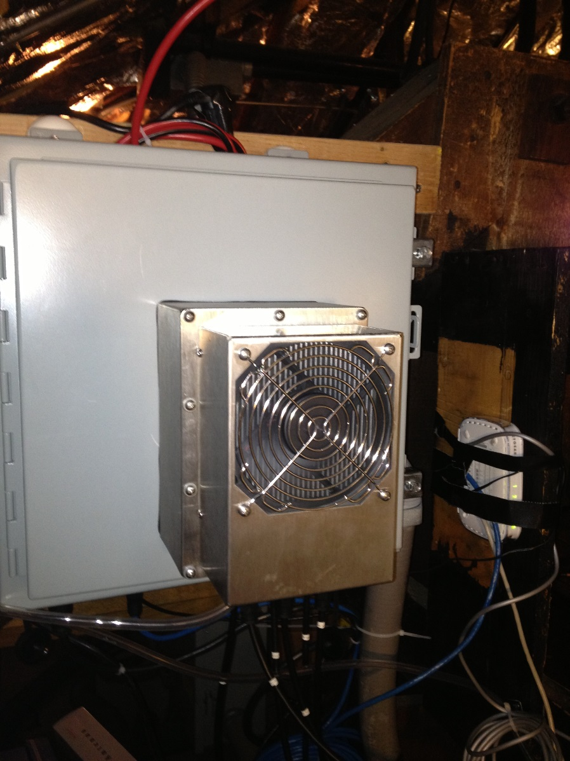
4.8 Corrosion Monitoring Sensor System – Installation (May 2013)
Power Supplies
Thermal Electric Cooler
(200 BTU)
Central Monitoring Computer (Windows XP, embedded)
Six Sensor Connection Suckets and Cabling

Slide 25
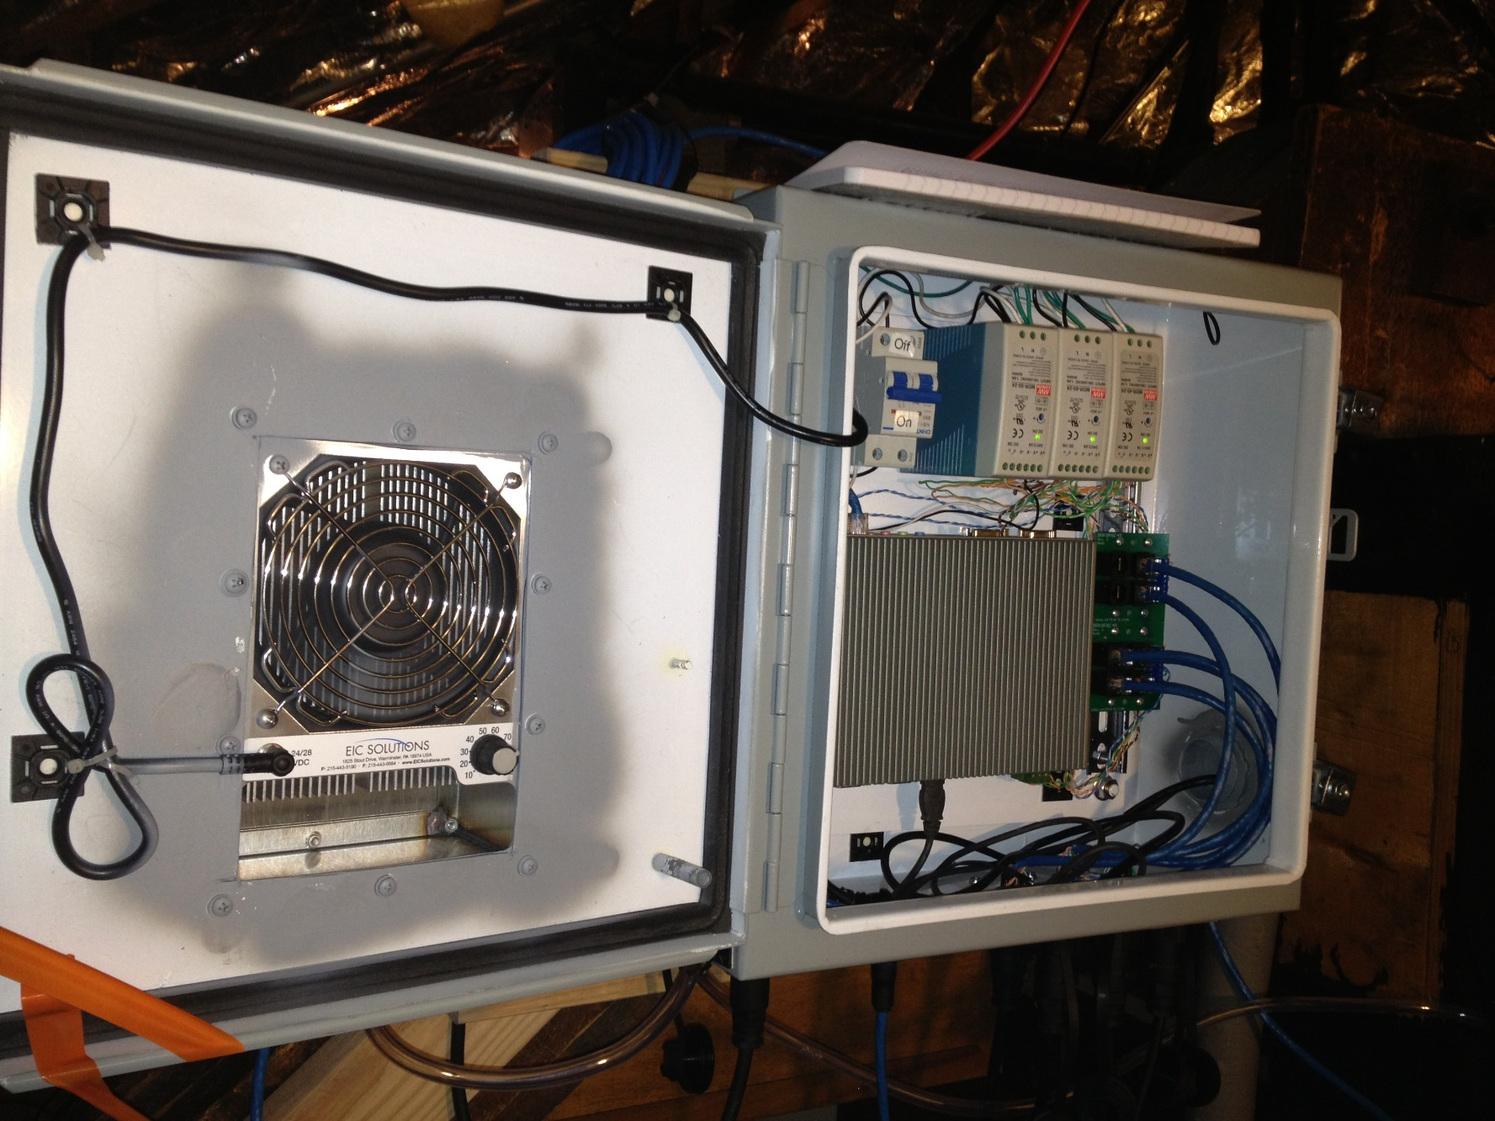
4.8 Corrosion Monitoring Sensor System Installation – May 2013
Power Supplies
Thermal Electric Cooler
Six Sensor Connection Sockets and Cabling
Central Monitoring Computer (Windows XP, embedded)

Slide 26
4.9 Deployment and Testing: Corrosion Sensors and Wired Sensor Network at RIA Bridge, IL
Sensor #1 (coal tar epoxy coated sol-gel sensor)
Sensor # 2 (coal tar epoxy coated sol-gel sensor)
Sensor #3 (sol-gel sensor)
Sensor #4 (sol-gel sensor)
Sensor #5 (stainless steel cylindrical sensor, coal-tar epoxy coated) Sensor #6 (A36 cylindrical sensor, coal-tar epoxy coated)

Slide 27
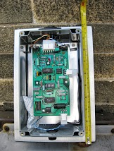
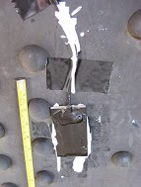
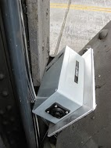
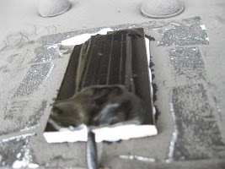
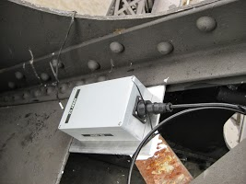
4.9 Deployment and Testing:
Corrosion Sensors at RIA Bridge, IL
Sensor #1 (coal tar epoxy coated sol-gel sensor) at the lower car deck (31 inches above the deck, 2 ft above the car deck level, on the west side of the bridge)
  Sensor #1 Sensor DAQ Box #1 Box#1 (before installation)
Sensor # 2 (coal tar epoxy coated sol-gel sensor) at the top of bridge control room (mounted on the vertically – south side)
Sensor #2 Sensor DAQ Box#2

Slide 28
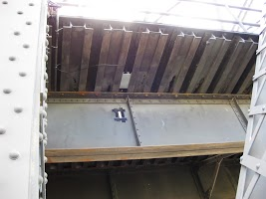
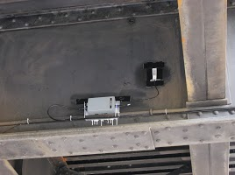
4.9 Deployment and Testing:
Corrosion Sensors at RIA Bridge, IL
Sensor #3 (sol-gel sensor) on the ceiling of the car deck, or below train deck (west side)
  Sensor #3 and Sensor DAQ Box#3
Sensor #4 (sol-gel sensor) on the ceiling of the car deck, or below train deck (east side)
  Sensor #4 and
  Sensor DAQ Box#4

Slide 29
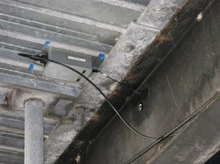
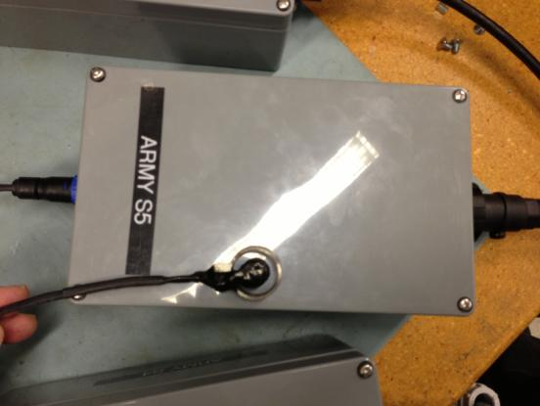
4.9 Deployment and Testing:
Corrosion Sensors at RIA Bridge, IL
Sensor #5 Cylindrical Sensor (316 stainless steel cylindrical rod and ring, coal-tar epoxy coated) under the car deck (west side)
  Sensor #5 and Sensor DAQ Box#5

Slide 30
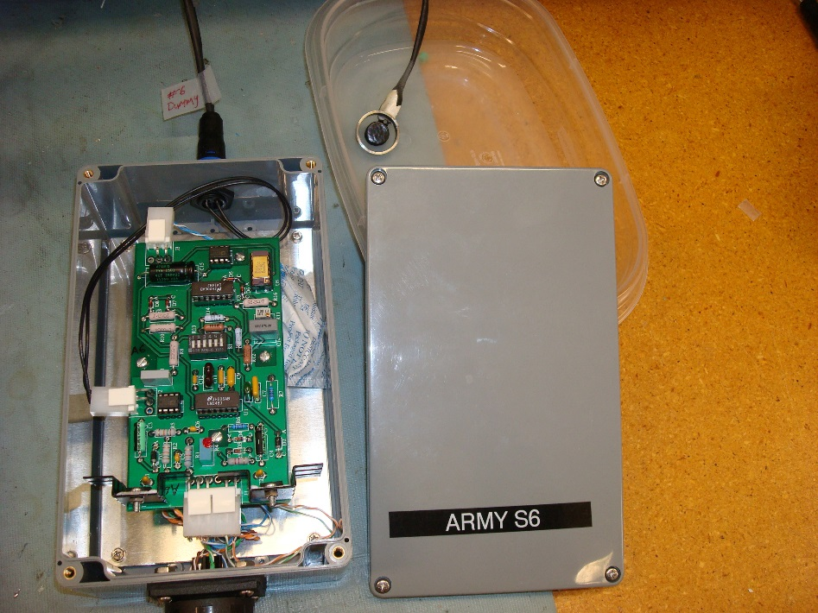
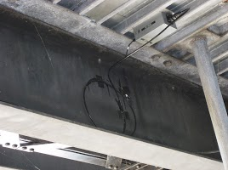
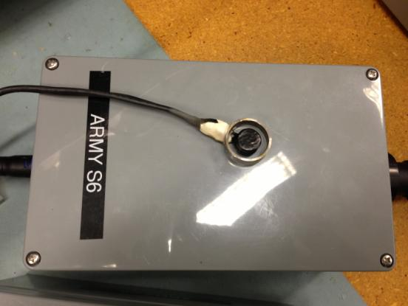
4.9 Deployment and Testing:
Corrosion Sensors at RIA Bridge, IL
Sensor #6 Cylindrical Sensor (A36 cylindrical rod sensor, stainless steel outer ring, coal-tar epoxy coated) under the car deck (east side).

Slide 31
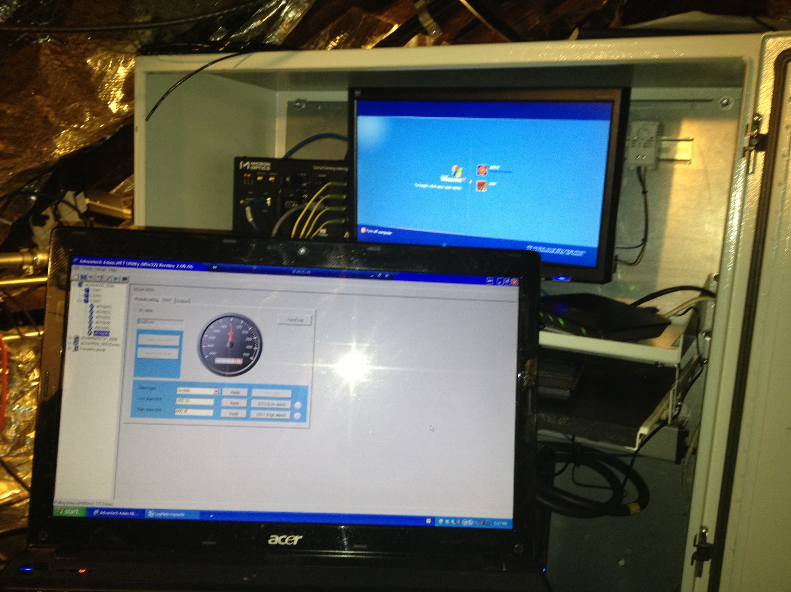
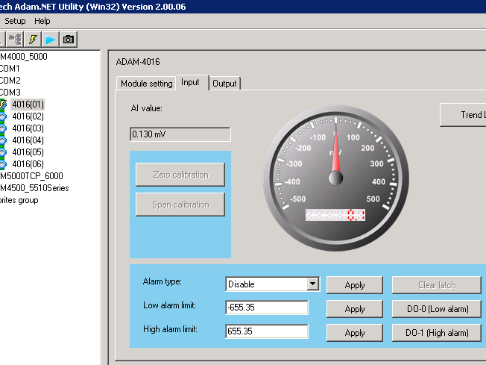
4.10 Testing of CMS with Sensor Nodes and Wired Sensor Network, RIA Bridge, IL
Initial Testing of Deployed Sensors using ADAM Utility & Spraying Water on Sensors

Slide 32
4.11 CMS Networking and Communication Subsystem
Redundant WiFi Hotspots and LAN Adapters

Slide 33
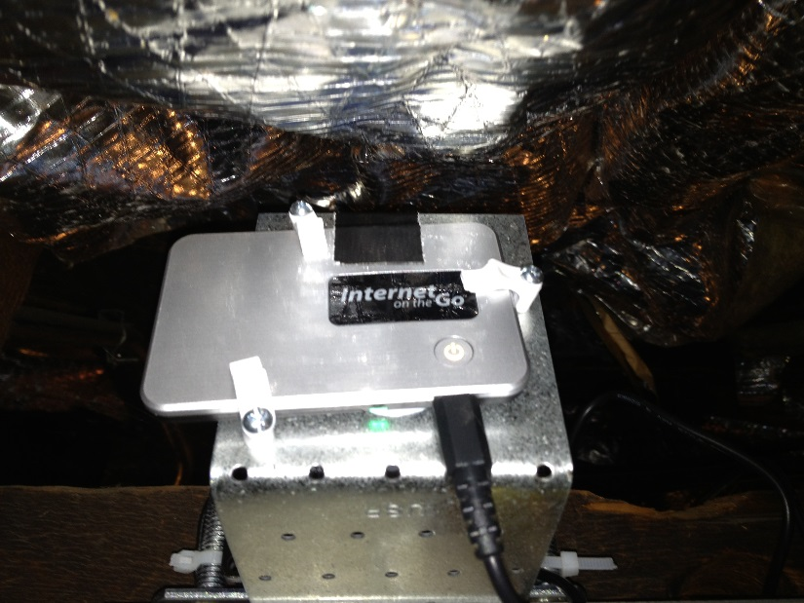
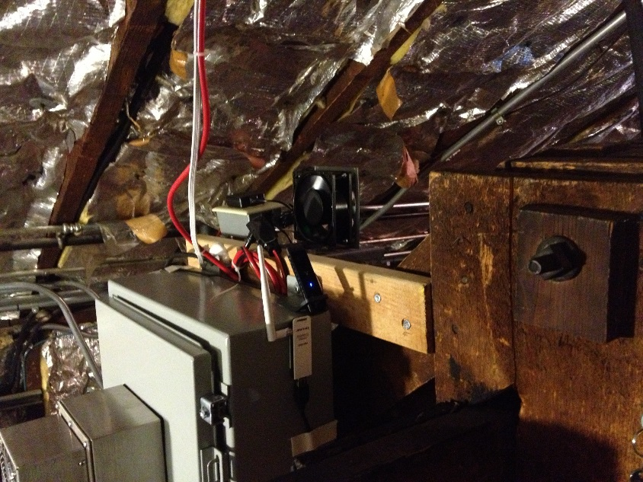
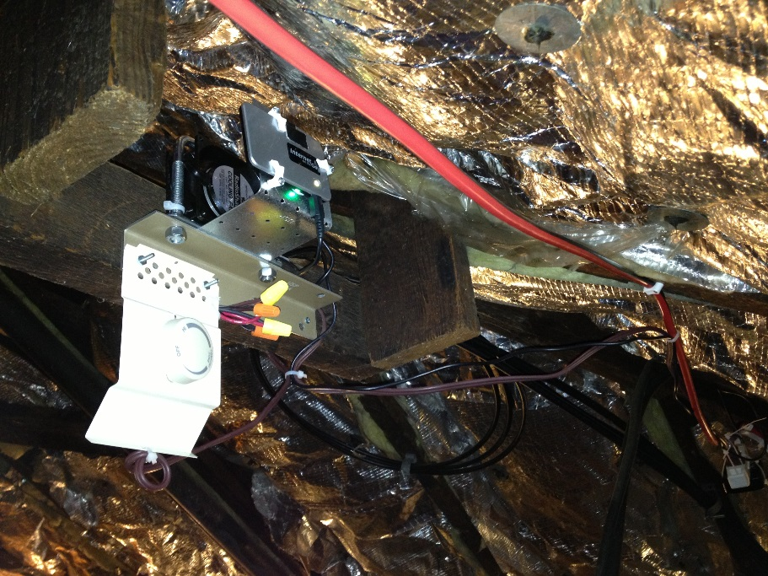
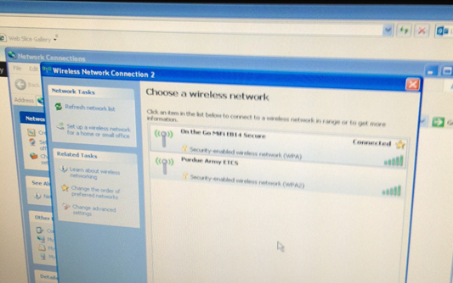
4.12 Redundant WiFi Hotspots and USB LAN Adapter
1st WiFi HotSpot
2nd WiFi HotSpot
Cooling Fan & Thermal Stat
2 WiFi HotSpot ⬄ Computer Side Wireless LAN Adapter

Slide 34
4.13 Corrosion Monitoring Sensor System
Server Scripts/Programs
CMS sensor data polling program
  Every 30 minute, read sensors capacitance/volatge value: S1,… S6
  Add time stamps
  Store sensor data S1, … S6
Sensor node control, data access
Remote access to the CMS through a secured web client
  Cloud storage service: DropBox
  Cloud-based remote access - LogMeIn

Slide 35
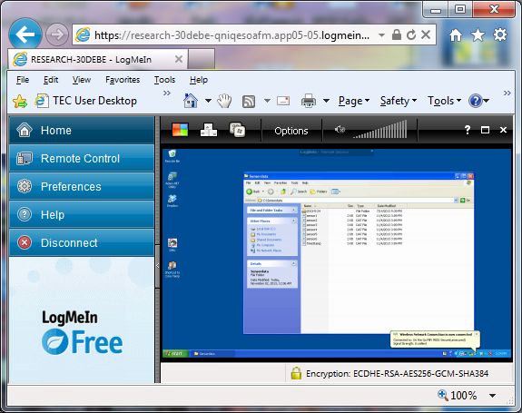
4.14 Sensor Data and Remote Data Collection
Data Collection and Storage
  Data saved (every 30 minutes) at the CMS system located at RIA bridge
Cloud-based Remote Access: LogMeIn
Move data to Cloud-based Data Store: Drop Box

Slide 36
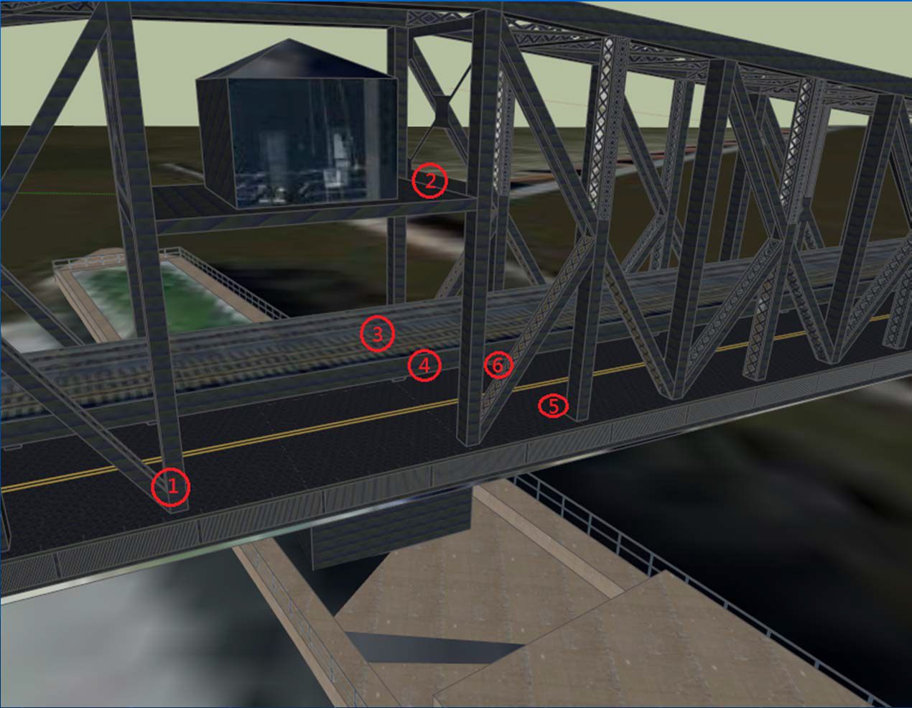
5. The Second Generation CMS System:
Wired & Wireless Sensor Nodes and Networks
Improved Internet and remote CMS system accessibility with at least one dedicated static IP address to provide better remote system access and maintenance support.
Addition of Wireless Sensor Nodes and Networks to enhance the system reliability
Additional local temperature and humidity data collection

Slide 37
5. Second Generation CMS System:
Wired & Wireless Sensor Nodes and Network
Wired Star Network: RS-485, Wireless Mesh Network

Slide 38
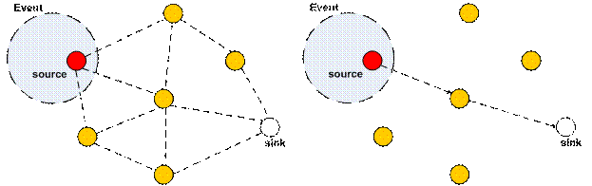
5. Second Generation CMS System:
Wired & Wireless Sensor Nodes and Networks
Wireless Sensor Nodes and Network to enhance the system reliability
  Redundant measurement using an extra wireless sensor node running ZigBee-based (XBee) sensor network protocol
  Mesh sensor network to provide maximum reachability and data routing for each sensor

Slide 39
5. Second Generation CMS System:
Wired & Wireless Sensor Nodes and Networks
Wireless Sensor Nodes and Networks to enhance the system reliability

Slide 40
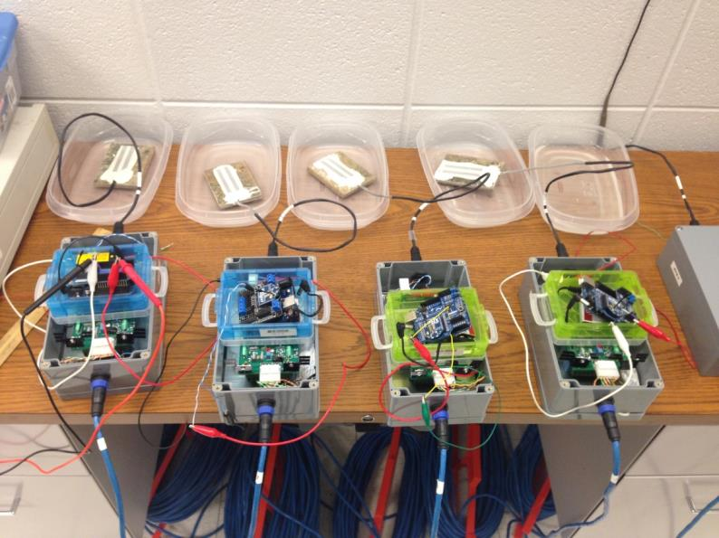
5. Second Generation CMS System:
Wired & Wireless Sensor Nodes and Networks
Experimental Testing of Wireless Sensor Nodes and Networks in M.S. Tech Graduate Research Lab

Slide 41
5. Second Generation CMS System:
Wired & Wireless Sensor Nodes
Experimental Testing of Wireless Sensor Nodes and Network

Slide 42
5. Second Generation CMS System:
Wired & Wireless Sensor Nodes and Networks
Experimental Testing of Wireless Sensor Nodes and Networks (at IPFW)
 | Base Station Node | Sensing & Routing Node 1 | Sensing & Routing Node 2 | Sensing Node
Base Station Node | 0 | 2 | 3 | 4
Sensing & Routing Node 1 | 2 | 0 | 4 | 6
Sensing & Routing Node 2 | 3 | 4 | 0 | 2
Sensing Node | 4 | 6 | 2 | 0

Slide 43
5. Second Generation CMS System:
Wired & Wireless Sensor Nodes and Networks
Experimental Testing of Wireless Sensor Nodes and Networks to enhance the system reliability (4 nodes)

Slide 44
5. Second Generation CMS System:
Wired & Wireless Sensor Nodes and Networks
Experimental Testing of Wireless Sensor Nodes and Networks to enhance the system reliability (4 nodes)

Slide 45
5. Second Generation CMS System:
Wired & Wireless Sensor Nodes and Networks
Experimental Testing of Four Wireless Sensor Nodes and Network

Slide 46
6. Summary and Future Work
The star-based wired sensor network for Army Bridge’s Corrosion Monitoring System deployed at RIA, IL has been running since May 2013
Wires and wireless sensors version of the CMS has been discussed at CERL, IL on April 14, 2014
Redesign new wireless sensor node which integrates the following modules and features (Luis Morale’s Master of Science Directed Project, Spring 2014)
  A new PCB board (surface mount)
  Analog Signal Processing Subsystem – corrosion sensing
  Xbee (Zigbee based transceiver with antenna)
  Temperature, humidity, and barometric pressure sensing
  Adurino Fio versions 2 and 3

Slide 47
Conclusion
Any Questions?
Thank you!!!

