Slide 1
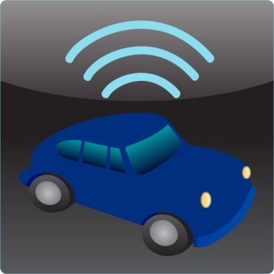

Auto Lynk OBD-II Scanner
Chris Frey
May 3, 2013
ECET - CPET 491 Senior Design Project Phase II
Project Advisor and Instructor: Professor Paul I. Lin

Slide 2
Summary
Goals
Motivation
Introduction
Problem Statement / Solution
Project Research
Overall Project Design
Hardware Interface
Software Design
Testing and Integration
Project Management
Conclusion

Slide 3
Goals
On-Board Diagnostic-II (OBD-II) scanner.
  Android-based
  Connection to an OBD-II Bluetooth adapter
  Monitor various vehicle subsystems.
  Users able to identify problems with their vehicles.

Slide 4
Motivation
Conquer my fear of programming
Interest in smartphones
Interest in automotive systems
Combining these = success?

Slide 5
Introduction
History of On-Board Diagnostics
  1950’s - Problems diagnosed by hand
  1960’s - Vehicles became more complex
    Humans being removed from the loop
  1980’s - Emerging emission standards
    Malfunction Indicator Lamp (MIL) became required
  1987 - California required OBD-I

Slide 6
OBD-II
Vehicles produced after 1996
Monitors various vehicle subsystems (Body, Powertrain, Chassis, Network)
  Values such as:
    Engine Load, Oxygen Sensor Voltage, MPH, RPM
Diagnostic Trouble Code (DTC)
  Stored when MIL illuminates

Slide 7
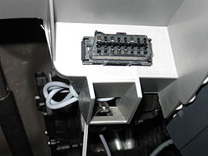
Problem / Solution
How do we read OBD-II data?
Where do we access it?
Answer:
  Adapter
  Application that allows OBD-II data to be read on a smartphone.
  Reset DTCs when vehicle problem has been solved

Slide 8
Project Research
OBD-II Specifications
  Standardized hardware interface
  Presented in C/C++ programming language
  Parameter ID (PID) message is sent to the vehicles Engine Control Unit (ECU)
  Value returned in hexadecimal format

Slide 9
OBD-II Specifications (cont.)
PID | Description | Min Value | Max Value | Units | Formula
04 | Engine Load | 0 | 100 | % | A * 100 / 255
05 | Engine Coolant Temperature | -40 | 215 | °C | A - 40
06 | Fuel Trim Bank 1 Sensor 1 | -100 | 99.22 | % | (A-128) * 100/128
07 | Fuel Trim Bank 1 Sensor 2 | -100 | 99.22 | % | (A-128) * 100/128
0B | Intake Manifold Pressure | 0 | 255 | kPa | A
0C | RPM | 0 | 16,383.75 | Rpm | (A*256) / 4
0D | Speed | 0 | 255 | Km/h | A
0E | Timing Advance | -64 | 63.5 | ° | A/2 - 64
0F | Intake Air Temperature | -40 | 215 | °F/°C | A – 40
11 | Throttle Position | 0 | 100 | % | A*100/255
14 | Oxygen Sensor Bank 1 Sensor 1 | 0 | 1.275 | Volts | A/200
15 | Oxygen Sensor Bank 1 Sensor 2 | 0 | 1.275 | Volts | A/200
AT RV | Voltage | 0 | 15 | Volts | A

Slide 10
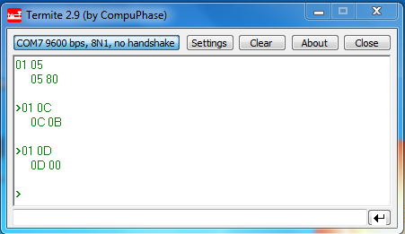
Initial Testing (Termite)
Coolant Temp: 80 (hex) = 128(decimal)
Engine RPM: 0B (hex) = 11 (decimal)
Vehicle Speed: 00 (hex) = 00 (decimal)

Slide 11
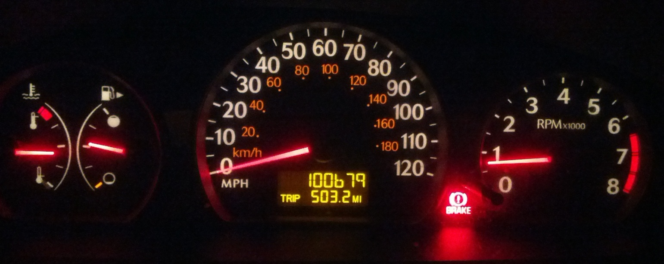
Initial Testing (cont.)
Engine Coolant Temp
A – 40 = (128 - 40) = 88°C = 190°F
Vehicle Speed
A = 0 km/h = 0 MPH
Engine RPM
(A * 256) / 4 = ((11) * 256) / 4 = 704 RPM

Slide 12
Overall Project Design

Slide 13
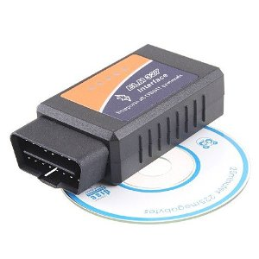
Hardware Interface
Soliport ELM 327 OBDII Bluetooth Adapter
  Allows communication between OBD-II port and smartphone via Bluetooth
  Bluetooth Serial Port Profile
    Emulates RS-232
  Sends and receives ASCII values
  Services one command at a
  time

Slide 14
Auto Lynk Design
Simple and easy to use
  List format
  Everything on one screen
Meets Requirements
  Reads OBD-II data
  Bluetooth Connectivity

Slide 15
Auto Lynk Design

Slide 16
Auto Lynk Algorithm
Establish constant data flow between ECU and Android device
Uses Java Switch statement

Slide 17
Auto Lynk – The Code
Eclipse IDE
Android Software Development Kit (SDK)
Android Virtual Device (AVD)

Slide 18
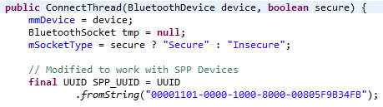
BluetoothChat Example
Enables Bluetooth
Scans for nearby Bluetooth devices
Connects to a Bluetooth device
  Creates socket to communicate between 2 devices
Modified Universally Unique Identifier (UUID)

Slide 19
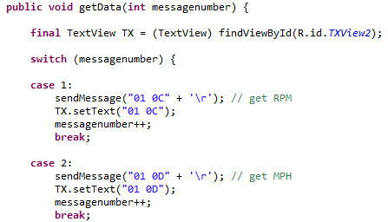
Sending Requests to the ECU
Start Transmission with “01 00” message
getData() method

Slide 20
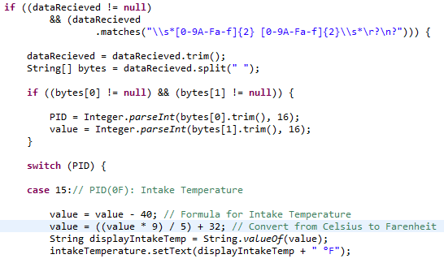
Parsing the Incoming Data
Regular Expressions
Switch Statement

Slide 21
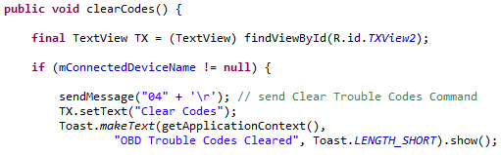
Resetting Trouble Codes
Easiest to implement
clearCodes() method

Slide 22
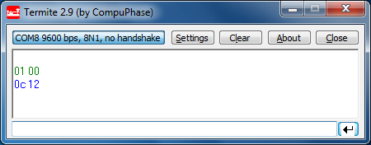
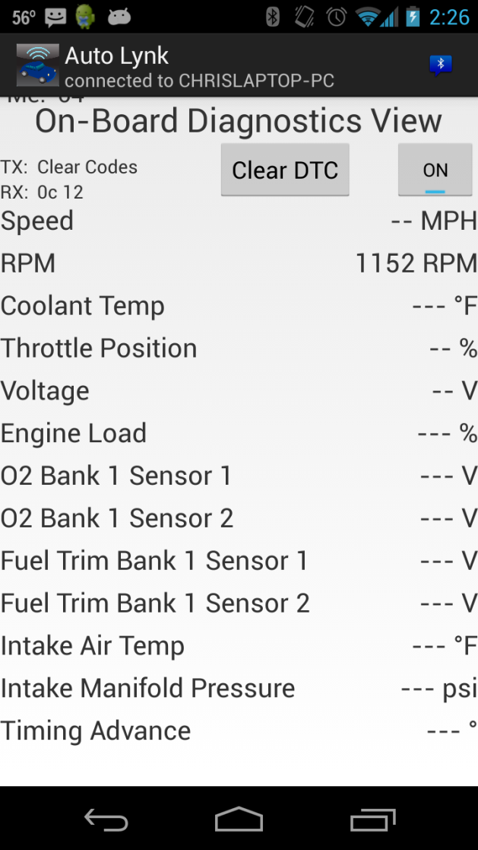
Testing and Integration
12(hex) = 18 (decimal)
(A * 256)/4 = ((18) * 256) / 4 = 1152

Slide 23
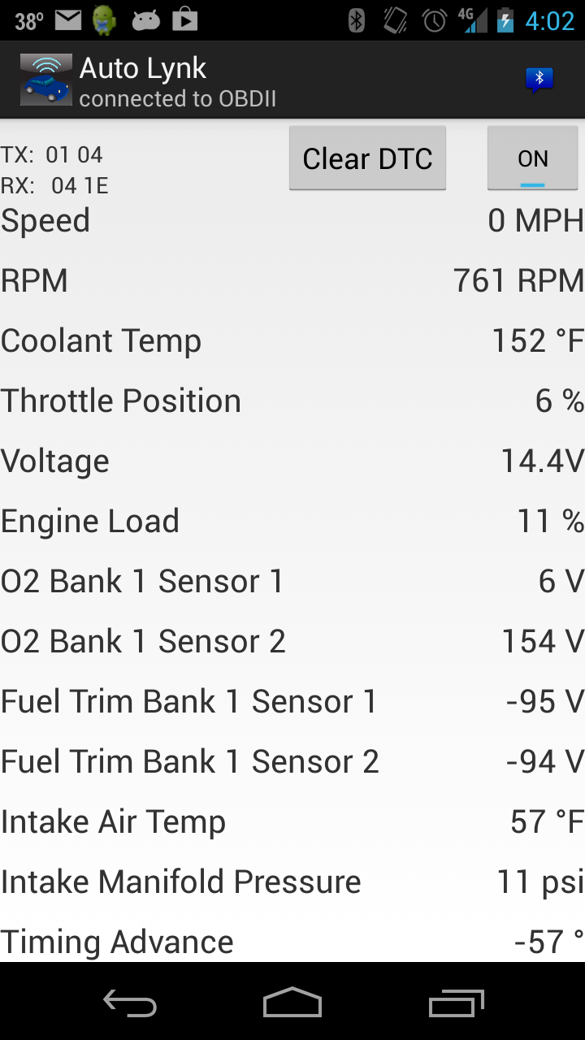
Testing and Integration (cont.)

Slide 24
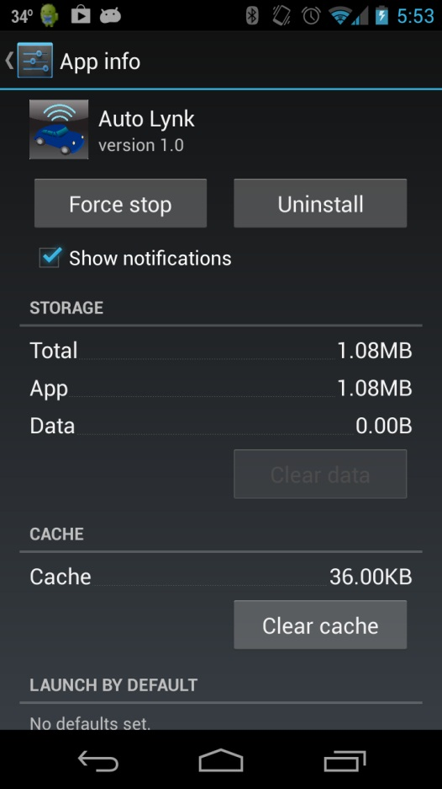
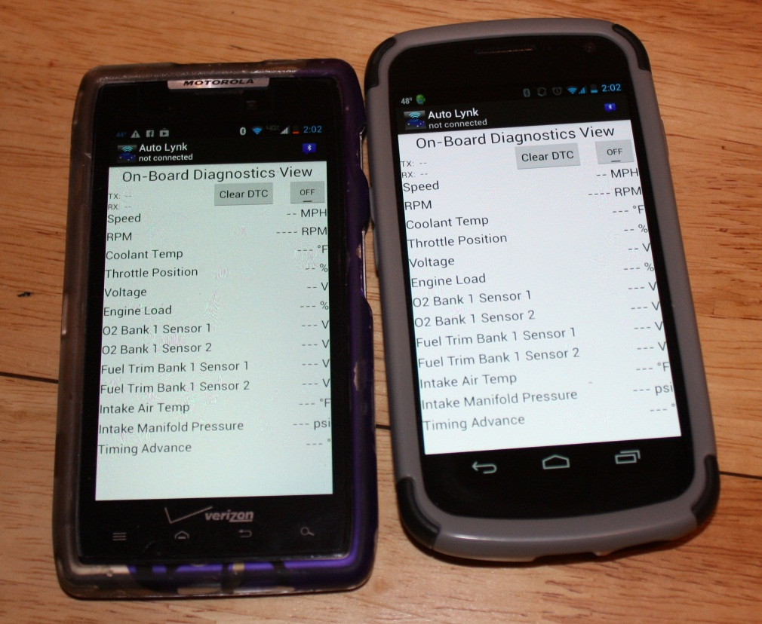
Validation of Requirements
Most requirements validated in demo

Slide 25
Validation of Requirements (cont.)
Diagnostic Trouble Code Reader
  Deadline approaching
  Code more difficult than expected
    Sheer number of codes
Will be implemented in future

Slide 26
Bill of Materials
Description | Supplier | Price
Soliport ELM 327 OBD-II Bluetooth Adapter | www.amazon.com | $22.43
RocketFish Micro Bluetooth Adapter | Best Buy | $20.00
Window 7 PC | Myself | $0.00
Java SE Development Kit (JDK) 6 | www.oracle.com | $0.00
Android Software Development Kit (SDK) Includes: Eclipse ADT plugin Android SDK tools Android Platform-tools | developer.android.com/sdk/index.html | $0.00
Samsung Galaxy Nexus smartphone w/ Android 4.2.2 | Myself | $0.00
 | Total | $42.43

Slide 27
Work Breakdown
Tasks | Estimated Hours of Completion | Actual Hours
System Design | 30 | 40
Assembly Phase | 58 | 77
System Testing | 35 | 35
Final Report Development | 15 | 32
Presentation Development | 10 | 7
Total | 150 | 191

Slide 28
Schedule
System Design Completed – February 18, 2013
  Research
Assembly Phase Completed – April 3, 2013
  Write Auto Lynk
System Integration Completed – April 25, 2013
  Testing
Final Report Complete – May 2, 2013
Presentation Complete – May 3, 2013

Slide 29
Lessons Learned
Time Constraints are crucial
Attention to detail
Organizational skills
OBD-II
Programming fear conquered!!

Slide 30
Conclusion
Provided research for OBD-II and Android
Auto Lynk OBD-II Scanning system was successful, although not complete
More features to be added in future
  DTC reader
  Others

Slide 31
Questions??

Slide 32
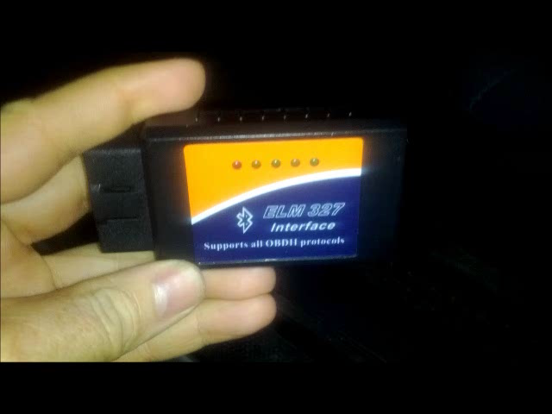
Demo

